Slide 1
Part 1 Signals
0368.3464
עיבוד ספרתי של אותות
Digital Signal Processing for Computer Science
AKA
Digital Signal Processing – Algorithms and Applications
WARNING: This is a very different course from DSP for Engineering students

Slide 2
The course
Always check the Moodle
We’ll start at 17:10
One break 18:30-1845, finish at 19:45

Slide 3
Requirements
Lecture attendance is mandatory
attendance checked from the third lecture on
active participation is better
if you can’t make it now and again – there will be recordings
2/3 participation is required to take the final exam
No homework assignments
Problems? use the Moodle forum

Slide 4
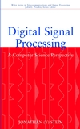
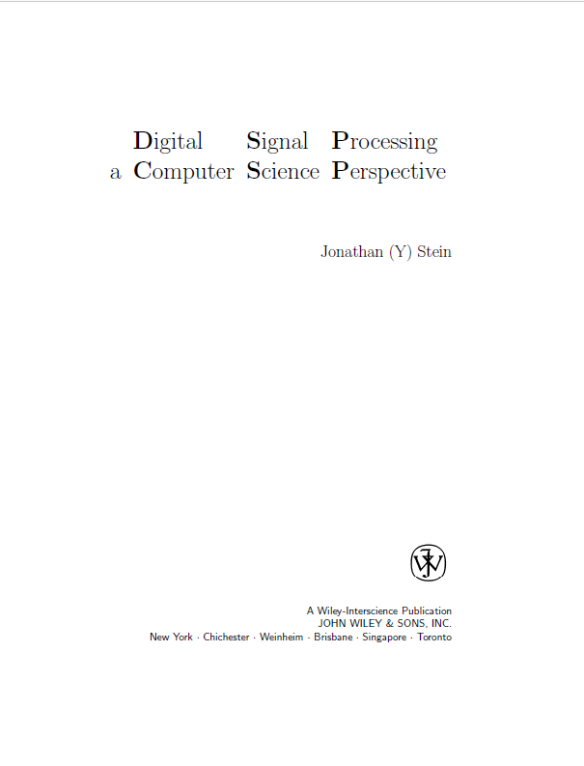
The course text
Digital
Signal
Processing
a
Computer
Science
Perspective
עיבוד ספרתי של אותות - ממבט מדעי מחשב
WWW.DSPCSP.COM

Slide 5
Why did I write this book?
The book started in a course I gave back in 1996
Until DSPCSP only engineering students learned DSP
and DSP is mostly programming!
Engineering students understood DSP
but not algorithms and not how to program
(one well-known DSP book by an Israeli author
apologizes for introducing the FFT algorithm!)
Computer Science students knew algorithms and programming
but the existing books were incomprehensible to them
(and its not just the strange usage of j = √-1
it is the whole mindset)
This book and course bridges the gap!
and there are now many more books like it (but not as good ☺)

Slide 6
A few more things
The course will focus on understanding the main concepts
not mathematical formulas or formal proofs of theorems
Hopefully, you will come away with an understanding
of how many many things work nowadays
and will remember these for many years
If there are applications that interest you
e.g., radar, predicting stock market trends, musical effects, …
we can talk about some of them in the course

Slide 7
Course Outline
Signals (analog and digital)
Spectrum (frequency domain)
Sampling
Transforms
Systems
Filters
Convolution
MA, AR, ARMA filters
System identification
Graph theory
FFT
DSP processors
Correlation and Adaptation
Speech signal processing
Data communications
…
PART 1
SIGNALS
PART 2
SYSTEMS
PART 3
ALGORITHMS
PART 4
APPLICATIONS

Slide 8
Questions?
Any questions about logistics?
(Please don’t ask about the final exam yet …)
???

Slide 9

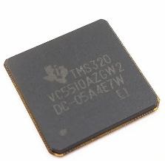
Motivation
What is DSP good for?
You are using
Digital Signal Processing
right now
and are probably carrying a few
Digital Signal Processors
with you right now!

Slide 10
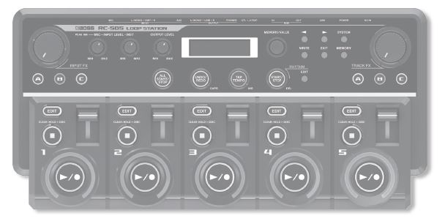
What is this?
BOSS RC-505 Loop Station
Let’s see it in (in)action
Let’s see someone who really knows about DSP
Some music effects are easy to understand

Slide 11
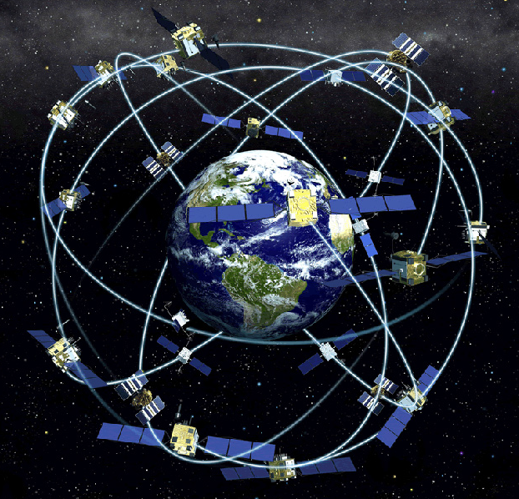
How does GPS work?
GPS and the quest for Pizza
But what signals do the satellites transmit?
and how does the GPS receiver know
WHEN a signal was received?

Slide 12



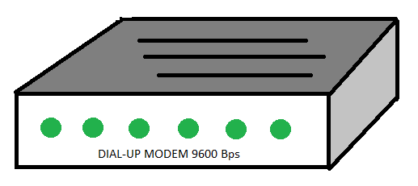
Telephony
How many of you have seen one of these?
How many of you still have one of these?
How many of you have used one of these?
One of these?

Slide 13
Wonderful tones!
dial and busy
dial and ring
different DTMF tones
T.30 fax
V.34 modem
different answer tones
musical instruments

Slide 14
5G
We have all heard that 5G is the NEXT THING
It is so much better than 4G …
How does it do it?

Slide 15






The 5G refrigerator

Slide 16
Speech
Speech synthesis – text to speech (demo)
Speech recognition – speech to text (demo)
Speaker recognition
Speaker verification
Speech compression
Dynamic Time Warping
Language recognition
Speech polygraph

Slide 17

Deep fakes
I’m sure you have all heard this

Slide 18
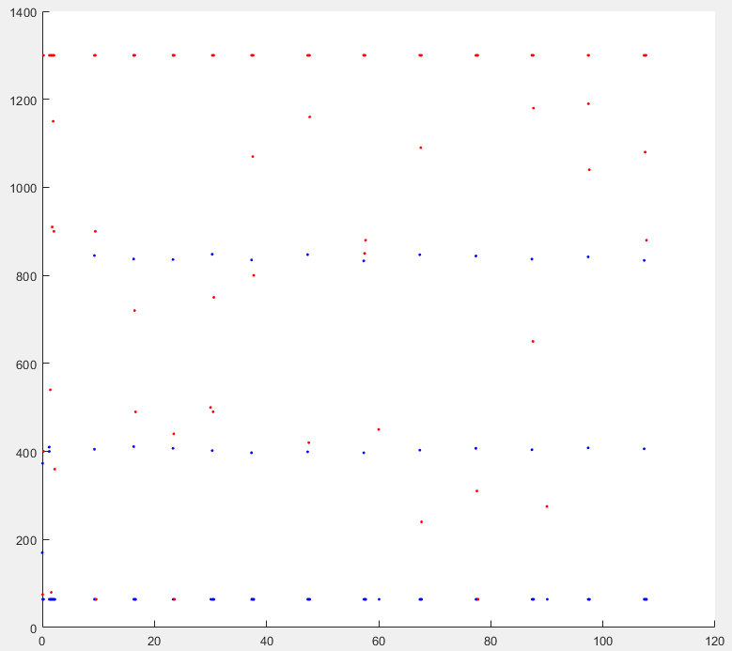
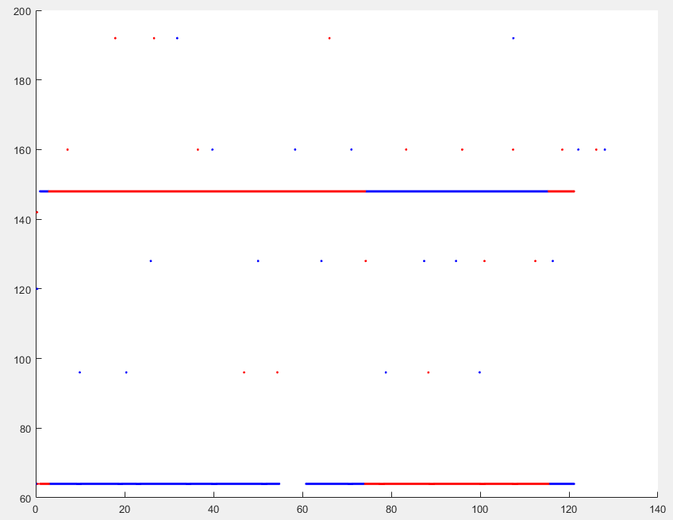
Classifying Encrypted Traffic
We all want our Internet traffic to be private
but we also want good Quality of Experience
How can an Internet Service Provider do this?

Slide 19
Let’s start - What is DSP?
Digital Signal Processing
Digital (Signal Processing)
עיבוד ספרתי של אותות
(Digital Signal) Processing
עיבוד של אותות ספרתיים

Slide 20
What is a signal?
There is no such thing as a signal !
But there is an analog signal and a digital signal
An analog signal s(t) is
a real function of a single variable called time (t)
But not just any function – in a moment we will see conditions
A digital signal s_{n} is
a real sequence with a single index called (discrete) time (n)
But not just any sequence – in a moment we will see conditions
And there is a connection between analog and digital signals !

Slide 21
What isn’t a signal? (Part 1)
Complex functions z(t) or sequences z_{n}
(they aren’t real!)
Images I(x,y)
(it is two dimensional – not a scalar function/sequence)
Videos v(x,y,t)
(it is three dimensional)
Waves w(x,t)
(they are functions of space and time, not just of time)
Information (I hope you know what that means …)
(but signals can carry information)

Slide 22
DSP
Digital Signal Processing vs. Analog Signal Processing
Why DSP ? use (digital) computer instead of (analog) electronics
more flexible
new functionality requires code changes, not component changes
more accurate
even simple amplification can not be done exactly in electronics
more stable
code performs consistently
more sophisticated
can perform more complex algorithms (e.g., SW receiver)
However
digital computers only process sequences of numbers
not analog signals
requires converting analog signals to digital domain for processing
and digital signals back to analog domain

Slide 23

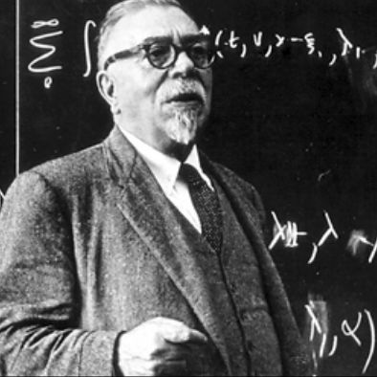

Is it worthwhile?
x(t)
y(t)
???
Norbert Wiener
x(t)
filter
A/D
D/A
filter
y(t)
Yes, because of
feasibility (there are operations that are impossible in analog)
flexibility (it is very difficult to upgrade analog hardware)
accuracy (even simple gain is not completely accurate in analog)

Slide 24
Signals
Analog signal
s(t)
continuous time
- ∞ < t < +∞
Digital signal
s_{n}
discrete time
n = - ∞ … +∞
(unlike sequences in math)
Physicality requirements
s values are real
s values defined for all times
Finite energy
Finite bandwidth
Mathematical usage
s may be complex
s may be singular
Infinite energy allowed
Infinite bandwidth allowed
Energy = how "big" the signal is
Bandwidth = how "fast" the signal is
(we’ll see the exact definitions later)

Slide 25
Show me the money!
Why are finite energy and bandwidth physicality requirements?
Energy of a signal is related to energy in physics
energy is conserved, so we are willing to pay for it!
(electric bill, gas for car, food)
A signal with infinite energy
would cost infinite money to generate!
Bandwidth of a signal
is related to how much information the signal carries
information always decreases (entropy always increases) so we are willing to pay for it!
(Internet, cellular, books, newspapers)
A signal with infinite bandwidth
would cost infinite money to generate!

Slide 26
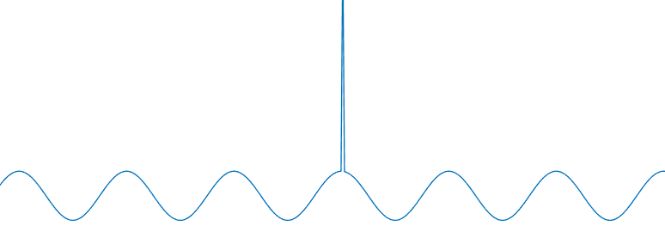
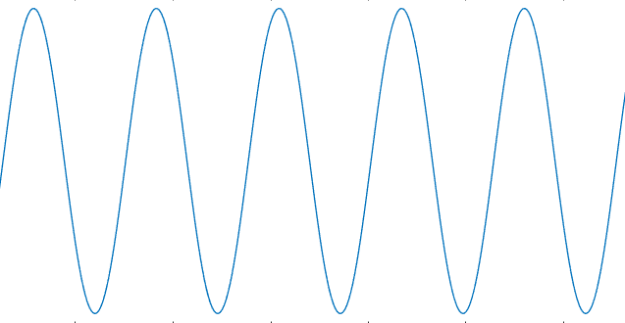
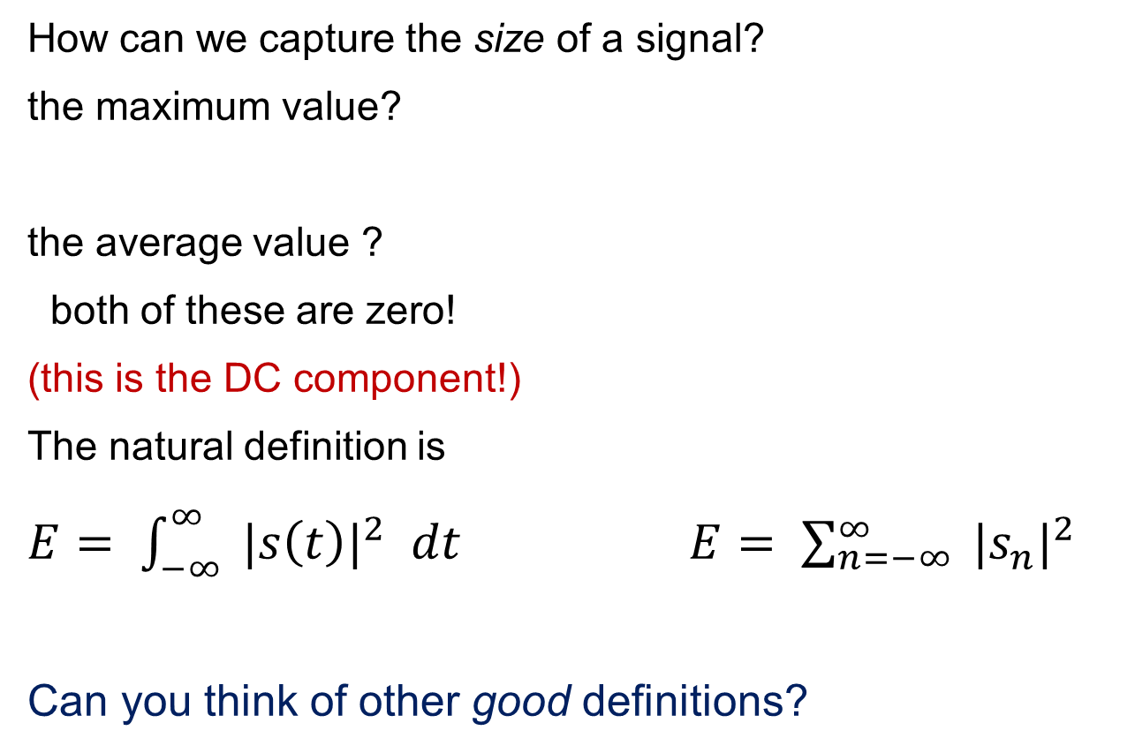
Energy
How can we capture the size of a signal?
the maximum value?
the average value ?
both of these are zero!
(this is the DC component!)
The natural definition is
$E= \int_{−∞}^{∞}{{ |s\left(t\right)|}^{2} dt}$ $E= \sum_{n=−∞}^{∞}{{ |s_{n}|}^{2}}$
Can you think of other good definitions?

Slide 27
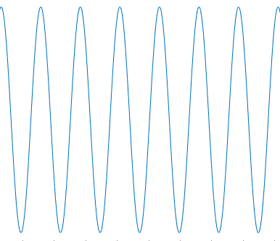
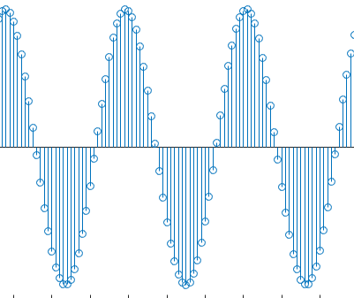

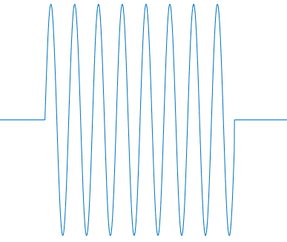
Handling infinite energy
Sinusoids
are among the most important signals we will use
But are infinite in extent and thus have infinite energy
So we fix them (limit them to a finite time duration)
by multiplying them by a gating signal
1

Slide 28
illegal signals
DSP is not just mathematics
it is a technology for interaction with the real world
The conditions guarantee that signals are real objects
of the kind we find in the real world
However, requiring every object to conform to the restrictions
would make the mathematics very hard
So we will often use objects which do not obey the conditions
complex functions/sequences
objects with infinite energy
and even call them signals!
But this is just to simplify the math
the answers will be the same!

Slide 29
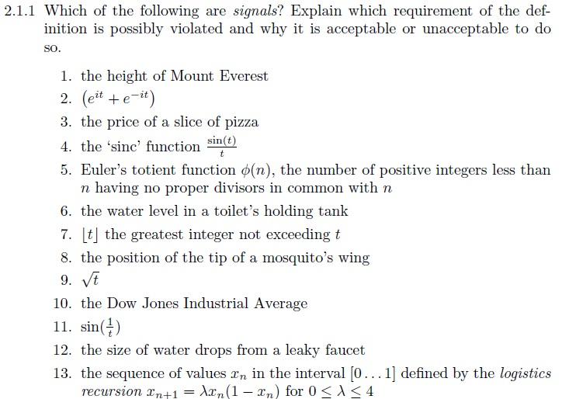
What isn’t a signal? Part 2
After trying look here - http://www.dspcsp.com/exercises/X2-1-1.pdf

Slide 30
Some digital signals
Zero signal
s_{n} = 0
Constant signal
( ∞ energy!) s_{n} = k
Unit Impulse (UI)
s_{n} = δ_{n,0}
Shifted Unit Impulse (SUI)
s_{n} = δ_{n,m}
Step ( ∞ energy!)
s_{n} = θ_{n}
n=0
dot plot
n=0
1
n=0
1
n=1
1
n=0

Slide 31
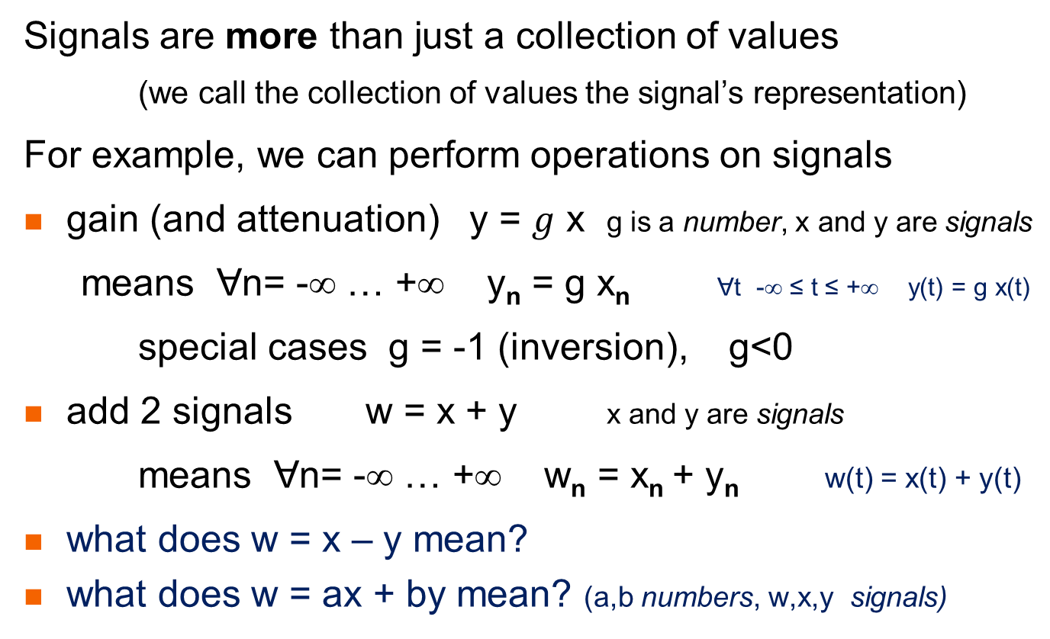
Signals as objects
Signals are more than just a collection of values
(we call the collection of values the signal’s representation)
For example, we can perform operations on signals
gain (and attenuation) y = $g$ x g is a number, x and y are signals
means Ɐn= -∞ … +∞ y_{n} = g x_{n} Ɐt -∞ ≤ t ≤ +∞ y(t) = g x(t)
special cases g = -1 (inversion), g<0
add 2 signals w = x + y x and y are signals
means Ɐn= -∞ … +∞ w_{n} = x_{n} + y_{n} w(t) = x(t) + y(t)
what does w = x – y mean?
what does w = ax + by mean? (a,b numbers, w,x,y signals)

Slide 32
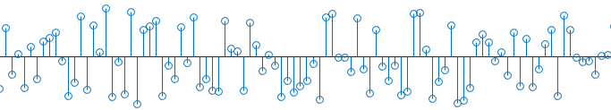
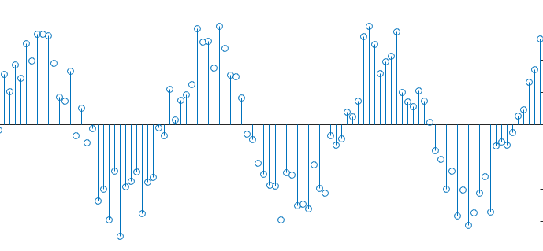
Deterministic vs stochastic signals
Signals (analog or digital) can be deterministic or stochastic
deterministic means that there is some algorithm
that enables us to predict the signal for all time
Stochastic means nondeterministic
the signal is random in some sense
The most stochastic signal of them all is white noise
even if we observe white noise w_{n} from -∞ to n
we can’t say anything about w_{n+1}
example of non-white stochastic signal
stem plot

Slide 33
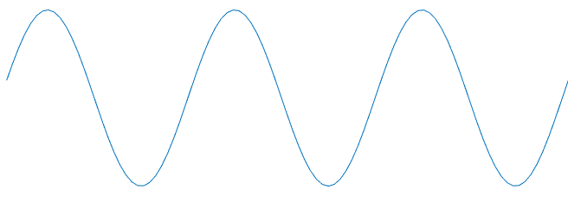
Periodic signals
Signals (analog or digital) can be periodic
Analog periodic signal p(t)
ⱻ T > 0 s.t. Ɐt -∞ ≤ t ≤ +∞ p(t+T) = p(t)
the smallest such T is called the period
Digital periodic signal p_{n}
ⱻ N > 0 s.t. Ɐn= -∞ … +∞ p_{n+N} = p_{n}
the smallest such N is called the period
Is the digital sinusoid s_{n} = A sin (ωn) always periodic? If not, when is it?
Only deterministic signals can be periodic
why can’t a periodic signal be stochastic?
T
t+T

Slide 34
Some periodic digital “signals”
1
Square wave
Triangle wave
Saw tooth
Sinusoid
(not always periodic!)
Pulse train
n=0
-1
1
n=0

Slide 35
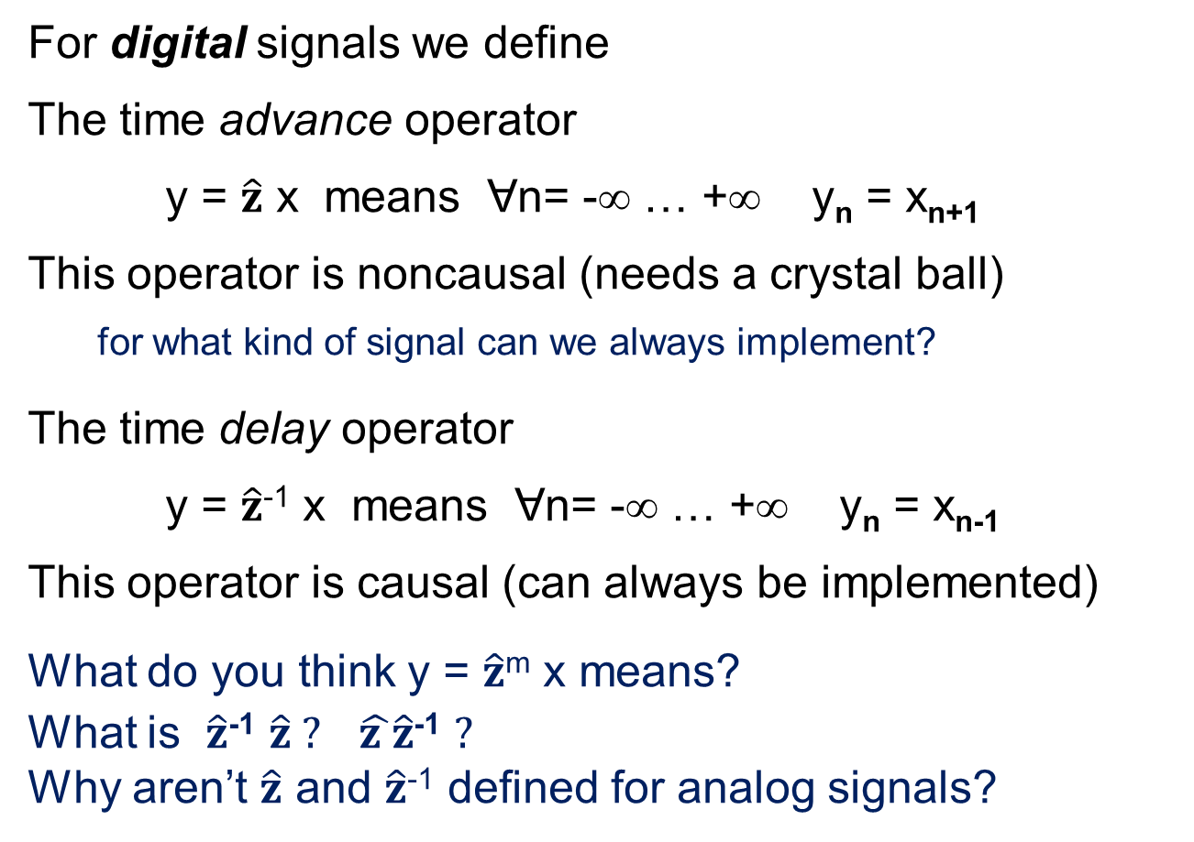

The $\hat{z}$ operator
For digital signals we define
The time advance operator
y = $\hat{z}$ x means Ɐn= -∞ … +∞ y_{n} = x_{n+1}
This operator is noncausal (needs a crystal ball)
for what kind of signal can we always implement?
The time delay operator
y = $\hat{z}$⁻¹ x means Ɐn= -∞ … +∞ y_{n} = x_{n-1}
This operator is causal (can always be implemented)
What do you think y = $\hat{z}$^{m} x means?
What is $\hat{z}$⁻¹ $\hat{z} ?$ $\hat{z }\hat{z}$⁻¹ $?$
Why aren’t $\hat{z}$ and $\hat{z}$⁻¹ defined for analog signals?
hat means operator – not gain!
we’ll see later why it is called “z”

Slide 36
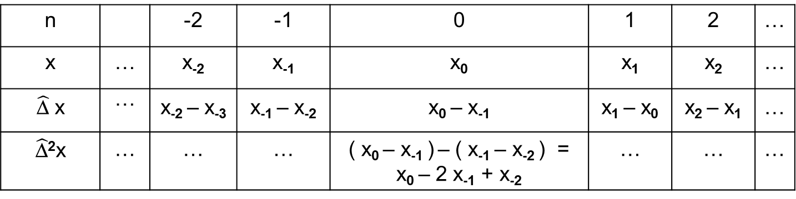

Some more operations
first finite difference y = $\hat{\text{D}}$ x means y_{n} = x_{n} - x_{n-1}
note: $\hat{\text{D}}$ = 1 - $\hat{z}$⁻¹
and there are higher order finite differences y = $\hat{\text{D}}$^{m} x
If the signal is a polynomial in time n what can we say about $\hat{\text{D}}$^{m} x ?
n |  | -2 | -1 | 0 | 1 | 2 | …
x | … | x₋₂ | x₋₁ | x₀ | x₁ | x₂ | …
$\hat{\text{D}}$ x | … | x₋₂ – x₋₃ | x₋₁ – x₋₂ | x₀ – x₋₁ | x₁ – x₀ | x₂ – x₁ | …
$\hat{\text{D}}$²x | … | … | … | ( x₀ – x₋₁ ) – ( x₋₁ – x₋₂ ) = x₀ – 2 x₋₁ + x₋₂ | … | … | …

Slide 37
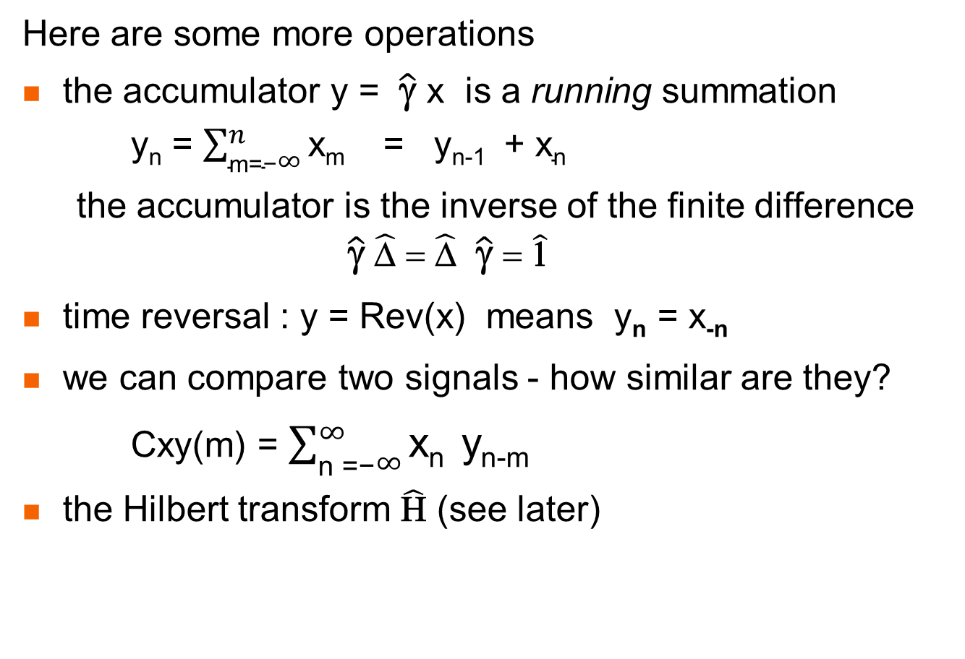
Some more operations
Here are some more operations
the accumulator y = $\hat{\text{γ}}$ x is a running summation
y_{n} = $\sum_{\text{m}\text{=−}∞}^{n}{\text{x}\text{m} }$ = y_{n-1} + $\text{x}\text{n}$
the accumulator is the inverse of the finite difference $\hat{\text{γ}}$ $\hat{\text{D}}$ = $\hat{\text{D}}$ $\hat{\text{γ}}$ = $\hat{\text{1}}$
time reversal : y = Rev(x) means y_{n} = x_{-n}
we can compare two signals - how similar are they?
Cxy(m) = $\sum_{\text{n}\text{ =−}∞}^{∞}{\text{x}\text{n} \text{y}\text{n}\text{−}\text{m} }$
the Hilbert transform $\hat{\text{H}}$ (see later)

Slide 38
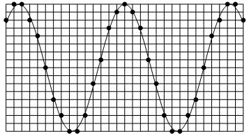
Sampling
From an analog signal we can create a digital signal
by SAMPLING
Under certain conditions
we can uniquely return to the analog signal !
Even though the digital signal has only א₀ values
and the analog has א₁
This sounds impossible!
How can we know what happens between 2 samples?

Slide 39
Digital signals and vectors
Digital signals are in many ways like vectors
… s₋₅ s₋₄ s₋₃ s₋₂ s₋₁ s₀ s₁ s₂ s₃ s₄ s₅ … ↔ (x, y, z)
In fact
the zero vector 0 (0_{n} = 0 for all times n)
every two signals can be added to form a new signal x + y = z
every signal can be multiplied by a real number (amplified!)
every signal has an inverse signal -s so that s + -s = 0 (zero signal)
every signal has a length - its energy
So, they form a linear vector space (with norm)
Similarly, analog signals, periodic signals with given period, etc.
all form linear vector spaces

Slide 40
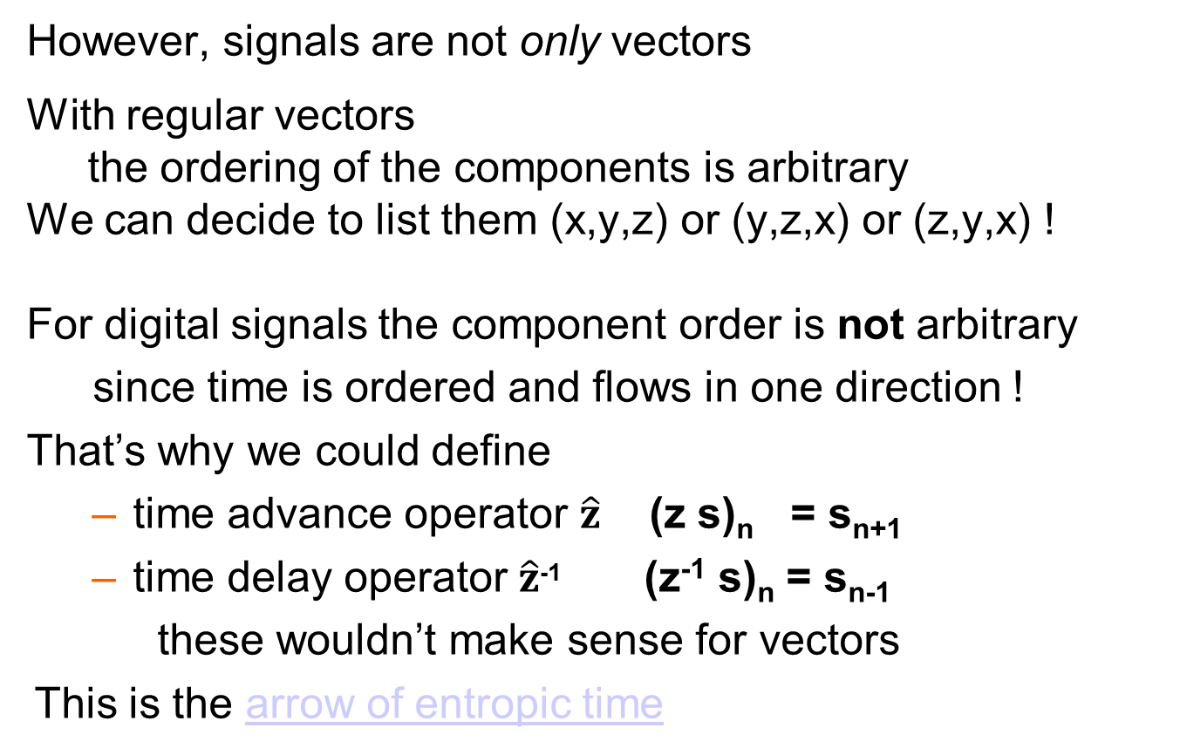
Time
However, signals are not only vectors
With regular vectors
the ordering of the components is arbitrary
We can decide to list them (x,y,z) or (y,z,x) or (z,y,x) !
For digital signals the component order is not arbitrary
since time is ordered and flows in one direction !
That’s why we could define
time advance operator $\hat{z}$ (z s)_{n} = s_{n+1}
time delay operator $\hat{z}$⁻¹ (z⁻¹ s)_{n} = s_{n-1}
these wouldn’t make sense for vectors
This is the arrow of entropic time

Slide 41
Bases
the fundamental theorem in linear algebra
All linear vector spaces have a basis (usually > 1 !)
A basis is a set of vectors b₁ b₂ … b_{d} that obeys 2 conditions :
1. spans the vector space
i.e., for every vector x : x = a₁ b₁ + a₂ b₂ + … + a_{d} b_{d}
where a₁ … a_{d} are a set of coefficients
2A the basis vectors b₁ b₂ … b_{d} are linearly independent
i.e., if a₁ b₁ + a₂ b₂ + … + a_{d} b_{d} = 0 (the zero vector)
then a₁ = a₂ = … = a_{d} = 0
OR
2B The expansion x = a₁ b₁ + a₂ b₂ + … + a_{d} b_{d} is unique
(we’ll prove that these 2 statements are equivalent)
Since the expansion is unique
the coefficients a₁ … a_{d} represent the vector in that basis

Slide 42
Equivalence
1. A → B
Given: the basis is linearly independent
a₁ b₁ + a₂ b₂ + … + a_{d} b_{d} = 0 → a₁ = a₂ = … = a_{d} = 0
Assume that the representation is not unique
x = a₁ b₁ + a₂ b₂ + … + a_{d} b_{d} = c₁ b₁ + c₂ b₂ + … + c_{d} b_{d}
By the definition of zero and that of subtraction of 2 vectors
0 = x-x = (a₁ - c₁) b₁ + (a₂ - c₂) b₂ + … + (a_{d} - c_{d}) b_{d}
From the assumption a₁=c₁ a₂=c₂ … a_{d}=c_{d}
2. B → A
Given: the representation is unique
x = a₁ b₁ + a₂ b₂ + … + a_{d} b_{d}
Assume that the basis is linearly dependent
a₁ b₁ + a₂ b₂ + … + a_{d} b_{d} = 0 and a₁ ≠ 0 and/or … a_{d} ≠ 0
Then the representation of the vector 0 is not unique!

Slide 43
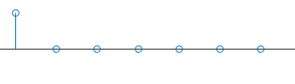
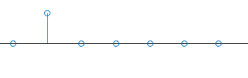
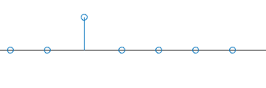
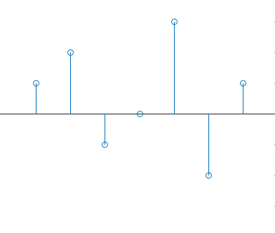
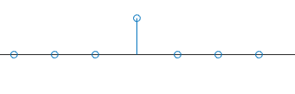
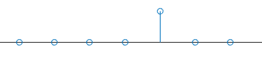
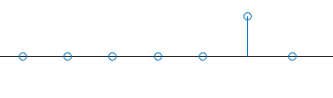

The SUI basis
(the natural basis)
Pick an arbitrary signal
… 1 2 -1 0 3 -2 1 …
1 *
+ 2 *
─ 1 *
3
2
+ 0 *
1
0
1
-1
+ 3 *
-2
─ 2 *
+ 1 *
3
2
=
1
1
0
-1
-2
What is the natural basis for the analog signals?

Slide 44
Dimension
The number of elements in the base
is called the dimension
2-space 3-space
The dimension of the vector space
of all digital signals is denumerably infinite
of all analog signals is nondenumerably infinite
y
y
x
x
z

Slide 45
Another basis
Vector fields can have more than one basis
For signals there is another important basis!
Let’s try to guess what it could be …
Fourier Demo

Slide 46
Fourier Series
In the demo we saw that many periodic analog signals
can be written as the sum of Harmonically Related Sinusoids (HRSs)
If the period is T, the frequency is f = 1/T, the angular frequency is ω = 2 π f = 2 π / T
s(t) = a₁ sin(ωt) + a₂ sin(2ωt) + a₃ sin(3ωt) + …
But this can’t be true for all periodic analog signals !
sum of sines is an odd function s(-t) = -s(t)
in particular, s(0) must equal 0
Similarly, it can’t be true that all periodic analog signals obey
s(t) = b₀ + b₁ cos(ωt) + b₂ cos(2ωt) + b₃ cos(3ωt) + …
Since this would give only even functions s(-t) = s(t)
We know that any (periodic) function can be written as the sum of
an even (periodic) function and an odd (periodic) function
s(t) = e(t) + o(t) where e(t) = ( s(t) + s(-t) ) / 2 and o(t) = ( s(t) - s(-t) ) / 2
So Fourier claimed that all periodic analog signals can be written :
s(t) = a₁ sin(ωt) + a₂ sin(2ωt) + a₃ sin(3ωt) + …
+ b₀ + b₁ cos(ωt) + b₂ cos(2ωt) + b₃ cos(3ωt) + …
What does this say about the dimension
of the subspace of periodic signals?

Slide 47
Fourier rejected
If Fourier is right, then-
the sinusoids are a basis for vector subspace of periodic analog signals
Lagrange said that this can’t be true –
not all periodic analog signals can be written as sums of sinusoids !
His reason –
the sum of continuous functions is continuous
the sum of smooth (continuous derivative) functions is smooth
His error –
the sum of a finite number of continuous functions is continuous
the sum of a finite number of smooth functions is smooth
Dirichlet came up with exact conditions for Fourier to be right :
finite number of discontinuities in the period
finite number of extrema in the period
bounded
absolutely integratable

Slide 48
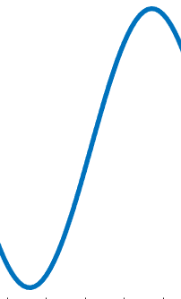
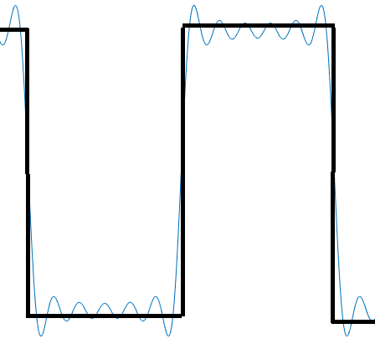
Why not polynomials?
The Taylor theorem tells us that functions (analog signals)
can be expanded in 1, t, t², t³, …
So these are a basis of the space of analog signals
and there is an orthonormal version – the Legendre polynomials
and for discrete time the Szego polynomials
Why aren’t these a useful basis for DSP ?
The Taylor expansion focuses on the area around a specific time t₀
The more basis functions we use
the larger the interval in which we know s(t)
In DSP we are interested in signals at all times
there is no special time t₀
The Fourier expansion operates at all times simultaneously
The more basis functions we use
the better the approximation everywhere

Slide 49

Spectra
Newton used a prism and separates white light into colors
Does the prism paint the light
or were the colors there to begin with?
One can recreate the white light
but only if no color is blocked
white
White light
has all the colors!
spectrum = ghost
white
white

Slide 50
Time and frequency domains
Vector spaces of signals have two important bases (SUIs and sinusoids)
And the representations (coefficients) of signals in these two bases
give us two domains
Time domain (axis)
s(t) s_{n}
Basis - Shifted Unit Impulses
Frequency domain (axis)
S(ω) S_{k}
Basis - sinusoids
We use the same letter capitalized to stress that these are the same signal, just different representations
To go between the representations :
analog signals - Fourier Transform FT/iFT
digital signals - Discrete Fourier Transform DFT/iDFT
There is a fast algorithm for the DFT/iDFT called the FFT

Slide 51
Signals - recap
So, we now have to backtrack
The definitions of a signal as a function or sequence of time
are actually merely the representations of the signal
in the time domain
The signal also has a frequency domain representation
The signal is more than just its representation!
DSP is the art of working in both domains
some processing is easier in the time domain
some processing is easier in the frequency domain
and we will have to go back and forth using the Fourier Transform

Slide 52
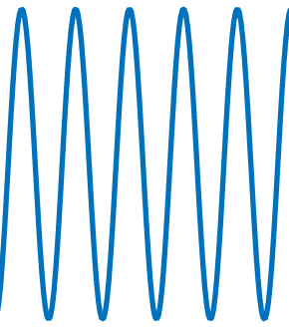
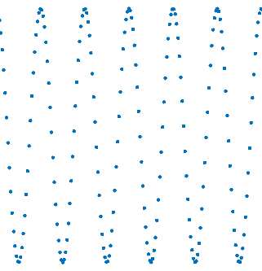
Simplest case – a sinusoid
We can now see the two representations using regular frequency
For an analog sinusoid s(t) = A sin(2π f₀ t)
time domain frequency domain
For a digital sinusoid s_{n} = A sin(2π k₀ n)
time domain frequency domain
s(t)
S(f)
t
f₀
f
s_{n}
S_{k}
n
k
k₀

Slide 53
Simplest case – a sinusoid
We can now see the two representations using angular frequency
For an analog sinusoid s(t) = A sin(ω₀ t)
time domain frequency domain
For a digital sinusoid s_{n} = A sin(ω₀ n)
time domain frequency domain
s(t)
S(ω)
t
ω₀
ω
s_{n}
S
n
ω₀
ω

Slide 54
DC component
The DC component is the spectral component
at zero frequency S(0) or S₀ (either regular or angular frequency)
s(t) = 1 + sin(ω₀ t)
time domain frequency domain
So, we can give two interpretations to the DC component:
TIME DOMAIN INTERPRETATION : the average value of s(t) or s_{n}
FREQUENCY DOMAIN INTERPRETATION : the value of S(0) or S₀
s(t)
S(ω)
t
0
ω₀
ω

Slide 55
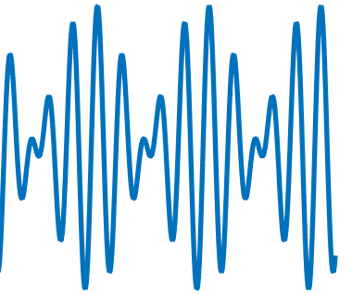
Two frequencies
What about the sum of two sinusoids (neither DC)?
time domain frequency domain
Two sinusoids with DC
s(t)
= sin(ω₁ t) + sin(ω₂ t)
S(ω)
t
ω
0
ω₁
ω₂
s(t)
= 1 + sin(ω₁ t) + sin(ω₂ t)
S(ω)
t
ω
0
ω₁
ω₂

Slide 56
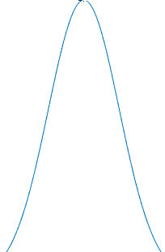
Bandwidth
We can finally define bandwidth
Bandwidth is the width of the spectrum
BW = f_{max} - f_{min}
This is a simplistic definition
usually there will be some constant
depending on how we want to define the point
when the spectrum is essentially zero
When the spectrum starts from DC
the BW is simply the highest frequency
Note that the bandwidth
of a single sinusoid (including DC) is zero!
f_{min}
f_{max}

Slide 57
Sampling again!
From an analog signal we can create a digital signal
by SAMPLING
Under certain conditions
we can uniquely return to the analog signal !
Nyquist (Low pass) Sampling Theorem
if the analog signal is BW limited and
has no frequencies in its spectrum above F_{Nyquist}
then sampling at above 2F_{Nyquist} causes no information loss

Slide 58
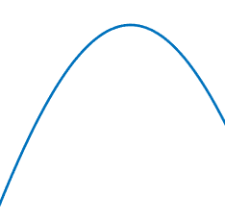
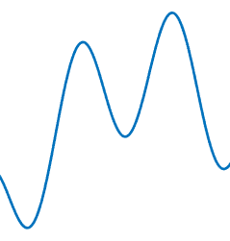
Does this make sense?
We understand how to interpolate if the analog signal looks like this :
But why can’t the signal do this?
Because that requires frequencies above F_{Nyquist} !!

Slide 59
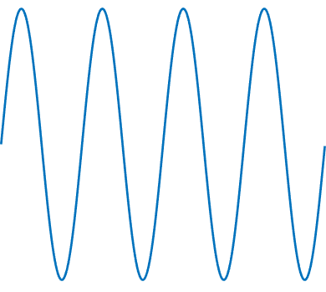
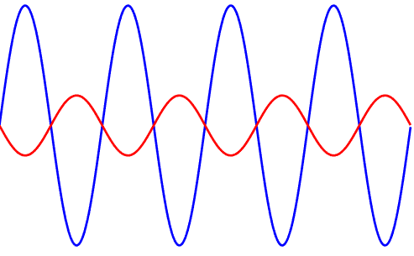
Does it really have to be > ?
You might hear people casually say
that you need to sample at twice the highest frequency
WRONG!
You must sample at MORE than twice F_{Nyquist} !!
For example, here we sample at precisely twice F_{nyquist}

Slide 60
Aliasing
What happens if you sample at too low a frequency?
Wagon wheel demo helicopter demo
This is called aliasing!
The maximum allowed frequency is the Nyquist frequency
f_{Nyquist} = f_{s} / 2
When sampling we have to make sure
that there are not spectral components over f_{Nyquist}
This is done using an anti-aliasing filter
that removes all energy in the spectrum over f_{Nyquist}
(we’ll learn about filters later …)

Slide 61
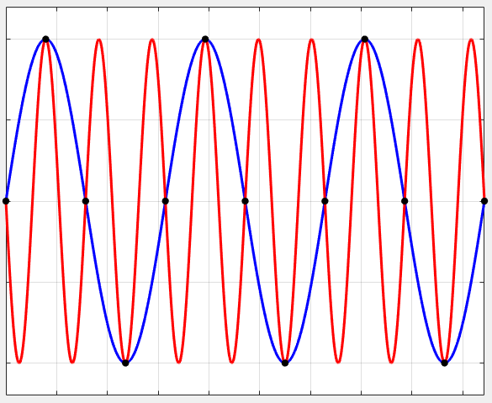
Aliasing in the time domain

Slide 62
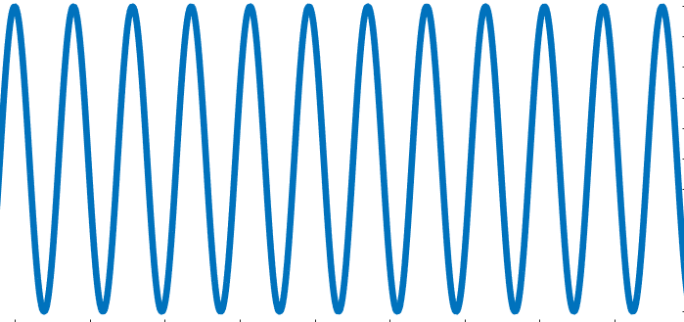
What is the highest frequency?
In analog signal processing, frequency has no upper limit
But in DSP the Nyquist frequency is the highest one can go!
How much is it?
When sampling we define n = t / t_{s} and thus k = f / f_{s}
Thus, the highest k is f_{max} = f_{Nyquist} / f_{s} = (½ f_{s}) / f_{s} = ½
What about angular frequency?
The highest ω_{digital-max} = 2 π f_{max} = π
All digital signals have finite bandwidth!
What is the Nyquist signal?
Sample a sine exactly twice per period
S = … +1 -1 +1 -1 …
f
f
ω
½
π

Slide 63
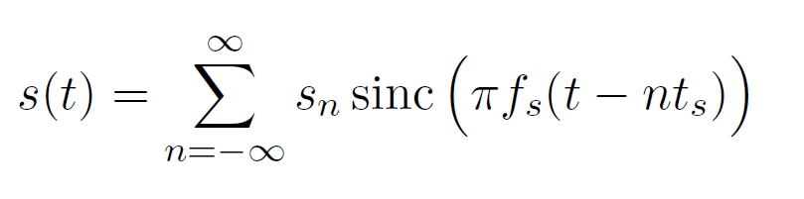
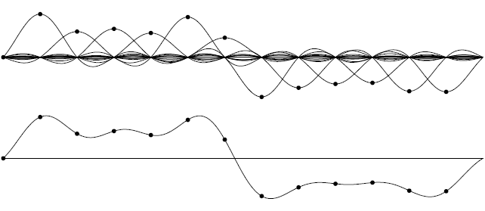
Reconstructing the signal
So, if we obey the sampling theorem and now have s_{n}
how do we recover s(t) at some other time?
In practice we only need a finite number of sincs
frequency
f_{s}/2 = f_{Nyquist}
so, each sinc is zero at neighboring sample points

Slide 64
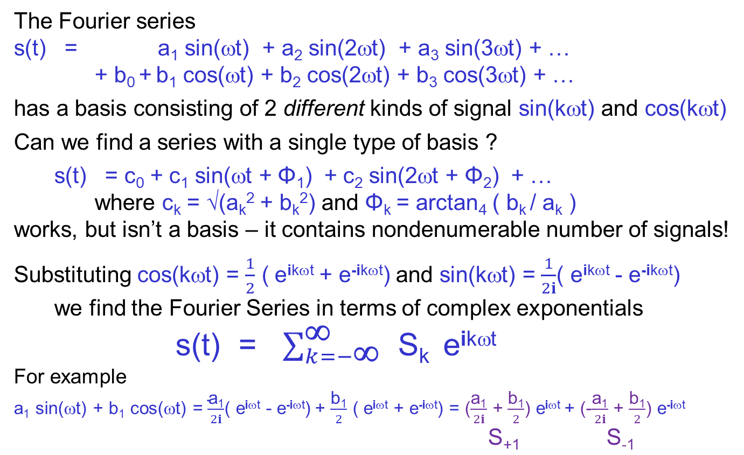
Complex exponentials Negative frequencies
The Fourier series
s(t) = a₁ sin(ωt) + a₂ sin(2ωt) + a₃ sin(3ωt) + …
+ b₀ + b₁ cos(ωt) + b₂ cos(2ωt) + b₃ cos(3ωt) + …
has a basis consisting of 2 different kinds of signal sin(kωt) and cos(kωt)
Can we find a series with a single type of basis ?
s(t) = c₀ + c₁ sin(ωt + Φ₁) + c₂ sin(2ωt + Φ₂) + …
where c_{k} = √(a_{k}² + b_{k}²) and Φ_{k} = arctan₄ ( b_{k} / a_{k} )
works, but isn’t a basis – it contains nondenumerable number of signals!
Substituting cos(kωt) = $\frac{1}{2}$ ( e^{ikωt} + e^{-ikωt}) and sin(kωt) = $\frac{1}{2i}$( e^{ikωt} - e^{-ikωt})
we find the Fourier Series in terms of complex exponentials
s(t) = $\sum_{k=−\text{∞}}^{\text{∞}}{ \text{S}\text{k} }$ e^{ikωt}
For example
a₁ sin(ωt) + b₁ cos(ωt) = $\frac{\text{a}\text{1}}{2i}$( e^{iωt} - e^{-iωt}) + $\frac{\text{b}\text{1}}{2}$ ( e^{iωt} + e^{-iωt}) = ($\frac{\text{a}\text{1}}{2i}$ + $\frac{\text{b}\text{1}}{2}$) e^{iωt} + (-$\frac{\text{a}\text{1}}{2i}$ + $\frac{\text{b}\text{1}}{2}$) e^{-iωt}
$\text{S}\text{+1}$ $\text{S}\text{-1}$

Slide 65
Handling the problems
This is aesthetically pleasing, but raises two problems:
1. the basis functions e^{ikωt} are complex
and thus not signals at all !
2. the frequencies kω can be negative
what does -2 cycles per second mean ?
Using complex exponentials and negative frequencies
so simplifies the mathematics
that we will do anything to allow it
1. We are understand that the true signals are real
– they are simply Re(e^{ikωt})
At the end of the calculations we look at the real part
2. The negative frequencies are the same as the positive ones
only the phase is different (see demo)
demo

Slide 66
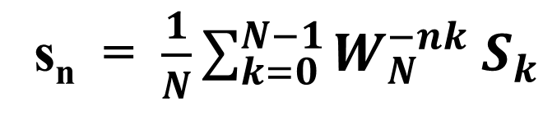
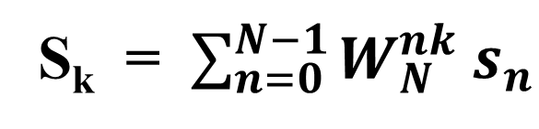



FS, FT, DFT – the long journey
Fourier Series (periodic analog signal → א₀ coefficients)
Fourier Transform (general analog signal → spectrum)
Discrete Fourier Transform (finite digital signal → digital spectrum)
s(t) = $\sum_{k=−∞}^{∞}{S_{k}{ e}^{−i kω t}}$
S(ω) = $\int_{−∞}^{∞}{s\left(t\right){ e}^{−iωt} dt}$
s(t) = $\frac{1}{2π}\int_{−∞}^{∞}{S\left(\text{ω}\right){ e}^{iωt} d\text{ω}}$
S_{k} = $\sum_{n=0}^{N−1}{W_{N}^{nk} s_{n}}$
s_{n} = $\frac{1}{N}\sum_{k=0}^{N−1}{W_{N}^{−nk} S_{k}}$
Actually, this is the Short Time DFT

Slide 67


From FS to FT
The Fourier series transforms a periodic analog signal
into a denumerable set of coefficients
What about non-periodic analog signals?
A non-periodic signal is the limit of a periodic one with period T→∞
so the base frequency f → 0 !
s(t)
T
S(f)
t
ω₀
ω
s(t)
2T
S(f)
t
ω₀/2
ω
s(t)
4T
S(f)
t
ω₀/4
ω

Slide 68




The spectrum in the limit
What about a periodic signal that is not a sinusoid?
i.e., has lots of frequencies in its spectrum ? (all multiples of ω₀)
…
continuous spectrum!
How can you recognize a periodic signal from its spectrum?

Slide 69



The Fourier Transform
So, the sum becomes an integral
and nonperiodic analog signals have Fourier Transforms
which are functions s(t) → S($ω$)
S($ω$) = FT( s(t) ) s(t) = iFT( S($ω$) ) (iFT = FT⁻¹)
The precise definitions are the integrals
Of course FT FT⁻¹ = FT⁻¹ FT = 1
which means that the product of the constants must be 1 / 2π
but there are various conventions as to how to do this

Slide 70



But we’re interested in DSP!
Sampling the analog signal in the time domain n = t / t_{s}
the integral becomes a sum
i.e., sampling in the frequency domain k = f / f_{s} = $ω$ / $ω$_{s}
Why don’t we need 2 ks, one for regular and one for angular frequency?
s(t) → s_{n} ↔ S($ω$) → S_{k}
We won’t prove this here – see the textbook!
but note that t_{s} = 1/f_{s} so f t = f/fs * t/ts = k n
So the integral over s(t) e ^{i 2 π f t}
will turn into a sum over s_{n} e ^{i 2 π n k}
The product of coefficients has to be 1/N
and we are following a (bad) convention
S_{k} = $\sum_{n=0}^{N−1}{e^{−i \frac{2 π n k}{N}} s_{n}}$
s_{n} = $\frac{1}{N}\sum_{k=0}^{N−1}{e^{i \frac{2 π n k}{N}}S_{k}}$

Slide 71


The DFT
So, the transformation now is the Discrete Fourier Transform
S_{k} = DFT( s_{n} ) s_{n} = iDFT( S_{k} ) (iDFT = DFT⁻¹)
We will deal with digital signals with N times
Yes, signals are defined for all times
but we don’t care about all other values
you can think that all other values are zero
or that the signal repeats over and over again
The precise form of the DFT and iDFT for finite N is:
Why must there be the same number of ks as ns ?
S_{k} = $\sum_{n=0}^{N−1}{e^{−i \frac{2 π n k}{N}} s_{n}}$
k = 0 … N-1
s_{n} = $\frac{1}{N}\sum_{k=0}^{N−1}{e^{i \frac{2 π n k}{N}}S_{k}}$
n = 0 … N-1

Slide 72

DFT is a transformation
If we think of the digital signals as vectors
then the DFT and iDFT are (unitary transformation) matrices
They change the representation from the SUI basis to the HRS one
We call the matrix W
So, we can write the DFT like this:

Slide 73



The Nth root of unity
W_{N}
There’s a better way of writing this
We define the N^{th} root of unity W_{N}, i.e., a number such that W_{N}^{N} = 1
It is also called the twiddle factor (we’ll see why later!)
W_{N} = $e^{−i \frac{2 π}{N}}$ for example, W₂ = -1 W₄ = - i W₈ = - $\frac{\sqrt{2}}{2}$ (1+i)
Now
W₂
W₄
W₈
S_{k} = $\sum_{n=0}^{N−1}{W_{N}^{nk} s_{n}}$
k = 0 … N-1
s_{n} = $\frac{1}{N}\sum_{k=0}^{N−1}{W_{N}^{−nk} S_{k}}$
n = 0 … N-1

Slide 74




Example : N=2
Let’s try one
For N=2 we have 2 signal values in the time domain s₀ s₁
W₂ = $e^{−i \frac{2 π }{2}}$ = $e^{−i π}$ = -1
and in the frequency domain S₀ = s₀ + s₁ S₁ = s₀ - s₁

Slide 75




Example : N=4
Let’s try another one
For N=4 we have 4 signal values in the time domain s₀ s₁ s₂ s₃
W₄ = $e^{i \frac{2 π }{4}}$ = $e^{i π/4}$ = -i

Slide 76

The W matrix in general
k=0 1 2 3 n-1
n=0
1
2
3
N-1
The first row is all 1s
so S₀ (the DC component) is the sum of all values
it would be the average if we used a different convention
The second row is powers of W_{N}
The third row is powers of W_{N}²
Row N/2 + 1 is +1 -1 +1 -1
The first column is all 1s
This matrix is not orthogonal but unitary – why?

Slide 77
Another meaning for frequency
Frequency is well defined for sinusoids
s(t) = A sin(ωt + ϕ) s_{n} = A sin(ωn + ϕ)
but all other signals have many - an entire spectrum of frequencies
There is an intuitive feeling
that at every time a signal
can have a different instantaneous amplitude and frequency
Can we find s(t) = A(t) sin(ω(t) t) for all signals?
Does that make sense? It can’t be unique!
Given any s(t) pick an arbitrary ω(t) and divide A(t) = s(t) / sin(ω(t) t)
A consistent meaning of instantaneous amplitude and frequency
can be obtained by a different transform (not Fourier!)
This new transform only works under 2 conditions
the signal has finite bandwidth (which real signals should)
the signal has no DC component – i.e., its time average is zero
A amplitude
ω (angular) frequency
Φ phase

Slide 78

Hilbert transform
The instantaneous (analytical) representation
x(t) = A(t) cos ( Φ(t) ) = A(t) cos ( ω_{c} t + φ(t) )
A(t) is the instantaneous amplitude
φ(t) is the instantaneous phase
This is used in information transmission
Amplitude Modulation x(t) = A(t) cos ( ω_{c} t )
Phase Modulation x(t) = A cos ( ω_{c} t + φ(t) )
Frequency Modulation x(t) ≠ A cos ( ω(t) t )
Why not?
Frequency is the derivative of phase
Φ(t) = ω₀ t then ω(t) = ω₀
Φ(t) = ω_{c} t + φ(t) then ω(t) = ω_{c} + $\frac{d }{dt}$φ(t)
ω_{c} center frequency
carrier frequency

Slide 79


AM and FM
Modulation means changing some parameter of a signal
so that it carries information
Here we change the sinusoid’s amplitude or frequency (phase)

Slide 80

Hilbert transform
The Hilbert transform is a 90 degree phase shifter $\hat{H}$ cos(Φ(t) ) = sin(Φ(t) )
Hence
x(t) = A(t) cos ( Φ(t) )
y(t) = $\hat{H}$ x(t) = A(t) sin ( Φ(t) )
$A\left(t\right)= \sqrt{{ x^{2}\left(t\right)+y}^{2}(t)}$
$\text{}$(t) = arctan₄ ( ${y(t)}/{x(t)}$ )
The instantaneous frequency is the derivative
of the instantaneous frequency
this is equivalent to shifting every spectral component separately by 90º

Slide 81

Uncertainty Theorem
When you see a sinusoid for a long time Δt
it is easy to measure its frequency : N_{cycles} / Δt
But when you only see it for a short time
the uncertainty in frequency Δω is large
The uncertainty theorem (well-known in quantum mechanics) says
Δω Δt > constant

Slide 82
One more transform
What is a transform in mathematics?
An operation that transforms some object into a similar object
while not losing information
For example
the FT transforms a function into a function
The DFT transforms a sequence into a sequence
The Fourier series is not a transform
since it converts a function into a sequence
In DSP we frequently use the z transform, although
it is not a transform (it converts a sequence into a function)
the name z is arbitrary
The zT is only defined for digital signals why?
Let’s start with something you already know - generating functions

Slide 83

Generating functions
In math we have the strong tools of analysis (calculus)
to study functions
For example
we can learn about a function by looking at its derivatives
But we have very few general mechanisms to handle sequences
(which is not good for DSP!)
So, mathematicians came up with a way
to convert a sequence into a function (the generating function)
and by studying the function we learn a lot about the sequence!
Given a sequence s_{n} where n = 0 … ∞
we define the generating function to be the power series

Slide 84
Riddle?
Why is this sculpture in Jerusalem called the golden sculpture?

Slide 85




Example – Fibonacci (1)
We all know the Fibonacci sequence 1, 1, 2, 3, 5, 8, 13, 21, …
which is recursively defined by
It is well known that the ratio of two consecutive terms
tends to the golden ratio ≈ 1.618
(note that γ-1 = 1/ γ !) ≈ -0.618
There is a nonrecursive formula for the n^{th} term!
The generating function is
We want to study this function
BTW, there is a nonrecursive formula for the N^{th} hexadecimal digit of π!

Slide 86

Example – Fibonacci (2)
We’ll use here for the first time some tricks
that we’ll be using again and again, so let’s do it slowly!
sum from n=2 since the left term has n-2
substitute m = n-1
substitute m = n-2
rename m back to n

Slide 87


Example – Fibonacci (2)
So
Using the techniques learned in elementary calculus we can sketch it
note: x² + x – 1 = 0 has roots -γ’ = 1/γ and -γ
-γ’ = 1/γ
-γ

Slide 88


Example – Fibonacci (2)
Using a partial fraction expansion
and comparing to the sum of a geometric series we can find :
How can this be an integer?
Why does the ratio f_{n+1} / f_{n} approach γ ?

Slide 89

From generating function to z transform
To use this technique for digital signals we define the z Transform
There are 3 changes as compared to the generating function
1. sum over n=-∞ … +∞ (sum – not integral! only for digital signals)
2. minus in exponent (convention)
3. z instead of x - since z is a complex variable
The zT allows us to use the even more powerful techniques
of complex analysis
The zT is defined over the complex plane
Each point in the plane represents a signal
S_{n} = z^{n}

Slide 90
The z plane
z=+i s_{n} = i^{n}
z=0 s_{n}=0
z=1 s_{n}=1 (DC)
z = -1
Nyquist frequency!
unit circle
(all z with |z|=1)
z=-i s_{n} = (-i)^{n}
What is the DC signal?
s_{n} = 1^{n} = … +1 +1 +1 +1 …
What is the Nyquist signal?
s_{n} = (-1)^{n} = … -1 +1 -1 +1 …

Slide 91



Some more signals on the z plane

Slide 92


What’s the connection with z?
We have used the letter z before -
for the time advance/delay operator
Is there a connection?
If we already know the zT of some signal x_{n} is X(z)
do we need to recalculate to find the zT of $\hat{z}$⁻¹ x ?
No!
So zT($\hat{z}$⁻¹ x) = $z$⁻¹ zT(x)
What can you say about zT ($\hat{z}$ x) ?
delay operator
complex number

Slide 93

What’s the connection with the DFT?
All complex numbers on the unit circle
are of the form e ^{i ω t}
(since all complex numbers
are r e ^{i ω t} and here r=1)
So the zT on the unit circle is
exactly the FT
If we look at points W_{N} we get exactly the DFT
e ^{i ω}
ω

Slide 94

Another riddle
Here is a proof that -1 = ∞
How much is $S=1+ \frac{1}{2}+ \frac{1}{4}+\frac{1}{8}+\frac{1}{16}+$ … ?
We all remember that S = 2 ! How do we prove this?
$S=1+ \frac{1}{2}\left( 1+\frac{1}{2}+\frac{1}{4}+\frac{1}{8}+\frac{1}{16}+ …\right)=1 + \frac{1}{2}S$
So $\frac{1}{2}S$ = 1 and so $S$= 2 !
Now, how much is $S=1+2+4+8+16+$ … ?
I am sure you agree that $S=$ ∞ !
But using the same trick
$S=1+2\left( 1+2+4+8+16+ …\right)=1 +2S$
So $S$= -1 !
What’s wrong???
The distributive law only holds if the sum converges

Slide 95
RoC
The zT is an infinite series
and we can get into trouble when it doesn’t converge!
It turns out that the Region of Convergence of the zT
is always a ring
General case DFT converges if
Sometimes we must use zT since DFT doesn’t converge!
Special case : R1=0 R2=∞ RoC = entire plane
Special case : R1=0 R2<∞ RoC = circle
Special case : R1>0 R2=∞ RoC = outside of a circle

