Slide 1
SDN NFV and all that
Presented by:
Yaakov (J) Stein
CTO

Slide 2
Outline
* Introduction
* SDN * NFV * Hype and doubts
* OpenFlow * Alternatives

Slide 3
Introduction to NFV and SDN

Slide 4
Today’s communications world
Today’s infrastructures are composed of many different Network Elements (NEs)
sensors, smartphones, notebooks, laptops, desk computers, servers,
DSL modems, Fiber transceivers,
SONET/SDH ADMs, OTN switches, ROADMs,
Ethernet switches, IP routers, MPLS LSRs, BRAS, SGSN/GGSN,
NATs, Firewalls, IDS, CDN, WAN aceleration, DPI,
VoIP gateways, IP-PBXes, video streamers,
performance monitoring probes , performance enhancement middleboxes,
etc., etc., etc.
New and ever more complex NEs are being invented all the time,
and RAD and other equipment vendors like it that way
while Service Providers find it hard to shelve and power them all !
In addition, while service innovation is accelerating
the increasing sophistication of new services
the requirement for backward compatibility
and the increasing number of different SDOs, consortia, and industry groups
which means that
it has become very hard to experiment with new networking ideas
NEs are taking longer to standardize, design, acquire, and learn how to operate
NEs are becoming more complex and expensive to maintain

Slide 5
Trends over time *
cost /
revenue
revenue
Service Provider bankruptcy point
margin
CAPEX + OPEX
desirable CAPEX + OPEX
time
* thanks to Prodip Sen from Verizon for ideas behind this slide

Slide 6
Two complementary solutions
Network Functions Virtualization (NFV)
This approach advocates replacing hardware NEs
with software running on COTS computers
that may be housed in POPs and/or datacenters
Advantages:
COTS server price and availability scales well
functionality can be placed where-ever most effective or inexpensive
functionality may be speedily deployed, relocated, and upgraded
Software Defined Networks (SDN)
This approach advocates replacing standardized networking protocols
with centralized software applications
that may configure all the NEs in the network
Advantages:
easy to experiment with new ideas
software development is usually much faster than protocol standardization
centralized control simplifies management of complex systems
functionality may be speedily deployed, relocated, and upgraded
Note: Some people call NFV Service Provider SDN
or Telco SDN !
Note: Some people call this SDN Software Driven Networking
and call NFV Software Defined Networking !

Slide 7
New service creation
Conventional networks are slow at adding new services
new service instances typically take weeks to activate
new service types may take months to years
New service types often require new equipment
or upgrading of existing equipment
New pure-software apps can be deployed much faster !
There is a fundamental disconnect between software and networking
An important goal of SDN and NFV is to speed deployment of new services

Slide 8
Function relocation
NFV and SDN facilitate (but don’t require) relocation of functionalities to
Points of Presence and Data Centers
Many (mistakenly) believe that the main reason for NFV
is to move networking functions to data centers
where one can benefit from economies of scale
And conversely, even nonvirtualized functions can be relocated
Some telecomm functionalities need to reside at their conventional location
Loopback testing
E2E performance monitoring
but many don’t
routing and path computation
billing/charging
traffic management
DoS attack blocking
The idea of optimally placing virtualized network functions in the network
is called Distributed-NFV
Optimal location of a functionality needs
to take into consideration:
economies of scale
real-estate availability and costs
energy and cooling
management and maintenance
security and privacy
regulatory issues

Slide 9
Example of relocation with SDN/NFV
How can SDN and NFV facilitate network function relocation ?
In conventional IP networks routers perform 2 functions
forwarding
observing the packet header
consulting the Forwarding Information Base
forwarding the packet
routing
communicating with neighboring routers to discover topology (routing protocols)
runs routing algorithms (e.g., Dijkstra)
populating the FIB used in packet forwarding
SDN enables moving the routing algorithms to a centralized location
replace the router with a simpler but configurable SDN switch
install a centralized SDN controller
runs the routing algorithms (internally – w/o on-the-wire protocols)
configures the SDN switches by populating the FIB
Furthermore, as a next step we can replace standard routing algorithms
with more sophisticated path optimization algorithms !

Slide 10
Service (function) chaining
Service (function) chaining is a new SDN application
that has been receiving a lot of attention
and a new Network Service Chaining WG has been formed in the IETF
Main application is inside data centers, but also applications in mobile networks
A packet may need to be steered through a sequence of services
Examples of services (functions) :
firewall
DPI for analytics
lawful interception (CALEA)
NAT
CDN
charging function
load balancing
The chaining can be performed by source routing, or policy in each station,
but simpler to dictate by policy from central policy server

Slide 11
Y(J)S taxonomy
While we have been using 2 buzz-words SDN and NFV,
there are actually 5 distinguishable trends :
Computications
blurring of division between communications and computation
Physics - Logic
spectrum of implementation options between HW and SW
virtualization
Philosophy
touchless, configurable, and fully programmable devices
Geography
location of functionality (locally or remotely)
Politics
distributed control planes vs. centralized management planes

Slide 12
Computications
Once there was no overlap
between communications (telephone, radio, TV)
and computation (computers)
Actually communications devices always ran complex algorithms
but these are hidden from the user
This dichotomy has certainly blurred !
Most home computers are not used for computation at all
rather for entertainment and communications (email, chat, VoIP)
Cellular telephones have become computers
The differentiation can still be seen in the terms algorithm and protocol
Protocols are to communications as algorithms are to computation
SDN claims that packet forwarding is a pure computation problem
and protocols as we know them are not needed
Scott Shenker’s talk entitled The future of networking and the past of protocols

Slide 13
Physics-Logic and Virtualization
VIRTUALIZATION
special purpose processors
general
purpose
software
PHYSICS
dedicated hardware
ASIC
FPGA
firmware
LOGIC
CONCRETIZATION
Concretization means moving a task usually implemented closer to SW towards HW
Justifications for concretization include :
cost savings for mass produced products
miniaturization/packaging constraints
need for high processing rates
energy savings / power limitation / heat dissipation
Virtualization is the opposite (although frequently reserved for the extreme case of HW → SW)
Justifications are initially harder to grasp:
lower development efforts and cost
flexibility and ability to upgrade functionality

Slide 14
Software Defined Radio
An extreme case of virtualization is Software Defined Radio
Transmitters and receivers (once exclusively implemented by analog circuitry)
can be replaced by DSP code
enabling higher accuracy (lower noise) and more sophisticated processing
For example, an AM envelope detector and FM ring demodulator
can be replaced by Hilbert transform based calculations
reducing noise and facilitating advanced features
(e.g., tracking frequency drift, notching out interfering signals)
SDR enables downloading of DSP code for the transmitter / receiver of interest
thus a single platform could be an LF AM receiver, or an HF SSB receiver, or a VHF FM receiver
depending on the downloaded executable software
Cognitive radio is a follow-on development
the SDR transceiver dynamically selects the best channel available
based on regulatory constraints, spectrum allocation, noise present at particular frequencies, measured performance, etc.)
and sets its transmission and reception parameters accordingly

Slide 15
Philosophy
flexibility
ZERO
TOUCH
BASIC CONFIGURABILITY
DPI
FULL
PROGRAMMABILITY
OpenFlow
Zero Touch Simplest devices have no configurable options
and very sophisticated devices may autonomously learn everything needed
Most communications devices need some configuration to perform a function
More flexible devices may be configured to perform multiple functions
we will see that OpenFlow is of this type
More complex devices may be programmed to perform multiple functions
from an intended ensemble
Full Programmability Most flexible devices can be programmed to do anything !

Slide 16
Geography
NFV and SDN facilitate (but don’t require) relocation of functionalities to
Points of Presence and Data Centers
Optimal location of a functionality needs to take into consideration:
economies of scale
real-estate availability and costs
energy and cooling
management and maintenance
security and privacy
regulatory issues
Some telecomm functionalities need to reside at their conventional location
Loopback testing
E2E performance monitoring
but many don’t
routing and path computation
billing/charging
traffic management
DoS attack blocking

Slide 17
Relocation without SDN/NFV
Just as virtualization in computation facilitated cloud computing
SDN/NFV facilitates relocation of network functions
However, there are relocation cases that do not depend on it
Examples:
CPRI
relocation of eNodeB processing to PoP
leaves only mixer and A/D at antenna location
MOCA
relocation of WiFi Access Point to closet
leaves only amplifier at antenna position
IPS as a service (e.g., RADWARE’s DefenseFlow)
relocation of DefensePro functionality to data center
leaves only basic detection at router

Slide 18
Relocation with SDN/NFV - RouteFlow
How do SDN and NFV facilitate network function relocation ?
In conventional IP networks routers perform 2 functions
forwarding
observing the packet header
consulting the Forwarding Information Base
forwarding the packet
routing
communicating with neighboring routers to discover topology (routing protocols)
runs routing algorithms (e.g., Dijkstra)
populating the FIB used in packet forwarding
SDN enables moving the routing algorithms to a centralized location
replace the router with a simpler but configurable SDN switch
install a centralized SDN controller
runs the routing algorithms (internally – w/o on-the-wire protocols)
configures the SDN switches by populating the FIB
Furthermore, as a next step we can replace standard routing algorithms
with more sophisticated path optimization algorithms !

Slide 19
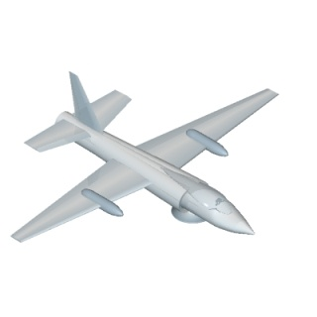
Politics
It has long been traditional to distinguish between :
forwarding
routing (i.e., learning how to forward)
administration (setting policy, service commissioning, monitoring, billing, …)
This leads to defining three planes – data (or user), control, and management
Traditionally the distinction between control and management was that :
management had a human in the loop
while the control plane was automatic
With the introduction of more sophisticated software
the human could often be removed from the loop
The difference that remains is that
the management plane is slow and centralized
the control plane is fast and distributed
management plane
control plane
data plane

Slide 20
Data, control, and management planes
As we specified, many SDN proponents claim
that separation of the data and control planes is a defining attribute of SDN rather than a time-honored fundamental characteristic of networks
This belief apparently arises from these proponents
being familiar with the Linux router
which does not clearly separate forwarding from routing
However, the Linux router was written by programmers
not by networking experts
What SDN really does is to erase the difference
between control and management planes
Note: some SDN proponents
are now proposing a 4-plane model
with evolutionary introduction from top to bottom
management plane
control plane
data plane
management plane
service plane
control plane
data plane

Slide 21
SDN

Slide 22
Why SDN ? Abstractions
SDN was triggered by the development of networking technologies
not keeping up with the new user applications requiring networking
Computer science theorists theorized
that this derived from a lack of abstractions
In CS an abstraction is a representation
that reveals semantics needed at a given level
while hiding implementation details
thus allowing a programmer to focus on necessary concepts
without getting bogged down in unnecessary details
Much of the progress in CS resulted from finding new abstractions
Example:
Programming languages with higher and higher layers of abstraction have been developed
It is very slow to code directly in assembly language (with 1 abstraction : mnemonics for opcodes)
It is a bit faster to coding in a low-level language like C (additional abstractions : variables, structures)
It is much faster coding in high-level imperative language like Python
It is much faster yet coding in a declarative language (coding has been abstracted away)
It is fastest coding in a domain-specific language (only contains the needed abstractions)

Slide 23
Control plane abstractions
The CS theorists came to the conclusion that ¹ :
The data plane has a useful abstraction – layering
There is no unified control plane or useful abstractions
instead each network application has its own tailored-made control plane
with its own element discovery, state distribution, failure recovery, etc.
Note the subtle change of terminology
instead of calling switching, routing, load balancing, etc. network functions
to the CS theorists they are network applications (like SW apps, they can be easily added)
SDN principle 1 APIs instead of protocols
Replace control plane protocols with well-defined APIs to network applications
This would hide details of the network from the network application
revealing high-level concepts
such as requesting connectivity between A and B
but hiding details unimportant to the application
such as details of switches through which the path A → B passes
¹ I personally believe that this insight is mostly misguided, but here I am reporting history

Slide 24
Network Operating System
Abstractions in computer science hide details not useful at a given level
For example, an operating system
sits between user programs and the physical computer hardware
reveals high level functions (e.g., allocating a block of memory or writing to disk)
hides hardware-specific details (e.g., memory chips and disk drives)
We can think of SDN as a Network Operating System
user
application
user
application
user
application
Note: apps can be added without changing OS
network
application
network
application
network
application
Computer Operating System
Network Operating System
HW
component
HW
component
HW
component
SDN
switch
SDN
switch
SDN
switch

Slide 25
Packet forwarding abstraction
Continuing the CS-theorist’s argument
another abstraction relates to how a network element forwards packets
A switch observes MAC addresses and VLAN tags and performs exact match
A router observes IP addresses and performs longest prefix match
A firewall observes multiple fields and performs regular expression match
We can hide these details and state :
SDN principle 2 Packet forwarding as a computational problem
The function of any Network Element is to
receive a packet
observe packet fields
apply algorithm (classification, decision logic)
optionally edit packet
forward or discard packet

Slide 26
Flows
It would be too slow for a Network Element
to query the central algorithm
for every packet received
So, it needs to store some network state
In order to reduce the amount of state it needs to store
we identify packets as belonging to flows
SDN principle 3 Flows (as in OpenFlow)
Packets are handled solely based on the flow to which they belong
Flows are thus just like Forwarding Equivalence Classes
Thus a flow may be determined by
an IP prefix in an IP network
A label in an MPLS network
VLANs in VLAN cross-connect networks
The granularity of a flow depends on the application

Slide 27
Network state and graph algorithms
In order to perform the forwarding algorithm on a packet belonging to a flow
NEs need to know something of the network state
(this may be complete knowledge or very limited local knowledge)
The best decisions can be made when there is full global knowledge
but it would be expensive for every NE to acquire and store such state
With full knowledge of topology and constraints
the flow routing problem can be solved by a graph algorithm
While it is possible to perform the decision algorithms in a distributed manner
it makes more sense to perform them centrally
The algorithm may be the same Dijkstra,
but performed in a central location by an entity with full knowledge
SDN principle 4 Eliminate distributed protocols
Replace distributed routing protocols with graph algorithms
performed at a central location
However, if the algorithm is not performed at the NE,
how does it know how to forward packets ?

Slide 28
Configuration
The optimal amount of network state to be stored at the individual NE
is just a flow table describing how to forward a packet belonging to a flow (FIB)
Conventional NEs have two parts:
smart but slow CPUs that create the FIB
fast but dumb switch fabrics that use the FIB
Since the algorithms to build the FIB are performed elsewhere
SDN brings the added bonus that we don’t need the CPU
Such a simplified NE is called an SDN switch
We populate the flow table by direct configuration
The entity that communicates with the SDN switch to send configuration
is called an SDN controller
SDN principle 5 Configuration
SDN switches are dumb and flows are configured by an SDN controller

Slide 29
SDN as a compiler
We have discussed the popular model of SDN as a Network Operating System
An alternative abstraction (advocated by Contrail, recently acquired by Juniper)
views SDN as a compiler
The idea is that the network user describes its requirements/constraints
in a high level declarative description
The SDN compiler
parses the requirements
compiles them to low level instructions for a NE (which may be an SDN switch)

Slide 30
Robustness
SDN academicians complain about
the brittleness / fragility of communications protocols
As opposed to the robustness their approach can bring
To investigate this claim, we need to understand what robustness means
We say that a system is robust to X
when it can continue functioning even when X happens
For example,
A communications network is robust to failures
if it continues functioning even when links or network elements fail
A communications network is robust to capacity increase
if it continues functioning when the capacity it is required to handle increases
Note that it is meaningless to say that a system is robust without saying to what !

Slide 31
Robustness (cont.)
Unfortunately, robustness to X may contradict robustness to Y
For example,
In order to achieve robustness to failures
the network is designed with redundancy (e.g., 1+1)
In order to achieve robustness to capacity increase
the network is designed for efficiency, i.e., with no redundancy
Thus networks can not be designed to be robust to everything
Instead, networks are designed to profitably provide services
The X that seems to be most on the minds of SDN proponents is
creation of new types of services
In the past, new service type creation was infrequent
so networks were not required to be robust to it
This is an area where SDN can make a big difference !

Slide 32
OpenFlow SDN (pre)history
2005 ● 4D project Greenberg, Hjalmtysson, Maltz, Myers, Rexford, Xie, Yan, Zhan, Zhang
2005-2006 ● Stanford PhD student Martin Casado develops Ethane
(with Michael Freedman, Nick McKeown, Scott Shenker, and others)
2008 ● OpenFlow: Enabling Innovation in Campus Networks paper
Authors: Nick McKeown, Guru Parulkar (Stanford), Tom Anderson (U Washington), Hari Balakrishnan (MIT),
Larry Peterson, Jennifer Rexford (Princeton), Scott Shenker (Berkeley), Jonathan Turner (Washington U St. Louis)
Stanford establishes OpenFlow Switching Consortium
2009
reporter Kate Greene coins term SDN (after SDR) in interview with McKeown
Nicira raises $575k funding
OpenFlow 1.0 spec published by Standford
2010
Big Switch raises $1.4M in seed funding
2011
NEC, HP, and Marvell announce OpenFlow products
Cisco, Juniper and others start talking about SDN
first Open Networking Summit
ONF founded, OpenFlow 1.1 and 1.2 and OF-CONFIG 1.0 specs published
2012 ● OpenFlow 1.3 and OF-CONFIG 1.1 specs published

Slide 33
Ethane – precursor to OpenFlow
Ethane was an enterprise network architecture
where connectivity is governed by high-level global fine-grained policy, e.g.,
users can only communicate if allowed
traffic of untrusted users may be required to pass through an IDS
traffic or rogue hosts can be blocked upon entry
certain traffic types may be given preferential treatment
Ethane had 2 components :
centralized omniscient controller that manages flows
simple (dumb) flow-based Ethane switches
Ethane was built to be backwards-compatible with existing hosts and switches
and thus enables hybrid topologies and migration
The controller
knows the global network topology
explicitly grants access by enabling flows
performs route computation for permitted flows
Ethane switches are simpler than Ethernet switches, consisting of
a flow table
a secure channel to the controller

Slide 34
Ethane in action
Bootstrapping
switches and controller form spanning tree with controller as root
Registration
all users, hosts, and switches must be authenticated
users are mapped to hosts, hosts to switch+port (mobility is part of policy)
Flow setup
A sends packet to B via switch
switch forwards packet to controller
controller consults policy and decides whether to allow /deny and path
controller adds flow entry to all switches along the path
controller sends packet back to switch
switch forwards packet
Forwarding
When a packet arrives to an Ethane switch
if in flow table, forwarded according to matching flow entry
if not in the flow table, it is sent to controller

Slide 35
SDN interfaces
Today, the most popular type of SDN :
utilizes flexibly programmable SDN switches
employs a centralized SDN controller
SDN thus requires a (southbound) protocol
to connect the SDN controller with SDN switches
The most popular such protocol is OpenFlow
others include ForCES, I2RS, netconf, BGP, …
In the popular model the SDN controller itself is not intelligent
intelligence sitting above it in
the Network Operating System (NOS)
and network applications (switching, routing, load balancing, security, etc.)
There is thus the need for a (northbound) protocol
to connect the SDN controller to the applications
NB protocols have yet to be standardized

Slide 36
SDN overall architecture
app
app
app
app
Network Operating System
northbound interface
SDN controller
southbound interface
(e.g., OpenFlow)
SDN switch
SDN switch
SDN switch
SDN switch
Network
SDN switch
SDN switch

Slide 37
Is SDN better than routing ?
OK, SDN switches may be cheaper – but is that the only advantage of SDN ?
Distributed routing protocols are limited to
finding simple connectivity
minimizing number of hops
but can not perform more sophisticated operations, such as
optimizing paths under constraints (e.g., security)
setting up non-overlapping backup paths
integrating networking functionalities (e.g., NAT, firewall) into paths
This is why MPLS created the Path Computation Element architecture
An SDN controller is omniscient (“God box”)
can perform arbitrary optimization calculations on the network graph
directly configures the forwarding actions of the SDN switches
But this advantage comes at a price
the controller is a single point of failure
the architecture is limited to a single network
additional (overhead) bandwidth is required
additional set-up delay may be incurred

Slide 38
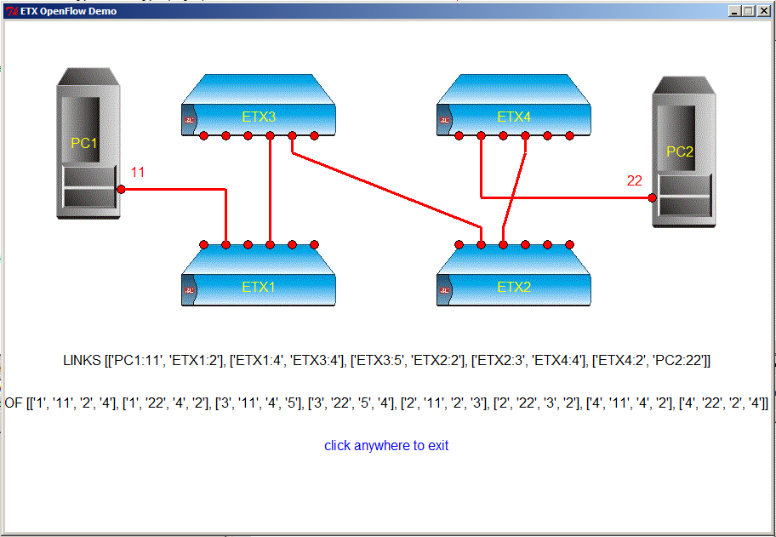
RAD SDN
RAD CTO Office has developed an OF to CLI converter for ETX2
and a graphic application above a standard OF controller
The converter enables standard ETXs to be used in an SDN network
The application enables setting up ETXs in a graphical manner
WARNING – DEMO ONLY

Slide 39
SDN vs. conventional NMS
So 1) is OF/SDN simply a new network management protocol ?
and if so 2) is it better than existing NMS protocols ?
1) Since it is replaces both control and management planes
it is much more dynamic than present management systems
2) Present systems all have drawbacks as compared to OF :
SNMP (currently the most common mechanism for configuration and monitoring)
is not sufficiently dynamic or fine-grained (has limited expressibility)
not multivendor (commonly relies on vendor-specific MIBs)
Netconf
just configuration - no monitoring capabilities
CLI scripting
not multivendor (but I2RS is on its way)
Syslog mining
just monitoring - no configuration capabilities
requires complex configuration and searching

Slide 40
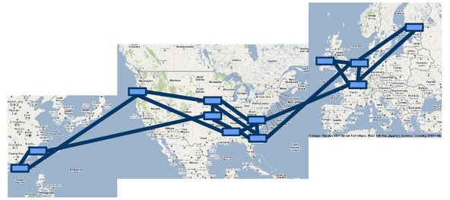
SDN case study - Google
Google operates two backbones:
I-scale Internet facing network that carries user traffic
G-scale Internal network that carries traffic between datacenters
(petabytes of web indexes, Gmail backups, different priorities)
The two backbones have very different requirements and traffic characteristics
I-scale has smooth diurnal pattern
G-scale is bursty with wild demand swings , requires complex TE
Since early 2012 G-scale is managed using OpenFlow
Since no suitable OF device was available
Google built its own switches from merchant silicon and open source stacks
For fault tolerance and scalability
network has multiple controllers
each site has multiple switches

Slide 41
SDN case study – Google (cont.)
Why did Google re-engineer G-scale ?
The new network has centralized traffic engineering
that leads to network utilization is close to 95% !
This is done by continuously collecting real-time metrics
global topology data
bandwidth demand from applications/services
fiber utilization
Path computation simplified due to global visibility
and computation can be concentrated in latest generation of servers
The system computes optimal path assignments for traffic flows
and then programs the paths into the switches using OpenFlow.
As demand changes or network failures occur
the service re-computes path assignments and reprograms the switches
Network can respond quickly and be hitlessly upgraded
Effort started in 2010, basic SDN working in 2011, move to full TE took only 2 months

Slide 42
Other SDN trials / deployments
DT’s Croatian subsidiary Hrvatski Telekom is integrating Tail-F technology
for service management in the new TeraStream all-IPv6 network
Colt is in pilot stage for a new SDN-based datacenter architecture
Telus and SFR are evaluating Nuage Networks datacenter solution
Telstra and Ericsson are working on service chaining
and optimizing the access network using SDN
Portugal Telecom is collaborating with NEC on SDN in carrier datacenters
Verizon is already using SDN to steer video traffic through in their network
and is studying the advantages of SDN in cloud environments
AT&T is offering SDN corporate VPN services for data and voice

Slide 43
Ofelia
OFELIA is an EU FP7 project
Participants : EICT, DT, I Bristol, i2CAT, TU Berlin, NEC, iMinds, Leland Stanford U, ADVA, CNIT, CREATE-NET, CTTC, Lancaster U, ITAV, U Sao Paulo, UFU,
The project set up a OF-controlled optical network that
can be dynamically controlled and extended by researchers over the web
The network
extends SDN into optical and wireless technologies
allows flexible control down to individual flows
is protocol agnostic
and allows non-IP experiments such as content-based addressing
allows deployment and test of new controllers and apps
supports automatic creation of slices
enables multi-domain extensions of controllers (for federation of islands)

Slide 44
Some more SDN projects
Comprehensive
OpenDaylight
SDN controllers:
NOX, POX (ICSI)
FloodLight (Big Switch)
Beacon (Stanford)
Trema (Open Source)
NOS and routing
Maestro (Rice U)
RouteFlow (CpqD)
Switches
Open vSwitch (Nicira/VMware)
Indigo (Big Switch)
Snabb (Open Source)
Pantou / OpenWRT (Standford)
Testing
Mininet (Stanford)
Cbench (Stanford)
NICE (EPFL, Princeton)
OFTest (Big Switch)
Extensions
Ofelia

Slide 45
NFV

Slide 46
Virtualization of computation
In the field of computation, there has been a major trend towards virtualization
Virtualization here means the creation of a virtual machine (VM)
that acts like an independent physical computer (or other hardware device)
A VM is software that emulates hardware (e.g., an x86 CPU)
over which one can run software as if it is running on a physical computer
The VM runs on a host machine
and creates a guest machine (e.g., an x86 environment)
A single host computer may host many fully independent guest VMs
and each VM may run different Operating Systems and/or applications
For example
a datacenter may have many racks of server cards
each server card may have many (host) CPUs
each CPU may run many (guest) VMs
A hypervisor is software that enables creation and monitoring of VMs

Slide 47
Cloud computing
Once computational and storage resources are virtualized
they can be relocated to a Data Center
as long as there is a network linking the place the user to the DC
DCs are worthwhile because
user gets infrastructure (IaaS) or platform (PaaS) or software (SaaS) as a service and can focus on its core business instead of IT
user only pays for CPU cycles or storage GB actually used (smoothing peaks)
agility – user can quickly upscale or downscale resources
ubiquitousness – user can access service from anywhere
cloud provider enjoys economies of scale, centralized energy/cooling
A standard cloud service consists of
Allocate, monitor, release compute resources (EC2, Nova)
Allocate and release storage resources (S3, Swift)
Load application to compute resource (Glance)
Dashboard to monitor performance and billing

Slide 48
Network Functions Virtualization
Computers are not the only hardware device that can be virtualized
Many (but not all) NEs can be replaced by software running on a CPU or VM
This would enable
using standard COTS hardware (e.g., high volume servers, storage)
reducing CAPEX and OPEX
fully implementing functionality in software
reducing development and deployment cycle times, opening up the R&D market
consolidating equipment types
reducing power consumption
optionally concentrating network functions in datacenters or POPs
obtaining further economies of scale. Enabling rapid scale-up and scale-down
For example, switches, routers, NATs, firewalls, IDS, etc.
are all good candidates for virtualization
as long as the data rates are not too high
Physical layer functions (e.g., Software Defined Radio) are not ideal candidates
High data-rate (core) NEs will probably remain in dedicated hardware

Slide 49
Distributed NFV
The idea of optimally placing virtualized network functions in the network
is called Distributed-NFVTM
Optimal location of a functionality needs to take into consideration:
resource availability (computational power, storage, bandwidth)
real-estate availability and costs
energy and cooling
management and maintenance
other economies of scale
security and privacy
regulatory issues
For example, consider moving a DPI engine from where it is needed
this requires sending the packets to be inspected to a remote DPI engine
If bandwidth is unavailable or expensive or excessive delay is added
then DPI must not be relocated
even if computational resources are less expensive elsewhere!

Slide 50
D-NFV orchestration
Data center orchestration systems decide where to place computational tasks
based on constraints, costs, present CPU/memory loading, etc
Similarly, with D-NFV we need to solve the VNF placement problem
i.e., to compute the optimal location to insert a virtual function
taking into account constraints, costs, CPU/memory load, …
For function chaining (placement of multiple VNFs)
there are frequently (partial) order rules as well
It is suboptimal to perform path computation and D-NFV placement separately
so we need to perform joint path computation and D-NFV placement
This is a novel and challenging graph optimization problem !

Slide 51
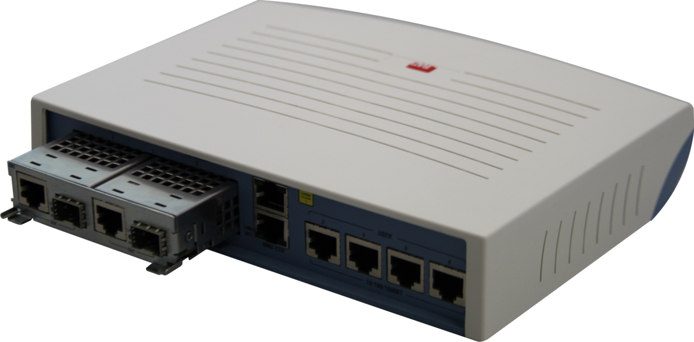
RAD D-NFV : ETX2 with VM
RAD’s first step in D-NFV is an x86 module for the ETX2
stand-alone device with standard computational (CPU) resources
x86 connected to switch ports, and can operate on packets at various stages
modular design – preparation for x86 server module
module may be upgraded
x86 module

Slide 52
ETX2 with VM
The ETX2 with module houses three virtual entities
standard ETX NTU (OAM, policing, shaping, etc.)
VM infrastructure (based on a KVM hypervisor)
VNFs that run on the VM infrastructure
The VNF software may be managed by OpenStack
OpenStack Compute node
VNF
VNF
OpenStack
Controller
Hypervisor
Customer Site
Data Center
Customer
Network
Network
ETX2

Slide 53
Firewall with ETX/VM
1 Gbps 3rd party firewall app
Data paths are directed to the VM per VLAN
Local filtering at customer firewall maximizes upstream BW
Firewall VNF
Firewall Management
Open vSwitch
OpenStack
Hypervisor
Firewall VLANs
Firewall VLANs
Customer
Network
Network
UNI
NNI
Pass-through VLANs

Slide 54
Packet collection with ETX/VM
Packet collector monitors traffic to analyze network behavior, performance and applications
Hardware forwarding with Flow Mirroring ensures VM does not introduce delay and is not a bottleneck
TCPdump Management
PC running PuTTY
for activating TCPdump and
retrieving the file
TCPdump VNF
SSH to activate/ deactivate TCPdump
SFTP for file transfer
Open vSwitch
OpenStack
Hypervisor
Monitored VLANs
Monitored VLANs
Customer
Network
Network
UNI
NNI
Pass-through VLANs

Slide 55
Distributed Application Awareness with ETX/VM
Central Site(s)
DPI Client/Server traffic
DPI
Engine
Display Application
Policy
Server
Application Performance information
DB Server
DB presentation information
SQL
Policy information
PM Engine
Customer Premises
IPFIX
RADIUS
Customer
Network
AAw-NID
Network
AAW SFP
AAw-NID – Ethernet/IP CLE sends new application samples to the DPI engine, and then handles traffic per application policy
DPI server – identifies the application based on sample traffic sent by the CPE
DB server – collects application-related information and statistics
Display application – generates graphs and reports based on collected application information
Policy server – distributes policies to the AAw-NIDs

Slide 56
RAD D-NFV : MiVM
The next step may be the MiVM
SFP “sleeve” device with computational resources (e.g., x86 CPU)
designed as physical SFP sleeve for plugging into SFP cage
hosts off-the-shelf SFP modules
MiNID NTU may be such a device
Note: putting an x86 into the SFP form factor
is a highly nontrivial exercise !

Slide 57
RAD D-NFV : VNFs
The next step will be in-house and partner development of VNFs
RAD will create an ecosystem of software vendors
writing for RAD VM devices
Service Providers will also be able to write their own VNFs
Virtual functions that are not network functions may also be hosted
FM MEP Y.1731/802.1ag compliant “light” MEP for FM
FM MIP Y.1731/802.1ag compliant MEP
PM MEP full Y.1731 compliant MEP
TWAMPGEN TWAMP generator
TWAMPREF TWAMP reflector
Visualizer Service/Application visibility
AttackBlocker DoS attack blocker
Quencher Rate limit specific application flows
Replicator Replicate specific packets and send to specified server
Packet editor Edit packets in flight
TunnelMaker Encapsulate packets for tunneling through network
NAT64 Gateway between IPv4 and IPv6 networks
Booster TCP performance improvement
Cryptorizer Encryption tool
AAW Distributed Application Awareness
ROUTIT router for flows
WANACC WAN acceleration (deduplication, caching, compression)
FIREWALL third party firewall
IPPBX IP PBX
Example VNFs

Slide 58
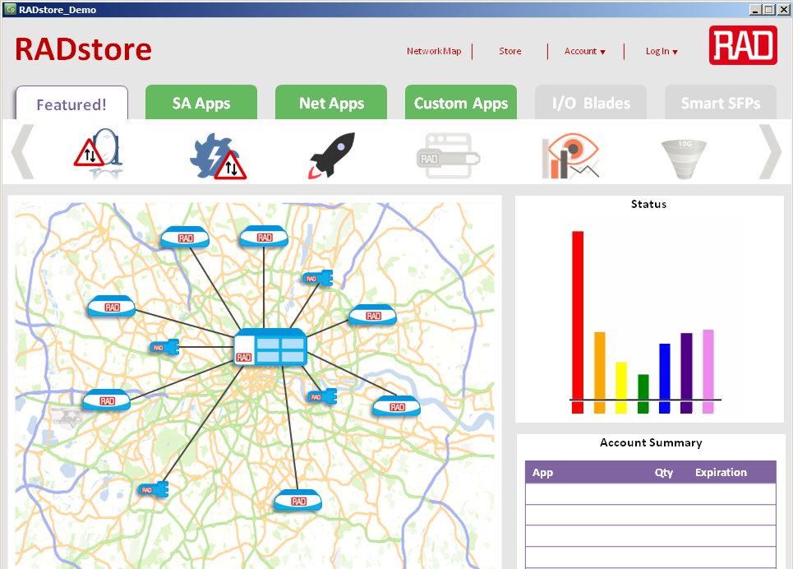
RAD D-NFV : RADstore
RADstore is a web-based graphical platform for network administrators
that enables purchasing virtual functions from RAD
RADstore can download to servers, D-NFV VMs in NIDs or D-NFV VMs in SFPs
RADstore downloads, chains, installs, activates, and manages the virtual functions
RADstore can also provide virtual non-networking functions and hardware

Slide 59
Is NFV a new idea ?
Virtualization has been used in networking before, for example
VLAN and VRF – virtualized L2/L3 infrastructure
Linux router – virtualized forwarding element on Linux platform
But these are not NFV as presently envisioned
Possibly the first real virtualized function is the Open Source network element :
Open vSwitch
Open Source (Apache 2.0 license) production quality virtual switch
extensively deployed in datacenters, cloud applications, …
switching can be performed in SW or HW
now part of Linux kernel (from version 3.3)
runs in many VMs
broad functionality (traffic queuing/shaping, VLAN isolation, filtering, …)
supports many standard protocols (STP, IP, GRE, NetFlow, LACP, 802.1ag)
now contains SDN extensions (OpenFlow)

Slide 60
Potential VNFs
OK, so we can virtualize a basic switch – what else may be useful ?
Potential Virtualized Network Functions
switching elements: Ethernet switch, Broadband Network Gateway, CG-NAT, router
mobile network nodes: HLR/HSS, MME, SGSN, GGSN/PDN-GW, RNC, NodeB, eNodeB
residential nodes: home router and set-top box functions
gateways: IPSec/SSL VPN gateways, IPv4-IPv6 conversion, tunneling encapsulations
traffic analysis: DPI, QoE measurement
QoS: service assurance, SLA monitoring, test and diagnostics
NGN signalling: SBCs, IMS
converged and network-wide functions: AAA servers, policy control, charging platforms
application-level optimization: CDN, cache server, load balancer, application accelerator
security functions: firewall, virus scanner, IDS/IPS, spam protection

Slide 61
NFV deployments and PoCs
Open vSwitch widely deployed in DCs
Colt has partnered with Juniper to deliver a virtual L3 CPE
Telefonica is partnering with NEC in a migration scenario study
to virtualize IP edge network elements
BT 2012 BRAS and CDN PoC
COTS HP BladeSystem with 10GbE interfaces
WindRiver hypervisor, Linux , home-made BRAS, commercial CDN
Price/performance close to dedicated hardware
BT/Intel 2013 H-QoS PoC
2x Intel Xeon 8-core @2.7GHz, 20MB L3 cache, 32 GB DDR3 , X520-SR2 Dual Port 10GbE Controller
Fedora r6 , Intel DPDK 1.4
Implemented a Hierarchical scheduler with:
5 levels, 64K queues, traffic shaping, strict priority and weighted round robin
Performance per core close to 10 Gb line rate for 64B packets (13.3 Mpps)

Slide 62
NFV ISG
An Industry Specifications Group (ISG) has been formed under ETSI to study NFV
ETSI is the European Telecommunications Standards Institute with >700 members
Most of its work is performed in Technical Committees, but there are also ISGs
Open Radio equipment Interface (ORI)
Autonomic network engineering for the self-managing Future Internet (AFI)
Mobile Thin Client Computing (MTC)
Identity management for Network Services (INS)
Measurement Ontology for IP traffic (MOI)
Quantum Key Distribution (QKD)
Localisation Industry Standards (LIS)
Information Security Indicators (ISI)
Open Smart Grid (OSG)
Surface Mount Technique (SMT)
Low Throughput Networks (LTN)
Operational energy Efficiency for Users (OEU)
Network Functions Virtualisation (NFV)
NFV now has 55 members (ETSI members)
and 68 participants (non-ETSI members, including RAD)

Slide 63
NFV ISG (cont.)
Members
Acme Packet, Allot, Amdocs, AT&T, ALU, Benu Networks, Broadcom, BT, Cablelabs, Ceragon, Cisco, Citrix, DT,
DOCOMO, ETRI, FT, Fraunhofer FOKUS, Freescale, Fujitsu Labs, HP, Hitachi, Huawei, IBM, Intel, Iskratel, Italtel, JDSU,
Juniper, KT, MetraTech, NEC, NSN, NTT, Oracle, PT, RadiSys, Samsung, Seven Principles, Spirent, Sprint, Swisscom,
Tektronix, TI, Telefon Ericsson, Telefonica, TA, Telenor, Tellabs, UPRC, Verizon UK, Virtela, Virtual Open Systems,
Vodafone Group, Yokogawa, ZTE
Participants
ADVA, AEPONYX, Affirmed Networks, ARM, Brocade, Cavium, CenturyLink, China Mobile, Ciena, CIMI, Colt,
Connectem, ConteXtream, Cyan, DELL, DESS, Dialogic, Embrane, EMC, EnterpriseWeb, EANTC,
Everything Everywhere, F5 Networks, Genband Ireland, IDT Canada, Infinera, Intune Networks, IP Infusion, Ixia,
KDDI, Lancaster U, Layer123, LSI, Mellanox, Metaswitch, Mojatatu, Netronome, Netsocket, Noviflow,
Openwave Mobility, Overture, PeerApp, Plexxi, PMC Sierra, Qosmos, RAD Data, Red Hat, Radware, Saisei Networks,
SCILD Communications, Shenick, SingTel Optus, SK Telecom, Softbank Telecom, Sunbay, Symantec, Tail-f, Tekelec,
Telco Systems, Telstra, Tieto Sweden, Tilera, Ulticom, Visionael, VMware, Windstream, Wiretap Ventures, 6WIND
Working and expert groups
Architecture of the Virtualisation Infrastructure (INF)
Management & Orchestration (MANO)
Performance & Portability Expert Group (PER)
Reliability & Availability (REL)
Security Expert Group (SEC)
Software Architecture (SWA)

Slide 64
NFV architecture
VNF
VNF
VNF
NFV infrastructure
NFV Orchestrator
NFV OS
VM
VM
VM
VNP
VNP
VNP
VM
image
hypervisor
net partitioner
NFV hardware
compute
storage
networking
special purpose

Slide 65
Hype and Doubts

Slide 66
Are SDN and NFV really solutions ?
Many in the industry seem to think so
VMware acquired Nicira for $1.26 billion
Cisco acquired Cariden for $141M and Meraki for $1.2B
Juniper acquired Contrail for $176m
In the OpenDaylight consortium many competitors, including
Brocade, Cisco, Citrix, Ericsson, IBM, Juniper, Microsoft , Redhat
NEC, Vmware
Adva, Arista, Ciena, Cyan, Dell, Fujitsu, Guavus, HP, Huawei, Inocybe, Intel, Nuage, Pantheon, Plexxi, Plumgrid, RADware, Versa
are working together and donating their work as Open Source
There have PoCs showing that showing that NFV is just around the corner
The reasoning is :
general purpose CPUs can not economically perform
the required network function right now
but, because of Moore’s law they will be able to do so soon

Slide 67
Doubts
On the other hand
there are some very good reasons that may lead us to doubt
that SDN and NFV will ever completely replace all networking technologies
The four most important (in my opinion) are :
Moore’s law vs. Butter’s law (NFV)
Consequences of SDN layer violations
CAP theorem tradeoffs (SDN)
Scalability of SDN

Slide 68
Moore’s law vs. Butter’s law
Moore’s law is being interpreted to state
computation power is doubling per unit price about every two years
However, this reasoning neglects Butter’s Law that states
optical transmission speeds are doubling every nine months
So, if we can’t economically perform the function in NFV now
we may be able to perform it at today’s data-rates next year
But we certainly won’t be able to perform it at the required data-rates !
The driving bandwidth will increase faster than Moore’s law, due to
increased penetration of terminals (cellphones, laptops)
increased number of data-hungry apps on each terminal

Slide 69
SDN layer violations
SDN’s main tenet is that packet forwarding is a computational problem
receive packet
observe fields
apply algorithm(classification, decision logic)
optionally edit packet
forward or discard packet
In principle an SDN switch could do any computation on any fields
for example forwarding could depend on an arbitrary function of
packet fields (MAC addresses, IP addresses, TCP ports, L7 fields, …)
While conventional network elements are limited to their own scope
Ethernet switches look at MAC addresses + VLAN, but not IP and above
routers look at IP addresses, but not at MAC or L4 and above
MPLS LSRs look at top of MPLS stack
A layer violation occurs when a NE observes / modifies a field outside its scope
(e.g., DPI, NATs, ECMP peaking under MPLS stack, 1588 TCs, …)

Slide 70
Consequences of layer violations
Client/server (G.80x) layering enables Service Providers
to serve a higher-layer SP
to be served by a lower-layer SP
Layer violations may lead to security breaches, such as :
billing avoidance
misrouting or loss of information
information theft
session highjacking
information tampering
Layer respect is often automatically enforced by network element functionality
A fully programmable SDN forwarding element creates layer violations
these may have unwanted consequences, due to :
programming bugs
malicious use

Slide 71
The CAP Theorem
There are three desirable characteristics of a distributed computational system
Consistency (get the same answer no matter which computational element responds)
Availability (get an answer without unnecessary delay)
Partition tolerance (get an answer even if there a malfunctions in the system)
The CAP (Brewer’s) theorem states that you can have any 2 of these, but not all 3 !
SDN teaches us that routing/forwarding packets is a computational problem
so a network is a distributed computational system
So networks can have at most 2 of these characteristics
Which characteristics do we need, and which can we forgo ?

Slide 72
CAP: the SP Network Choice
SPs pay dearly for lack of service
not only in lost revenues, but in SLA violation penalties
SP networks are designed for¹ :
high availability (five nines) and
high partition tolerance (50 millisecond restoration times)
So, consistency must suffer
black-holed packets (compensated by TTL fields, CV testing, etc.)
eventual consistency (but steady state may never be reached)
This is a conscious decision on the part of the SP
The precise trade-off is maintained by a judicious combination
of centralized management and distributed control planes
¹ This applies to services that have already been configured.
When commissioning a new service Availability is sacrificed instead
which is why service set-up is often a lengthy process.
CAP
X

Slide 73
CAP: the SDN Choice
SDN has emphasized consistency (perhaps natural for software proponents)
So such SDNs must forgo either availability or partition tolerance (or both)
Either alternative may rule out use of SDN in SP networks
Relying solely on a single¹ centralized controller
(which in communications parlance is a pure management system)
may lead to more efficient bandwidth utilization
but means giving up partition tolerance
However, there are no specific mechanisms to attain availability either !
Automatic protection switching needs to be performed quickly
which can not be handled by a remote controller alone²
X
CAP
¹ Using multiple collocated controllers does not protect against connectivity failures.
Using multiple non-collocated controllers requires synchronization, which can lead to low availability.
² There are solutions, such as triggering preconfigured back-up paths,
but present SDN protocols do not support conditional forwarding very well.

Slide 74
Scalability
In centralized protocols (e.g., NMS, PCE, SS7, OpenFlow)
all network elements talk with a centralized management system (AKA Godbox)
that collects information, makes decisions, and configures elements
In distributed protocols (e.g., STP, routing protocols)
each network element talks to its neighbors
and makes local decisions based currently available information
Distributed protocols are great at discovering connectivity
but are not best for more general optimization
Distributed protocols scale without limit
but may take a long time to completely converge (only eventual consistency)
Centralized protocols can readily solve complex network optimization problems
but as the number of network elements increases
the centralized element becomes overloaded
Dividing up the centralized element based on clustering network elements
is the first step towards a distributed system (BGP works this way)
We will return to scaling issues in the context of OpenFlow

Slide 75
OpenFlow

Slide 76
Open Networking Foundation
In 2011 the responsibility for OpenFlow was handed over to the ONF
ONF is both an SDO and a foundation for advancement of SDN
ONF objectives
to create standards to support an OpenFlow ecosystem
to position SDN/OF as the future or networking and support its adoption
raise awareness, help members succeed
educate members and non-members (vendors and operators)
ONF methods
establish common vocabulary
produce shared collateral
appearances
industry common use cases
The ONF Inherited OF 1.0 and 1.1 and standardized OF 1.2, 1.3.x, 1.4.x
It has also standardized of-config 1.0, 1.1, 1.2, of-notifications-framework-1.0
OF produces Open interfaces but not Open Source and does not hold IPR
but no license charges to all members, no protection for non-members

Slide 77
ONF structure
Management Structure
Board of Directors (no vendors allowed)
Executive Director (presently Dan Pitt, employee, reports to board)
Technical Advisory Group (makes recommendations not decisions, reports to board)
Working Groups (chartered by board, chair appointed by board)
Council of Chairs (chaired by executive director, forwards draft standards to board)
ONF Board members
Dan Pitt Executive Director
Nick McKeown Stanford University
Scott Shenker UC Berkeley and ICSI
Deutsche Telecom AG
Facebook
Goldman Sachs
Google
Microsoft
NTT Communications
Verizon
Yahoo
run giant data centers

Slide 78
ONF groups
Working Groups
Architecture and Framework
Forwarding Abstraction
Northbound Interface (new)
Optical Transport (new)
Wireless and Mobile (new)
Configuration and Management
Testing and Interoperability
Extensibility
Migration
Market Education
Hybrid - closed
Discussion Groups
Carrier grade SDN
Security
L4-7
Skills Certification
Wireless Transport
Japanese

Slide 79
ONF members
6WIND,A10 Networks,Active Broadband Networks,ADVA Optical,ALU/Nuage,Aricent Group,Arista,
Big Switch Networks,Broadcom,Brocade,
Centec Networks,Ceragon,China Mobile (US Research Center),Ciena,Cisco,Citrix,CohesiveFT,Colt,Coriant,Cyan,
Dell/Force10,Deutsche Telekom,
Ericsson,ETRI,Extreme Networks,F5 / LineRate Systems, Facebook,Freescale,Fujitsu,
Gigamon,Goldman Sachs,Google, Hitachi,HP,Huawei,IBM,Infinera,Infoblox / FlowForwarding,
Intel,Intune Networks,IP Infusion,Ixia, Juniper Networks, KDDI,KEMP Technologies,Korea Telecom,
Lancope,Level 3 Communications,LSI,Luxoft,
Marvell,MediaTek,Mellanox,Metaswitch Networks, Microsoft,Midokura,
NCL,NEC,Netgear,Netronome,NetScout Systems,NSN,NoviFlow,NTT Communications,
Optelian,Oracle,Orange,Overture Networks,
PICA8,Plexxi Inc.,Procera Networks, Qosmos,
Rackspace,Radware,Riverbed Technology,
Samsung, SK Telecom,Spirent,Sunbay,Swisscom,
Tail-f Systems,Tallac,Tekelec,Telecom Italia,Telefónica, Tellabs,Tencent,
Texas Instruments,Thales,Tilera,TorreyPoint,Transmode,Turk Telekom/Argela,TW Telecom,
Vello Systems,Verisign,Verizon,Virtela,VMware/Nicira, Xpliant, Yahoo, ZTE Corporation

Slide 80
OpenFlow
The OpenFlow specifications describe
the southbound protocol between OF controller and OF switches
the operation of the OF switch
The OpenFlow specifications do not define
the northbound interface from OF controller to applications
how to boot the network
how an E2E path is set up by touching multiple OF switches
how to configure or maintain an OF switch (see of-config)
The OF-CONFIG specification defines
a configuration and management protocol between
OF configuration point and OF capable switch
configures which OpenFlow controller(s) to use
configures queues and ports
remotely changes port status (e.g., up/down)
configures certificates
switch capability discovery
configuration of tunnel types (IP-in-GRE, VxLAN )
OF
OF
OF
OF
switch
OF
switch
NB for Open vSwitch OVSDB (RFC 7047) can also be used
OF
switch
OF-CONFIG
OF capable switch

Slide 81
OF matching
The basic entity in OpenFlow is the flow
A flow is a sequence of packets
that are forwarded through the network in the same way
Packets are classified as belonging to flows
based on match fields (switch ingress port, packet headers, metadata)
detailed in a flow table (list of match criteria)
Only a finite set of match fields is presently defined
and an even smaller set that must be supported
The matching operation is exact match
with certain fields allowing bit-masking
Since OF 1.1 the matching proceeds in a pipeline
Note: this limited type of matching is too primitive
to support a complete NFV solution
(it is even too primitive to support IP forwarding, let alone NAT, firewall ,or IDS!)
However, the assumption is that DPI is performed by the network application
and all the relevant packets will be easy to match

Slide 82
OF flow table
match fields
actions
counters
flow entry
match fields
actions
counters
match fields
actions
counters
flow miss entry
actions
counters
The flow table is populated only by the controller
The incoming packet is matched by comparing to match fields
For simplicity, matching is exact match to a static set of fields
If matched, actions are performed and counters are updated
Entries have priorities and the highest priority match succeeds
Actions include editing, metering, and forwarding

Slide 83
OpenFlow 1.3 basic match fields
Switch input port
Physical input port
Metadata
Ethernet DA
Ethernet SA
EtherType
VLAN id
VLAN priority
IP DSCP
IP ECN
IP protocol
IPv4 SA
IPv4 DA
IPv6 SA
IPv6 DA
TCP source port
TCP destination port
UDP source port
UDP destination port
SCTP source port
SCTP destination port
ICMP type
ICMP code
ARP opcode
ARP source IPv4 address
ARP target IPv4 address
ARP source HW address
ARP target HW address
IPv6 Flow Label
ICMPv6 type
ICMPv6 code
Target address for IPv6 ND
Source link-layer for ND
Target link-layer for ND
IPv6 Extension Header pseudo-field
MPLS label
MPLS BoS bit
PBB I-SID
Logical Port Metadata (GRE, MPLS, VxLAN)
bold match fields MUST be supported

Slide 84
OpenFlow Switch Operation
There are two different kinds of OpenFlow compliant switches
OF-only all forwarding is based on OpenFlow
OF-hybrid supports conventional and OpenFlow forwarding
Hybrid switches will use some mechanism (e.g., VLAN ID ) to differentiate
between packets to be forwarded by conventional processing
and those that are handled by OF
The switch first has to classify an incoming packet as
conventional forwarding
OF protocol packet from controller
packet to be sent to flow table(s)
OF forwarding is accomplished by a flow table or since 1.1 flow tables
An OpenFlow compliant switch must contain at least one flow table
OF also collects PM statistics (counters)
and has basic rate-limiting (metering) capabilities
An OF switch can not usually react by itself to network events
but there is a group mechanism that can be used for limited reaction to events

Slide 85
OF 1.1+ pipeline
Each OF flow table can match multiple fields
So a single table may require
ingress port = P and
source MAC address = SM and destination MAC address = DM and
VLAN ID = VID and EtherType = ET and
source IP address = SI and destination IP address = DI and
IP protocol number = P and
source TCP port = ST and destination TCP port = DT
This kind of exact match of many fields is expensive in software
but can readily implemented via TCAMs
OF 1.0 had only a single flow table
which led to overly limited hardware implementations
since practical TCAMs are limited to several thousand entries
OF 1.1 introduced multiple tables for scalability
ingress
port
Eth
DA
Eth
SA
VID
ET
IP
SA
IP
DA
IP
pro
TCP
SP
TCP
DP

Slide 86
OF 1.1+ flow table operation
flow table
0
flow table
1
…
flow table
n
packet
in
action
set
packet
out
Table matching
each flow table is ordered by priority
highest priority match is used (match can be made “negative” using drop action)
matching is exact match with certain fields allowing bit masking
table may specify ANY to wildcard the field
fields matched may have been modified in a previous step
Although the pipeline was introduced for scalability
it gives more expressibility to OF matching syntax (although no additional semantics)
In addition to the verbose
if (field1=value1) AND (field2=value2) then …
if (field1=value3) AND (field2=value4) then …
it is now possible to accommodate
if (field1=value1) then if (field2=value2) then …
else if (field2=value4) then …

Slide 87
Unmatched packets
What happens when no match is found in the flow table ?
A flow table may contain a flow miss entry
to catch unmatched packets
The flow miss entry must be inserted by the controller just like any other entry
it is defined as wildcard on all fields, and lowest priority
The flow miss entry may be configured to :
discard packet
forward to subsequent table
forward (OF-encapsulated) packet to controller
use “normal” (conventional) forwarding (for OF-hybrid switches)
If there is no flow miss entry
the packet is by default discarded
but this behavior may be changed via of-config

Slide 88
OF switch ports
The ports of an OpenFlow switch can be physical or logical
The following ports are defined :
physical ports (connected to switch hardware interface)
logical ports connected to tunnels (tunnel ID and physical port are reported to controller)
ALL output port (packet sent to all ports except input and blocked ports)
CONTROLLER packet from or to controller
TABLE represents start of pipeline
IN_PORT output port which represents the packet’s input port
ANY wildcard port
LOCAL optional – switch local stack for connection over network
NORMAL optional port sends packet for conventional processing (hybrid switches only)
FLOOD output port sends packet for conventional flooding

Slide 89
Instructions
Each flow entry contains an instruction set to be executed upon match
Instructions include
Metering : rate limit the flow (may result in packet being dropped)
Apply-Actions : causes actions in action list to be executed immediately
(may result in packet modification)
Write-Actions / Clear-Actions : changes action set associated with packet
which are performed when pipeline processing is over
Write-Metadata : writes metadata into metadata field associated with packet
Goto-Table : indicates the next flow table in the pipeline
if the match was found in flow table k
then goto-table m must obey m > k

Slide 90
Actions
OF enables performing actions on packets
output packet to a specified port
drop packet (if no actions are specified)
apply group bucket actions (to be explained later)
overwrite packet header fields
copy or decrement TTL value
push or pop push MPLS label or VLAN tag
set QoS queue (into which packet will be placed before forwarding)
Action lists are performed immediately upon match
actions are accumulatively performed in the order specified in the list
particular action types may be performed multiple times
further pipeline processing is on modified packet
Action sets are performed at the end of pipeline processing
actions are performed in order specified in OF specification
actions can only be performed once
mandatory to support
optional to support

Slide 91
Meters
OF is not very strong in QoS features, but does have a metering mechanism
A flow entry can specify a meter, and the meter measures and limits the aggregate rate of all flows to which it is attached
The meter can be used directly for simple rate-limiting (by discarding)
or can be combined with DSCSP remarking for DiffServ mapping
Each meter can have several meter bands
if the meter rate surpasses a meter band, the configured action takes place
Possible actions are
drop
increase DSCP drop precedence

Slide 92
OpenFlow statistics
OF switches maintain counters for every
flow table
flow entry
port
queue
group
group bucket
meter
meter band
Counters are unsigned and wrap around without overflow indication
Counters may count received/transmitted packets, bytes, or durations
See table 5 of the OF specification for the list of mandatory and optional counters

Slide 93
Flow removal and expiry
Flows may be explicitly deleted by the controller at any time
However, flows may be configured with finite lifetimes
and are automatically removed upon expiry
Each flow entry has two timeouts
hard_timeout : if non-zero, the flow times out after X seconds
idle_timeout : if non-zero, the flow times out
after not receiving a packet for X seconds
When a flow is removed for any reason,
there is flag which requires the switch to inform the controller
that the flow has been removed
the reason for its removal (expiry/delete)
the lifetime of the flow
statistics of the flow

Slide 94
Groups
Groups enable performing some set of actions on multiple flows
thus common actions can be modified once, instead of per flow
Groups also enable additional functionalities, such as
replicating packets for multicast
load balancing
protection switch
Group operations are defined in group table
Group tables provide functionality not available in flow table
While flow tables enable dropping or forwarding to one port
group tables enable (via group type) forwarding to :
a random port from a group of ports (load-balancing)
the first live port in a group of ports (for failover)
all ports in a group of ports (packet replicated for multicasting)
Action buckets are triggered by type:
All execute all buckets in group
Indirect execute one defined bucket
Select (optional) execute a bucket (via round-robin, or hash algorithm)
Fast failover (optional) execute the first live bucket
ID
type
counters
action buckets

Slide 95
Slicings
Network slicing
Network can be divided into isolated slices
each with different behavior
each controlled by different controller
Thus the same switches can treat different packets in completely different ways
(for example, L2 switch some packets, L3 route others)
Bandwidth slicing
OpenFlow supports multiple queues per output port
in order to provide some minimum data bandwidth per flow
This is called slicing since it provides a slice of the bandwidth to each queue
Queues may be configured to have :
given length
minimal/maximal bandwidth
other properties

Slide 96
OpenFlow protocol packet format
OF runs over TCP (optionally SSL for secure operation) using port 6633
and is specified by C structs
OF is a very low-level specification (assembly-language-like)
Ethernet header
IP header (20B)
TCP header with destination port 6633 (20B)
Version (1B)
0x01/2/3/4
Type (1B)
Length (2B)
OpenFlow
Transaction ID (4B)
Type-specific information

Slide 97
OpenFlow messages
The OF protocol was built to be minimal and powerful (like x86 instruction set ☺)
and indeed it is low-level assembly language-like
There are 3 types of OpenFlow messages :
OF controller to switch
populates flow tables which SDN switch uses to forward
request statistics
OF switch to controller (asynchronous messages)
packet/byte counters for defined flows
sends packets not matching a defined flow
Symmetric messages
hellos (startup)
echoes (heartbeats, measure control path latency)
experimental messages for extensions

Slide 98
OpenFlow message types
Symmetric messages
0 HELLO
1 ERROR
2 ECHO_REQUEST
3 ECHO_REPLY
4 EXPERIMENTER
Switch configuration
5 FEATURES_REQUEST
6 FEATURES_REPLY
7 GET_CONFIG_REQUEST
8 GET_CONFIG_REPLY
9 SET_CONFIG
Asynchronous messages
10 PACKET_IN = 10
11 FLOW_REMOVED = 11
12 PORT_STATUS = 12
Controller command messages
13 PACKET_OUT
14 FLOW_MOD
15 GROUP_MOD
16 PORT_MOD
17 TABLE_MOD
Multipart messages
18 MULTIPART_REQUEST
19 MULTIPART_REPLY
Barrier messages
20 BARRIER_REQUEST
21 BARRIER_REPLY
Queue Configuration messages
22 QUEUE_GET_CONFIG_REQUEST
23 QUEUE_GET_CONFIG_REPLY
Controller role change request messages
24 ROLE_REQUEST
25 ROLE_REPLY
Asynchronous message configuration
26 GET_ASYNC_REQUEST
27 GET_ASYNC_REPLY
28 SET_ASYNC
Meters and rate limiters configuration
29 METER_MOD
Interestingly, OF uses a protocol version and TLVs for extensibility
These are 2 generic control plane mechanisms,
of the type that SDN claims don’t exist …

Slide 99
Session setup and maintenance
An OF switch may contain default flow entries to use
before connecting with a controller
The switch will boot into a special failure mode
An OF switch is usually pre-configured with the IP address of a controller
An OF switch may establish communication with multiple controllers in order
to improve reliability or scalability. The hand-over is managed by the controllers.
OF is best run over a secure connection (TLS/SSL),
but can be run over unprotected TCP
Hello messages are exchanged between switch and controller upon startup
hellos contain version number and optionally other data
Echo_Request and Echo_reply are used to verify connection liveliness
and optionally to measure its latency or bandwidth
Experimenter messages are for experimentation with new OF features
If a session is interrupted by connection failure
the OF switch continues operation with the current configuration
Upon re-establishing connection the controller may delete all flow entries

Slide 100
Bootstrapping
How does the OF controller communicate with OF switches
before OF has set up the network ?
The OF specification explicitly avoids this question
one may assume conventional IP forwarding to pre-exist
one can use spanning tree algorithm with controller as root,
once switch discovers controller it sends topology information
How are flows initially configured ?
The specification allows two methods
proactive (push) flows are set up without first receiving packets
reactively (pull) flows are only set up after a packet has been received
A network may mix the two methods
Service Providers may prefer proactive configuration
while enterprises may prefer reactive

Slide 101
Barrier message
In general an OD switch does not explicitly acknowledge receipt or execution of OF controller messages
Also, switches may arbitrarily reorder messages to maximize performance
When the order in which the switch executes messages is important
or an explicit acknowledgement is required
the controller can send a Barrier_Request message
Upon receiving a barrier request
the switch must finish processing all previously received messages
before executing any new messages
Once all old messages have been executed
the switch sends a Barrier_Reply message back to the controller

Slide 102
Scaling
Can OF architecture scale to large networks ?
Switch flows
Single TCAM-based table can handle 1000s of flows
With multiple tables, or use of switch fabric and memory for basic matching, this grows to 100s of thousands of flows per switch
Controller based on commercial server can handle
a single server processor can handle 100Gbps = 150 Mpps
which is enough to control many 1000s of switches
a single server can handle 1000s to 10,000s of TCP connections
So there is a limitation of about 10K switches per controller
The obvious solution is slicing to use multiple controllers, but
this is not (yet) specified in the OF specifications
it is not clear how to avoid coordination
since end-to-end paths need to be set up

Slide 103
What’s new in OF 1.4 ?
New TCP port number 6653 (obsoletes 6633 and 976)
More use of TLVs for extensibility
Support for optical ports
New error codes, change notifications, and more descriptive reasons
Mechanisms for handling tables becoming too full (vacancy event warning threshold passed, eviction to eliminate low-importance entries)
More support for multiple controllers (monitor changes caused by other controllers, event for controller master role changes)
Bundling mechanism to apply multiple OF messages as a single operation
Synchronized tables (two tables with same entries for dual access)
New PB UCA field

Slide 104
Alternatives to OpenFlow

Slide 105
OpenFlow Alternatives
Any protocol that can configure forwarding elements
can be considered an SDN southbound interface
Indeed many protocols other than OpenFlow have been so used
netconf (YANG)
ForCES
I2RS
SNMP
CLI scripts
PCEP
Router APIs
BGP
LISP (RFC 6830)
We will discuss a few of the less known options

Slide 106
ForCES background
A Network Element (e.g., router) has both control and forwarding elements
These elements conventionally
are co-located inside a physical box
look like a single entity to the outside world
communicate over internal interfaces (buses)
communicate using proprietary mechanisms
Forwarding and Control Element Separation IETF WG
standardizes a framework and information exchange between :
Control Elements (usually software running control/signaling protocols)
Forwarding Elements (usually hardware performing forwarding)
made of Logical Function Blocks (classifier, scheduler, shaper, IP LPM, MPLS stack processing, …)
The ForCES framework and protocol enable
CEs and FEs to be logically or physically separated
standardized protocol for communications between CEs and FEs
communications over IP (or other protocols) not just proprietary backplane
complex forwarding processing due to multiple LFBs per FE

Slide 107
To learn more
ForCES is developed in the IETF
The following are the most important references for our purposes :
RFC 3654 ForCES requirements
RFC 3746 ForCES framework
RFC 5810 ForCES protocols
RFC 5811 ForCES SCTP-Based Transport Mapping Layer
RFC 5812 ForCES Forwarding Element Model
RFC 6956 ForCES LFB library
draft-wang-forces-compare-openflow-forces

Slide 108
Why ForCES ?
In any case NEs are composed
of CEs (typical CPU + software)
and FEs (typically ASIC or network processors)
the ForCES architecture doesn’t change this
but clarifies, standardizes, and simplifies NE design
ForCES is a new NE architecture
the network stays the same (routing protocols, topology, …)
so it is an evolutionary improvement in networkingThe logical separation enables to separate the development of CEs and FEs
(thus accelerating innovation)
CEs and FEs can be separated at
blade level (in which case ForCES protocol replaces proprietary I/F) or
box level (which is a new option enabled by ForCES)

Slide 109
ForCES and SDN ?
ForCES changes the architecture of an NE, not of the network
The CE(s) and FE(s) continue to look like a single NE to the outside world
So what does this have to do with SDN ?
CE manages (inquire/configure/add/remove/modify) LFBs through the ForCES protocol
When one or more CEs (which can be considered SDN controllers)
control remote FE(s) (which can be considered NEs)
this can be used to achieve SDN
And the ForCES protocol can be an alternative to OpenFlow !

Slide 110
ForCES Architecture
A CE may control multiple FEs and an FE may be controlled by multiple CEs
CE and FE managers determine their associations (and capabilities)
and may be simply init files
The ForCES protocol runs on the F_{p} interface between CEs and FEs
CE → FE is a master/slave relationship
FEs can redirect packets to CE (e.g., router alert)
CEs and FEs can dynamically join/leave NE
F_{c}
CE
F_{r}
CE
CE manager
NE
F_{p}
F_{p}
F_{p}
FE manager
F_{f}
FE
FE
F_{i}
…
…

Slide 111
LFBs
Each LFB has conceptual input/output port(s), and performs a well-defined function
e.g., input packet, modify packet, generate metadata, output packet
LFBs belong to classes (formally modeled using XML syntax)
and there can be several LFBs of the same class in an FE
An FE is fully described by
FE-level attributes (e.g., capabilities)
LFBs it contains
LFB interconnect topology
RFC 6956 gives a library of useful standard LFBs, including :
Ethernet processing (EtherPHYCop, EtherMACIn, EtherClassifier, EtherEncap, EtherMACOut)
IP packet validation (IPv4Validator, IPv6Validator)
IP forwarding (IPv4UcastLPM, IPv4NextHop, IPv6UcastLPM ,IPv6NextHop)
CE – FE redirection (RedirectIn, RedirectOut)
General purpose (BasicMetadataDispatch, GenericScheduler)
Other generic LFBs handle QoS (shaping/policing), filtering(ACLs), DPI, security (encryption), PM (IPFLOW, PSAMP), and pure control/configuration entities
EtherPHYCop
EtherMACIn
EtherMACOut

Slide 112
ForCES Protocol
The ForCES protocol consists of 2 layers
Transport Mapping Layer (may be TCP/UDP or SCTP or …)
Presentation Layer (TLV-based CE-FE messaging)
and has 2 phases
Pre-association phase
Post-association phase (once CEs and FEs know their associations)
association setup stage
FE attempts to join previously configured CE
if granted – capabilities exchange
CE sends initial configuration
established stage (until association is torn down or connectivity is lost)
Messages:
Association (setup, setup response, teardown)
Configuration (config, config response)
Query (query, query response)
Event notification
Packet redirect
Heartbeat

Slide 113
ForCES protocol example
Association Setup Request
Association Setup Response
Query - capabilities
Association
Setup
Stage
Query Response
Query - topology
Query Response
Heartbeats
CE
FE
Config SET LFB_{n} attributes
Config Response
…
Query - LFB_{n} stats
Established
Stage
Query Response
…
Event notification

Slide 114
ForCES vs. OpenFlow
Both ForCES and OpenFlow assume separation of control and data planes
but ForCES assumes that both are present in an NE
while OpenFlow assumes a pure forwarding SDN switch
Both protocols enable configuration of forwarding elements
but OpenFlow replaces routing protocols with centralized knowledge
while ForCES assumes CEs participate in routing protocols
Both protocols are extensible by using TLVs
ForCES has nested TLVs, while OpenFlow is less extensible
OF runs only over TCP/IP while ForCES can run over alternative TMLs
An OpenFlow switch consists of a sequence of matching tables and a group table
tables are built on a TCAM concept
and don’t directly enable LPM, tries, range match, regular expressions, etc.
while ForCES allows arbitrary (real router) LFBs with arbitrary topology
and is thus capable of much more complex processing (NAT, ACLs, …)
Both architectures enable internal exchange of metadata

Slide 115
I2RS
Almost all NEs have some kind of CLI interface, a MIB interface,
and many have some API or programmatic interface
but these are mostly vendor-specific
Interface To the Routing System is an IETF WG is tasked to define
a programmatic, asynchronous, fast, interactive interface to the RS
allowing information, policies, and operational parameters
to be written to and read from the RS
With I2RS routing protocols still perform most tasks
but software network applications can rapidly modify routing parameters
based on policy, network events, ToD, application priorities, topology, …
I2RS will enable applications to
request and receive (e.g., topology) information from the RS
subscribe to targeted information streams or filtered/thresholded events
customize network behavior (while leveraging existing RS)
I2RS interacts with the RIB (not with the FIB)
and coexists with existing configuration and management interfaces

Slide 116
I2RS architecture
App
App
App
App
App
client can be
local
or
remote
to app
client can provide
access to a single
or multiple apps
client
client
client
client can access
single or multiple
agents
I2RS protocol
Agent 1
Agent 2
Routing
and
Signaling
Local
Config
Routing
and
Signaling
Local
Config
Dynamic
System
State
Static
System
State
Dynamic
System
State
Static
System
State
Routing Element 1
Routing Element 2

Slide 117
I2RS and SDN ?
I2RS is based on the existing routing infrastructure
So what does this have to do with SDN ?
Routing processes are usually co-located with local forwarding elements
but may not be
When not co-located, the RS compute routes and paths for data packets
and the forwarding is carried out somewhere else
Once again, this is essentially SDN
but a kind of hybrid SDN (working in parallel with routing protocols)
Typical apps using the I2RS interface will be management applications
enabling user applications with specific demands on network behavior
For example - I2RS may be used to solve service chaining problems
I2RS may also be used as a migration path to full SDN
an SDN controller can use I2RS protocol to
learn topology
directly program the RIB (for routers supporting I2RS)
indirectly program the RIB using routing protocols

Slide 118
PCE
PCE is an IETF WG that develops an architecture
for computation of MPLS/GMPLS p2p and p2mp Traffic Engineered LSPs
PCE held BOFs in 2004, and was chartered as a WG in 2005
The PCE architecture defines:
Path Computational Element – a computational element capable of computing a path (TE-LSP) obeying constraints based on the network graph
Path Computation Client – requests the PCE to perform path computation
PCE Protocol - runs between PCC and PCE
The PCE may be a NE or an external server, but in any case
participates in the IGP routing protocol
builds the Traffic Engineering Database
The PCE is assumed to be
omniscient – it knows the entire network topology (graph)
computationally strong – it can perform difficult optimizations
For further information
see RFCs 4655, 4657, 4674, 4927, 5088, 5089, 5376, 5394, 5440, 5441, …

Slide 119
PCEP
PCE(s) to be used by PCC can be statically configured,
or discovered through extensions to OSPF or IS-IS
PCEP runs over TCP (even open and keepalives) using port 4189
A PCEP session is opened between PCC and PCE
capabilities are advertised
parameters are negotiated
PCEP messaging is a based on the request/reply model
PCEP messages :
Open initiates PCEP session
Keepalive maintains session
PCReq PCC → PCE request for path computation
request details required bandwidth and other metrics
PCRep PCE → PCC reply (negative or list of computed paths)
PCNtf sent by PCE or PCC to notify of an event (e.g., PCE overloaded)
PCErr indication of protocol error
Close message to close PCEP session

Slide 120
PCE and SDN ?
PCE is an old add-on to the MPLS/GMPLS architecture
that enables configuration of TE LSPs
What does that have to do with SDN ?
An MPLS-TE network can be considered to be an SDN
MPLS LSRs are built with full separation of control and forwarding planes
LSR performs exact match on a single field in the packet header
LSR processing is simple – stack operation and forward
without routing protocols (e.g., MPLS-TP)
all paths are configured from a central site
PCEP can be considered the earliest SDN southbound protocol
PCE is an SDN controller plus the application logic for path computation
(one mechanism - Backward Recursive Path Computation – is specified)
PCE provides end-to-end paths (when requested)
PCC installs a received path specification

Slide 121
Segment routing
Cisco has developed a method for explicitly specifying paths
Variants are defined for MPLS and for IPv6
Segment routing is similar to source routing
but does not require option headers or any special forwarding processing
In the MPLS version, a large number (up to 20) of labels are prepended
These labels specify each link along the path
Each LSR reads the label and pops it off the stack
This behavior is implementable in existing LSRs
and only requires routing protocol changes (to advertise labels for links)
Segment routing solves the function chaining problem

Slide 122
Segment routing vs. SDN
SDN offers a solution to function chaining
but with SDN (e.g., OpenFlow) misconfigurations can impact existing traffic
and are not limited to the present flow
So a minor programming error can bring down a network
and deliberate attacks are even worse!
With segment routing, the impact of any misconfiguration is limited to that flow
and does not affect pre-existing services.
Thus segment routing is a safer alternative to SDN for function chaining !

Slide 123
ALTO
Applications do not have access to (topology, preference, …) information
available in the routing system
Application-Layer Traffic Optimization is an IETF WG
that specifies how (peer-to-peer) applications can gain such access
An advantage of peer-to-peer is redundancy in information sources
but present systems have insufficient information to select among peers
Currently ALTO is used to provide information for Content Delivery Networks
The ALTO service provides abstract topology maps of a network
ALTO
defines a standard topology format
uses RESTful design
uses JSON encoding for requests and responses
ALTO provides a northbound interface from the network to applications

Slide 124
Other SDN languages
OpenFlow is a very low-level SDN protocol
it defines the interface to a single SDN switch
its constructs are hardware-driven (essentially configuring TCAMs)
direct use of OpenFlow is very error-prone
OpenFlow has no software-engineering mechanisms
order is critical, subroutines are not possible
But there are alternatives
Frenetic if OpenFlow is like assembly language, frenetic is more like C
and it compiles to OpenFlow
Pyretic and Pyretic is like Python
Procera a declarative language based on functional reactive programming
Contrail (and now Open-Contrail) is another declarative SDN approach
Onyx a distributed SDN platform

Slide 125
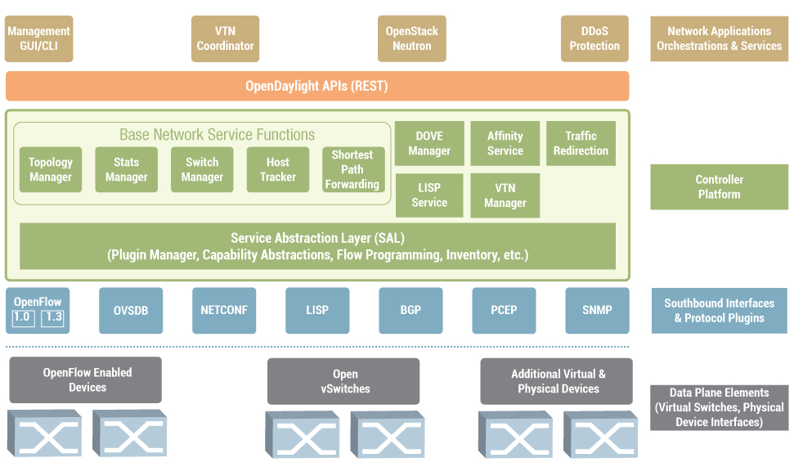
OpenDaylight
ODL merits a session of its own

Slide 126
OpenStack
OpenStack is an Infrastructure as a Service (IaaS) cloud computing platform
(Cloud Operating System)
It provides means to control/administer
compute, storage, network, and virtualization technologies
Managed by the OpenStack foundation, and all Open Source (Apache License)
OpenStack is actually a set of projects:
Compute (Nova) similar to Amazon Web Service Elastic Compute Cloud EC2
Object Storage (Swift) similar to AWS Simple Storage Service S3
Image Service (Glance)
Identity (Keystone)
Dashboard (Horizon)
Networking (Neutron ex-Quantum) manage virtual (overlay) networks
Block Storage (Cinder)
Telemetry (Ceilometer) monitoring, metering , collection of measurements
Orchestration (Heat)

