Slide 1
IPR and patents
Yaakov (J) Stein
CTO

Slide 2
Types of property
Real property
Personal property
Intellectual property (IPR)

Slide 3
Types of IPR
utility patents (inventions)
design patents (industrial designs)
copyrights
trademarks
trade secrets
trade dress (distinctive packaging)
publicity rights (of celebrities)
geographical indications (terroir, e.g., of wine)
database rights (EU)
...

Slide 4
Why IPR ?
IPR creates an artificial monopoly – why is this justified ?
utilitarian (economic) theory
promote innovation and incentivize progress in arts and sciences
labor desert theory
natural rights
Lockean proviso (there is enough left in common for others)
moral rights
Note that all forms of IPR are limited
in term
in jurisdiction
in scope

Slide 5
IPR law
Unauthorized use of someone else’s IPR is called infringement
Infringement may be the subject of civil law or criminal law
Infringement does not necessarily require knowledge
but willful infringement may be more serious (e.g., triple damages)
IPR rights
are always limited in time duration
are usually limited to a given jurisdiction
sometimes require registration and/or examination in a jurisdiction
There are ways to legally use someone else’s IPR
assignment
exclusive license
non-exclusive license
A license is an authorization/permission by the IPR owner
to exercise a privilege that otherwise would constitute infringement
License terms often involve payments ☹

Slide 6
Utility patents
promote progress in science and technology
rights are per jurisdiction
each country has national patent office (e.g. USPTO)
in EU - European Patent Organization (EP)
Paris convention
Patent Cooperation Treaty (PCT) - WIPO
grant exclusivity to inventor against infringement
making, using, selling, offering for sale, exporting
not against researching, drawing, thinking about
note - unlike copyright, infringement does not require copying
exclusivity is for a limited period of time
in US: 20 years from filing (once was 17 years from grant)
priority and first to file

Slide 7
Requirements
Utility
must be industrially/commercially useful
Novelty
must not be previously known/used/published/patented
in US, inventor may publish up to 1 year before application
elsewhere – no prior disclosure is allowed
applications are usually published after 18 months
Non-obviousness
to a person well versed in the art
once required creative spark
sufficiently different from existing knowledge
only real advances are awarded patents

Slide 8
Why patent ?
There are many reasons to apply for a patent
offensive
licensing and royalties
monopoly vs. freedom to operate
protect market share
NPE (trolls)
defensive
balance of fear
valuation
IPR is a significant fraction of value of technology companies
>80% of value of S&P500 companies is intangible
issued patents may add 1M$ to company value upon acquisition

Slide 9
What can be patented?
Given Utility, Novelty, and Non-obviousness
the following types of inventions can be patented
machines (man-made products)
processes (including some algorithms)
In the US, the machine or transformation test was often used
is the invention implemented by a particular machine ?
does the invention transform an article from one state to another ?

Slide 10
What can not be patented?
Some examples :
abstract ideas
natural phenomena, law of nature, scientific theories
mathematical facts and methods
methods for performing purely mental acts
computer programs
presentations of information
purely aesthetic creations (literary works, music compositions)
forms of energy
naturally occurring genetic material (DNA sequences)

Slide 11
Software
Algorithms may be protected by patents
Databases may be protected (in the EU) by the database directive
Source code may be protected by copyrights
Some history (in the US) will help explain …
1974 Commission on New Technological Uses of Copyrighted Works
decided that computer programs, to the extent that they embody
an author's original creation, are proper subject matter of copyright
1980 US Congress added computer program to copyright law
1983 Apple vs. Franklin: Court of Appeals decides that even object code
is subject to copyright
1986 Whelan v. Jaslow, Broderbund v. Unison: extended software copyright to
structure, organization, look-and-feel
1997 No Electronic Theft Act raises criminal penalties (even w/o monetary gain)
to 5 years + 250K$ + higher civil damages, closing the LaMacchia loophole

Slide 12
How much is a patent worth ?
Patents can be sold, so patents have monetary value
How can this value be estimated ?
compare to price of similar patents recently sold
often hard to know, since price is frequently not released
A consortium is offering 1.3M$ for Orckit’s close to 200 patents – about $7.5K per patent.
IPOfferings LLC says that the average paid for issued US patent is $375K
Google acquired Motorola Mobility, essentially for its 17,000 patents, for $12.5B, i.e., about $735K per patent
Rockstar consortium (Apple/Ericsson/Microsoft/Sony) paid 4.5B$ for 6000 patents from bankrupt Nortel (easily trumping Google that bid a mere 900M$), i.e. $750k per patent!
how much is it worth to a NPE (troll)?
number of potential infringers
royalties (Georgia-Pacific factors)
how much is it worth to a PE?
save litigation costs (average $5M per suit)
save royalty payments
freedom to operate
technical valuation

Slide 13
Stages in patenting
The following need to be performed in each jurisdiction
Prior art search
in the US - you may want to file a provisional application
Drafting
Filing (from now on patent pending)
Publication (usually after 18 months)
Prosecution (office actions, final office action, RCE, appeals)
Allowance
Fees
Issuance (patent number)
Marking
Maintenance (periodic fees)
Expected expense to receive a US patent $10K-$20K
Expected expense to receive worldwide family coverage $50K-$100K
Yearly maintenance on a worldwide family $5K

Slide 14
Provisional patent applications
Since 1995, the US PTO allows filing a provisional application
Provisional applications
have lower fees
are simpler to prepare (do not even require claims)
do not require filing Information Disclosure Statements
capture a priority date
allow the filer to mark products patent pending
but
are never examined and thus never become patents
there is no such thing as a provisional patent !
only last for 1 year and can not be extended
all rights are lost if you don’t file a nonprovisional patent application
So, it is worthwhile filing a provisional patent applications
if you are unsure of the usefulness of the invention
if you are waiting for funding to develop the invention (and pay fees)

Slide 15
Where to file?
Patents are per jurisdiction
and each patent office has its own requirements
US
Canada
EPO – common examination, but need to file in each country!
PCT (Patent Cooperation Treaty) – no protection by itself!
Japan
China
To decide, consider
where are your competitors?
where are your customers?

Slide 16
Patent families
There are often many related patents in a family
similar patents in different jurisdictions
may be different due to different requirements and details of prosecution process in various patent offices
continuation
additional claims to previous patent
must be filed before issuance of original patent
divisional
distinct variant
often filed following examiner restriction relating to multiple inventions
must be filed before issuance of original patent
Continuation In Part
adds subject matter not in original patent
retains priority date (and term) of original patent
must be filed during lifetime of original patent

Slide 17
Format of US patent
First page
number, title, dates, inventors, assignee, search codes, references, credits, abstract, figure
Drawing sheets
Description
Background (including field of invention and prior art)
Summary
Brief description of drawings
Detailed description of preferred embodiment(s)
Claims
independent
dependent
claim language is not plain English

Slide 18
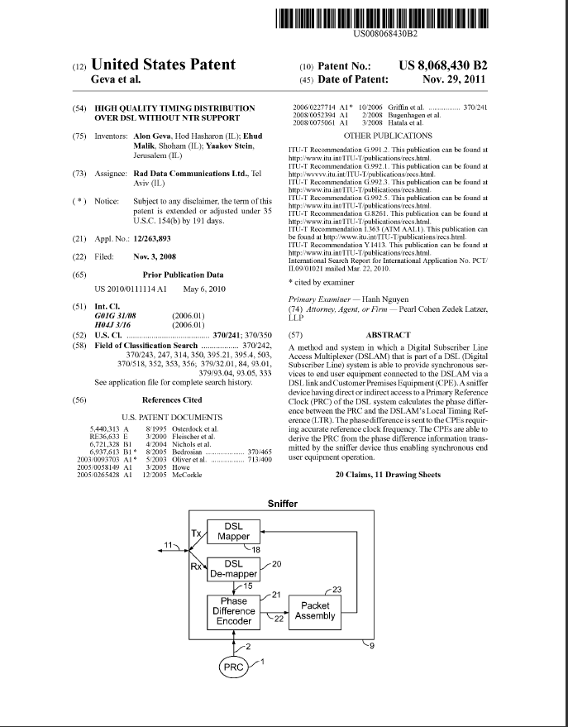
First page

Slide 19
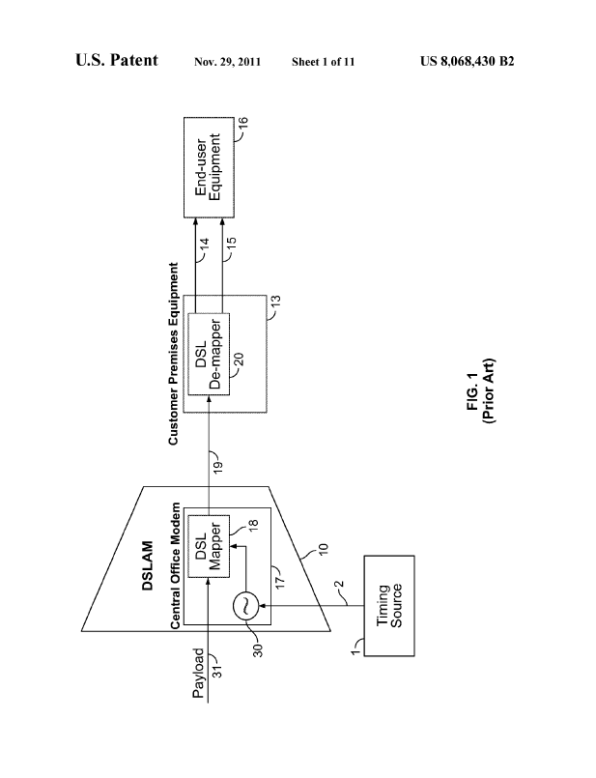
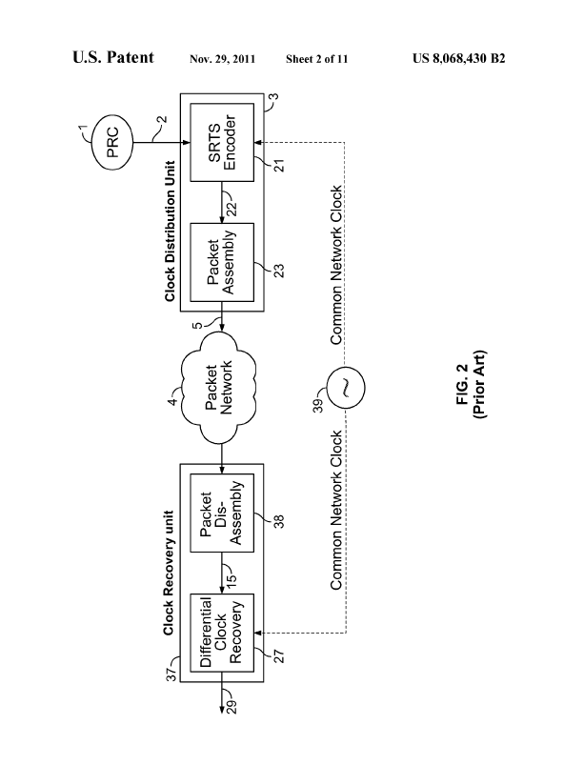
Drawing sheets
...

Slide 20
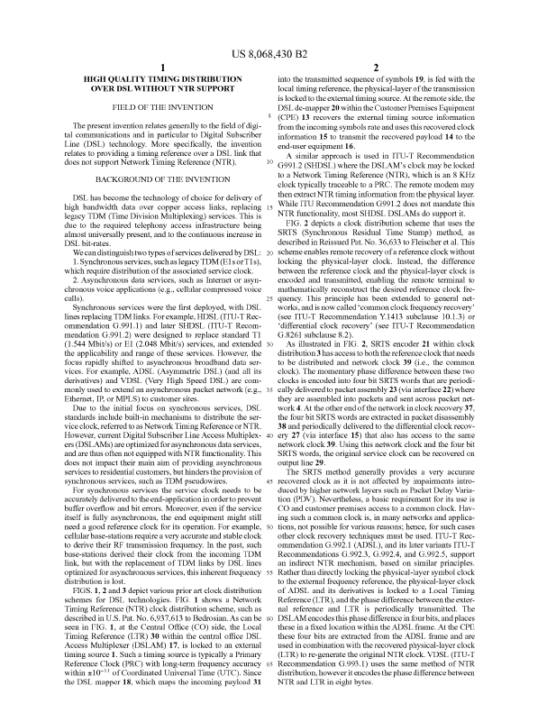
Description

Slide 21
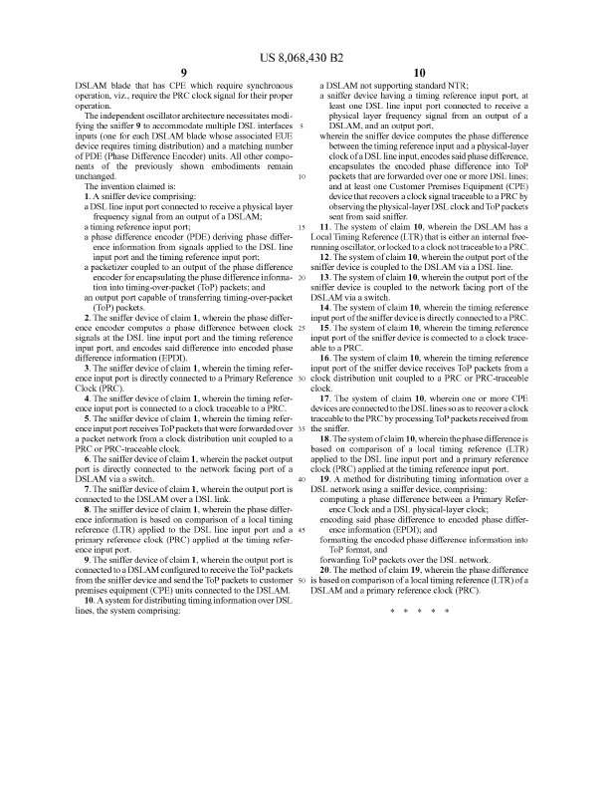
Claims
claims define the patent coverage
must define technical features
(description defines terms used)

Slide 22
Claim language
A claim consists of
Preamble
An apparatus, A device ...
A method ...
A system ...
... according to claim X
independent vs. dependent claims
Transitional phrase
comprising ...
having at least one ...
Limitations describing how desired result is achieved
Purpose (Optional) describing the invention’s goal
wherein ...
whereby ...

Slide 23
Claim types
There are many types of claims:
method/process/use claim
mathematical
computer-aided process
product/apparatus claim
system claim
means plus function
business method (Bilski, Alice)
Consider who will infringe
the end user
a competing vendor
a component manufacturer
Consider how infringement will be proven

Slide 24
Searching
Google patent search www.google.com/patents
US-PTO www.uspto.gov/patent
WIPO www.wipo.int/patents/en/
EPO Espacenet www.epo.org/searching/free/espacenet.html
EP patent wrappers register.epo.org/regviewer
US-PTO wrappers portal.uspto.gov/pair/PublicPair
Latest patents www.latestpatents.com/
IP marketplace www.ip-marketplace.org/
Note – many companies do not allow R&D to look at patents
in order to avoid willful infringement and triple damages

