Slide 1


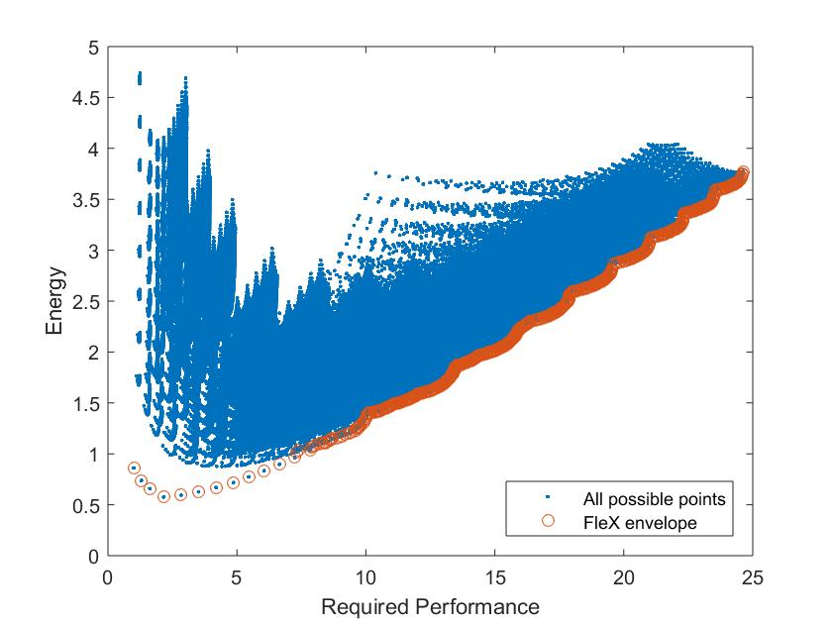
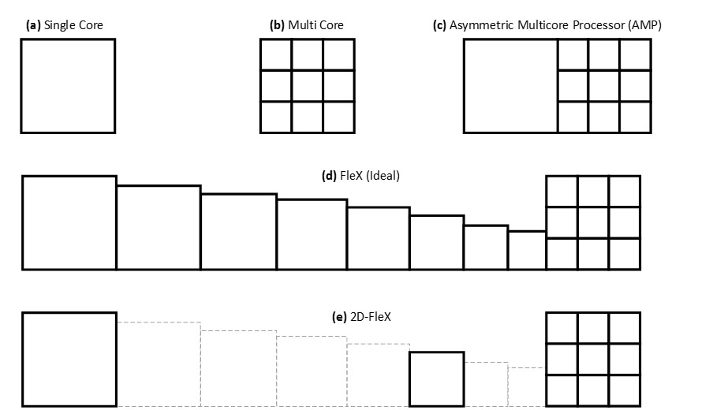

Multi-Core NFV Uri Weiser & Isaac Keslassy Technion – with ADVA
Energy minimization in asymmetric multi-core NFV
Obtained set of optimal points based on required performance
Many options for cores, frequencies, etc. → performance/energy tradeoff

Slide 2

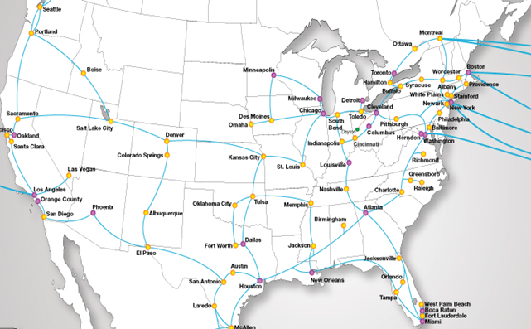








Efficient implementation of NFV in Heterogeneous Networks
Seffi Naor & Ariel Orda, Technion
SDN
Controller
Distributed Network
Functions (services) are implemented at various locations in the network
Traffic is routed to these servers using the control mechanism of SDN
given route
new route
Where to place services/functions?
Servers have bounded capacity
Opening cost for functions
Minimize detour distance of traffic routed to functions via new route
Generalizing classic facility location
Achievements
Novel NFV model
Efficient placement algorithms
O(1)-bicriteria approximation algs.
Improved experimental results
Extension to dynamic environments
PCE LTE TE
PDN-GW S-GW
SGSN/GGSN
SIP NAT RSVP
EPC
DPI

Slide 3
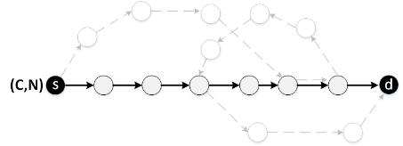
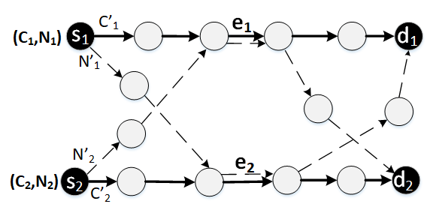
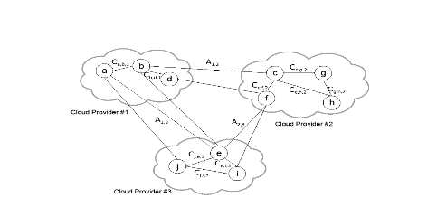
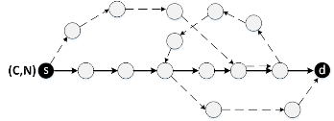

The Neptun SDN: Make&Activate-Before-Break.
Prof. Shlomi Dolev. Group. Daniel Khankin, Prof. Yefim Dinitz, Dr. Alexander Binun, Dr. Shimrit Tzur-David Department of Computer Science, Ben-Gurion University of the Negev
Cloudification
Given:
Network Functions (NFs) (e.g. computers, routers)
Several cloud providers (CPs) C1, C2, C3
Goal:
Assign NFs to CPs. A NF 𝑁 is virtualized by a NF 𝑁′
Constraints:
“Virtualization cost” is imposed by a cloud provider
Communication costs between cloud providers
Every cloud provider must be nonempty
If there is an edge between two NFs then there must be a edge between their “virtualized” counterparts
Route Replacement
Replace Routes Simultaneously
Dependencies between subroutes (e.g. launching a new subroute eliminates a certain sequence of other subroutes).
Replace Independent subroutes (C’₁ by N’₁, C’₂ by N’₂) simultaneously
Articles
S. Delaet, S. Dolev, D. Khankin, S. Tzur-David, and T. Godinger, “Seamless SDN Route Updates,” The 14th International Symposium on Network Computing and Applications (NCA), 2015
Y. Dinitz, S. Dolev, and D. Khankin, “Dependence Graph and Master Switch for Seamless Dependent Routes Replacement in SDN”, The 16th IEEE International Symposium on Network Computing and Applications, 2017
Yefim Dinitz, Shlomi Dolev, Daniel Khankin:
Make&Activate-Before-Break: Policy Preserving Seamless Routes Replacement in SDN. SIROCCO 2018: 34-37
Y.Dinitz, S.Dolev, S.Frenkel, A.Binun and D.Khankin. Network Cloudification. 3rd International Symposium on Cyber Security Cryptology and Machine Learning (CSCML 2019). Be'er Sheva, Israel June 27-28, 2019
Sylvie Delaët, Shlomi Dolev, Daniel Khankin, Shimrit Tzur-David:
Make&activate-before-break for seamless SDN route updates. Computer Networks 147: 81-97 (2018)
Prototypes
Cloudification:
Calculates optimal and suboptimal cloudification assignments
Demonstrates markers to virtualize an example network
Route Replacement
Simulator based on Mininet + POX
A network function emulated by a software running on a Mininet host
A network state is emulated by custom data
Given:
A pair of routes (grey=new route, solid-old route)
Goal: Seamlessly replace the old route by the new one
without packet losses, delays & congestions to be minimal
Main Idea: Common subroutes
Route and NF Replacement Verifying
1
2
3
4
Given:
Subroute (A,B) is replaced by a new subroute with the same endpoints.
Packet duplication at A begins from the packet #N. Next packets will be forwarded along both routes.
Algorithm
1. Packets <=#N are forwarded along the current route.
2. Duplicates of packets, with index >=#N are traversed along both current and new sub-routes. As packets arrive at a router along the new sub-route, the new NFs are initialized
3. The controller saves the last seen packet arrived along the current route. Denote the packet index as LS
4. Packets arrive at B via the new sub-route. The new subroute can be considered as operational.
5. Duplicates of already seen packets arriving along the new route are discarded and packets that were traversing along the old route are still forwarded.
6. When a packet arriving along the new route is subsequent
to LS, the current route is dismantled
Cloudification Assignment
Optimal:Integer Linear Programming (cvxpy, JavaILP)
Suboptimal:
Enumerate all assignments differing in one NF
as long as the cost is improved
until the cost slightly differs from the optimal
A subroute (s,t) is legitimate in C if s lies earlier than t in C
Algorithm Idea (replacing a route R by a new route R’):
Find all legitimate subroutes that are not common for R and R’; enumerating them from the end
For every legitimate routes in the enumeration:
Launch a legitimate sub-route N’ in R’ from a router r to r’ ; redirect the flow at r to the first link of N’
The current flow route goes along C from s to r, continues along N’ up to r’ and finishes along C from r’ to d.
Eventually: No cycle is created; the entire old route C from r to r’ is eliminated.
Seamless Launch of a Cloudified Net
New route R’= (Source’,Target’) is launched in cloud, mimicking an old route R=(Source,Target)
Markers are packets aimed at testing reachability
SDN controller sends marker M, obtains response R(M)
Source and destination of each flow almost would not feel any trouble from moving to cloud except for a small delay
Algorithm
SDN controller sends marker M from Source to Target and the marker M’ from Source’ to Target’
t
Packets sent along R are duplicated along R’
SDN controller sends marker M₁ from Source to Target and from Source’ to Target’
M₁ arrives at a NF N ∈ R => copy the state of N to N’
M₁ arrives at a NF N’ ∈ R’ => hold the incoming packets in buffer, release & process them before other packets when N’ obtains the state from N
M₁ arrives at a NF N ∈ R => cancel packet duplication along R and sends marker M₂ from Source to Target and the marker M’₂ from Source’ to Target’
M’₂ arrives at N’ => erase all packets with the timestamp preceding M₂
The SDN controller dismantles the original network
Idea:
All the information that pass across the cloud is information-theoretically secured.
Each participant is allocated a share of the secret,
Only a group of >=k participants reconstructs the secret
Application:
Secret: data to be sent.
Participants: different paths to the route destination .
No router sees k or more shares.
Only the destination at the public cloud that gets all the shares, can decrypt the data
When n > k, we allow n-k shares to get lost, due to congestion or even by malicious routers.
SDN Private hybrid cloud
Seamless launch of the new route
A new route is created and activated by duplicating packets along the corresponding portions of both new and old routes, without exceeding bandwidth demands on network links.
When the controller verifies the correct establishment and operation of the specific portion of the new route, the corresponding portion of the old route is removed.
Problem: Seamlessly redirect packets
Route Replacement Verification: several phases of sending markers to verify correctness of the new portion of a route and diverting packets
Future work
Self stabilizing SDN supporting seamless route replacement
Notes:
3
3
Add articles for Daniel, 2018, c4 2017
Route replacement –sequential, parallel and nfv
Replace
3

Slide 4
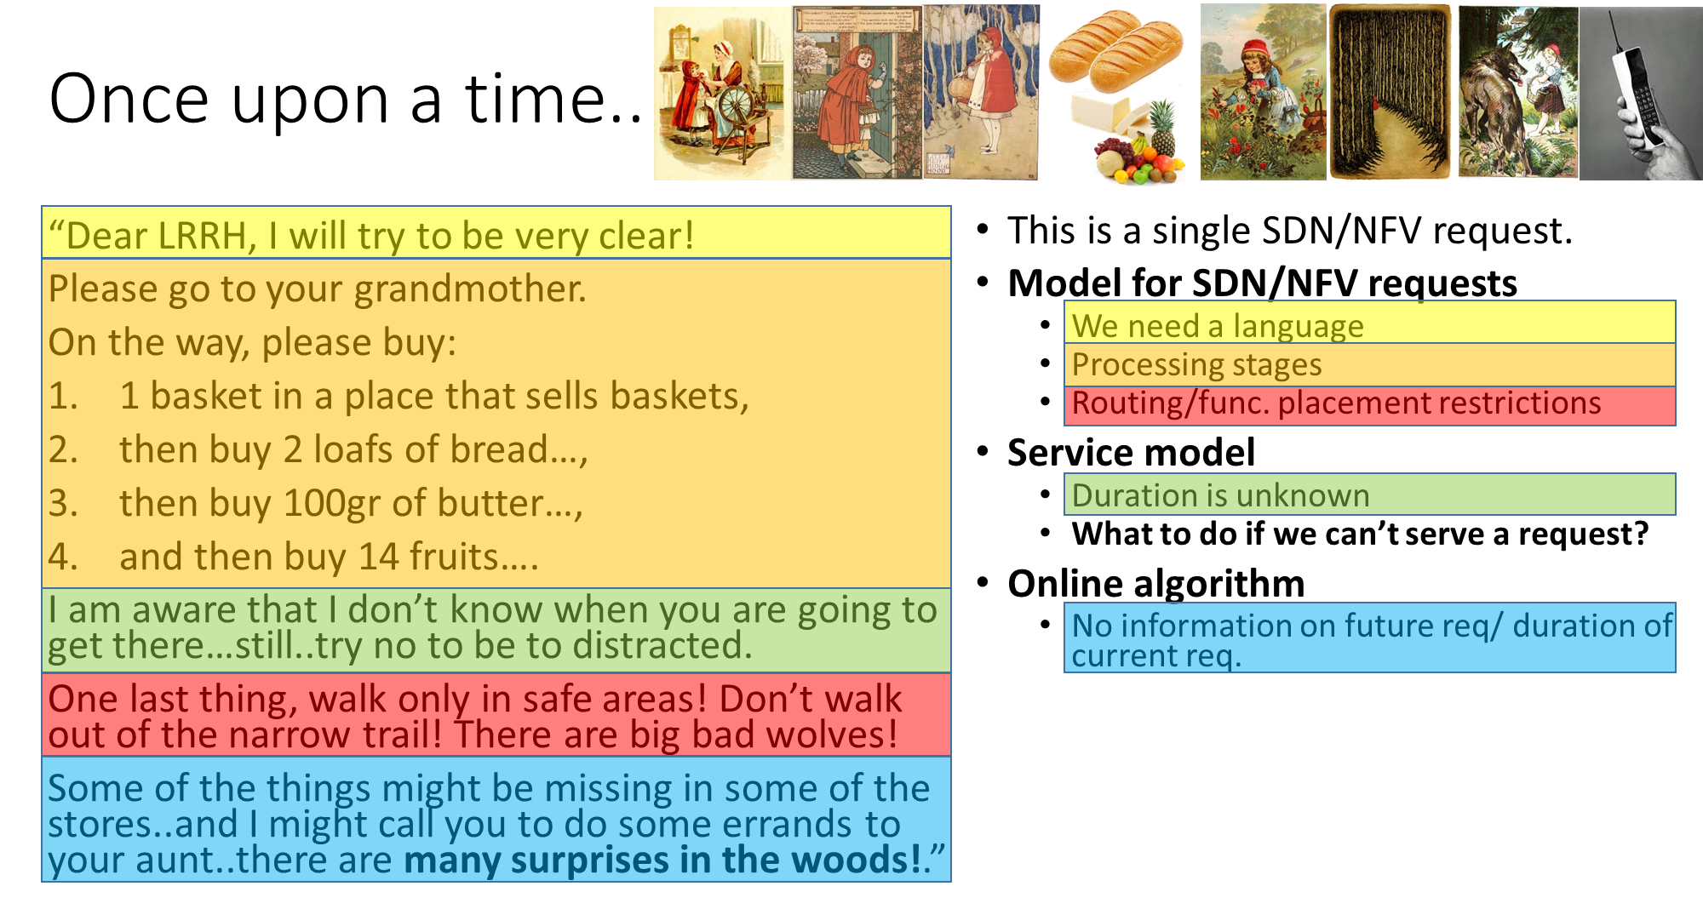

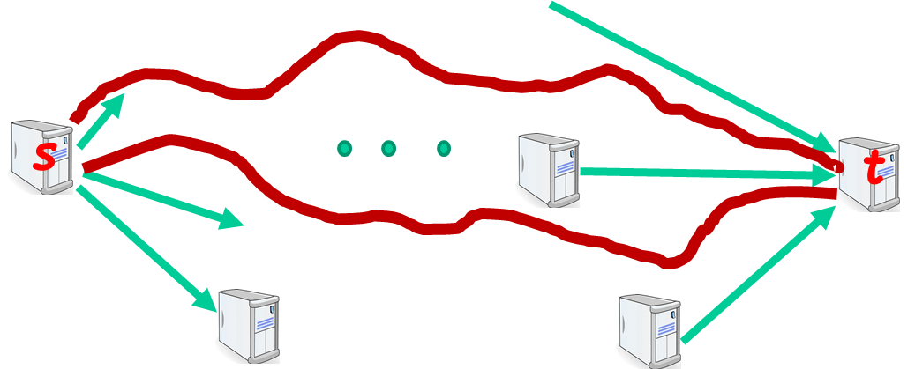

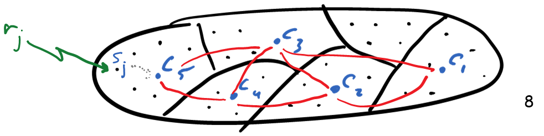
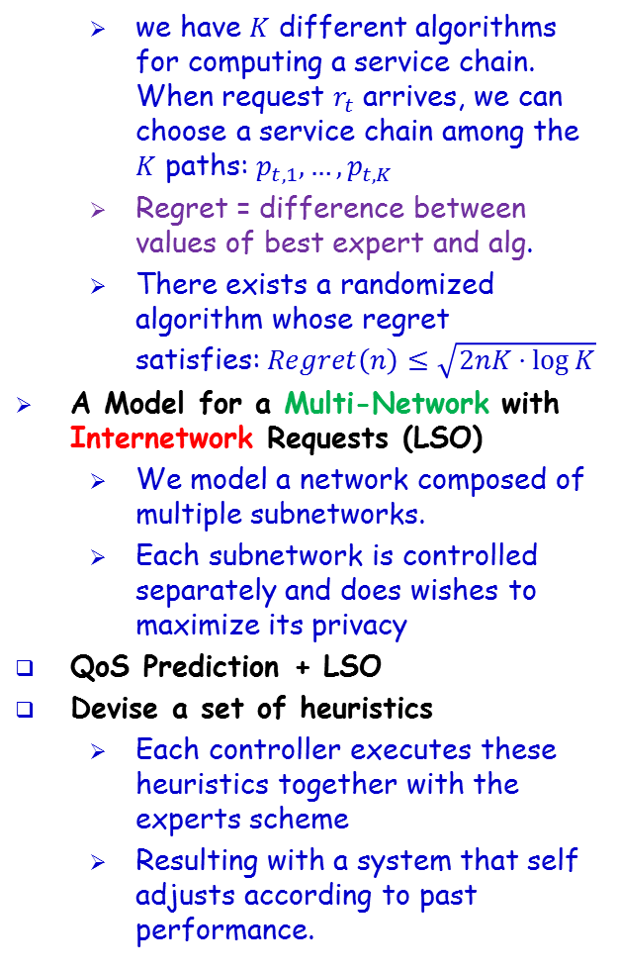
אלגוריתמים לתזמור משאבים ברשת מִתַּכְנֶתֶת Prof Guy Even, EE@TAU/Dr Moti Medina, ECE@BGU/Prof Boaz Patt-Shamir, EE@TAU/ Dr Dror Rawitz, EE@BIU with Dr Yaakov Stein @RAD
On-Line Path Computation and Function Placement in SDNs
Even, G., Medina, M, & Patt-Shamir. B.
Best paper award SSS 2016
Journal paper in Theory of Computing Systems
Online Fault Tolerant Service Chaining
Extended online alg to deal with 1+f routes
Lift restriction on k – the max number of functions along a service chain.
Obtain quasi-polynomial running time (running time is not exp in k)
Improved competitive ratio: from O(log n + log k) to O(log n)
Predicting QoS
Network elements do not report available capacity.
But, we do see the QoS of service chains that have been already assigned
we have $K$ different algorithms for computing a service chain. When request $r_{t}$ arrives, we can choose a service chain among the $K$ paths: $p_{t,1}, …, p_{t,K}$
Regret = difference between values of best expert and alg.
There exists a randomized algorithm whose regret satisfies:$Regret\left(n\right)≤\sqrt{2nK⋅\log{K}}$
A Model for a Multi-Network with Internetwork Requests (LSO)
We model a network composed of multiple subnetworks.
Each subnetwork is controlled separately and does wishes to maximize its privacy
QoS Prediction + LSO
Devise a set of heuristics
Each controller executes these heuristics together with the experts scheme
Resulting with a system that self adjusts according to past performance.

Slide 5






Wireless Controller Placement Problem
LTE-U-Heterogeneous Networks
Wi-Fi
Operator
LTE-U Operator
SouthBound interface

Slide 6
NFV: Location and Coordination Problems
Yuval Emek & Shay Kutten, Technion
Place NFs to optimize coverage
Minimize distances
max, average, p-norm
Minimize #NFs
Uncertain scenarios captured by probabilistic models
Probabilistic link delays
Distances are random variables
Minimize max, average, p-norm in expectation
Inter-SDNs
Demands in netwrok A can be served by NFs in network B
Probabilistic external NF locations
max, average, p-norm distance are random variables
Minimize expectation
Optimization problems are computationally intractable
Design efficient approximation algorithms
Publication: Efficient Job Dispatching in Emerging Clouds.
Shimon Bitton, Yuval Emek, and Shay Kutten.
INFOCOM 2018

Slide 7
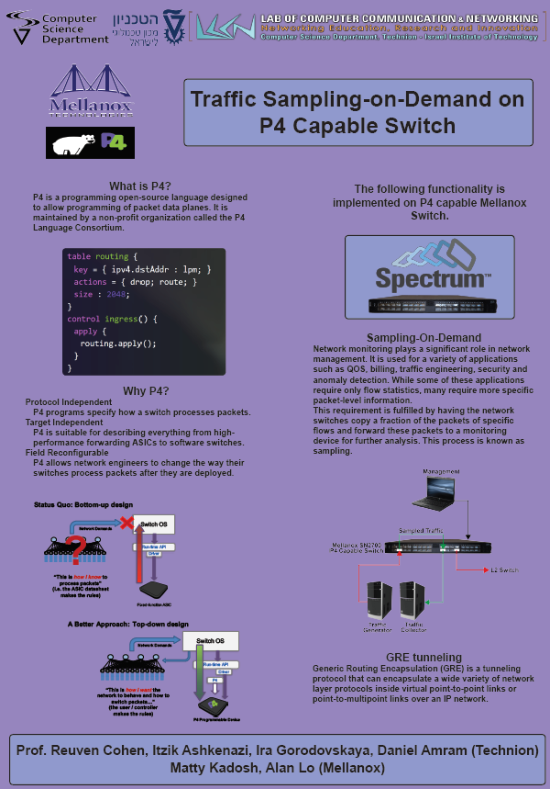

Slide 8
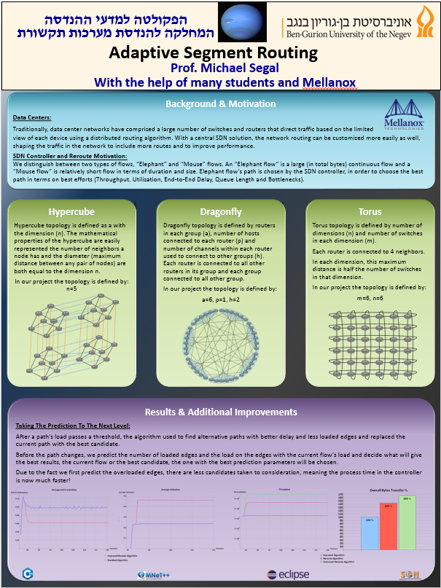

Slide 9
