Slide 1



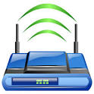


Wireless Controller Placement Problem
LTE-U-Heterogeneous Networks
Wi-Fi
Operator
LTE-U Operator
SouthBound interface

