Slide 1


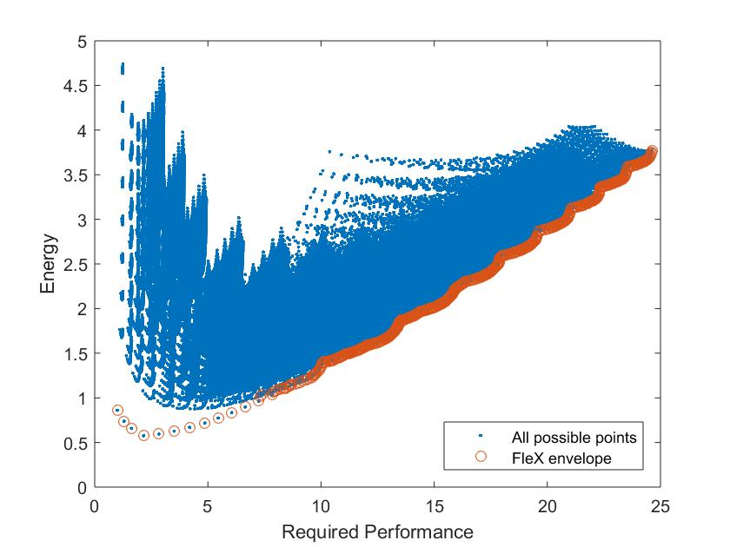
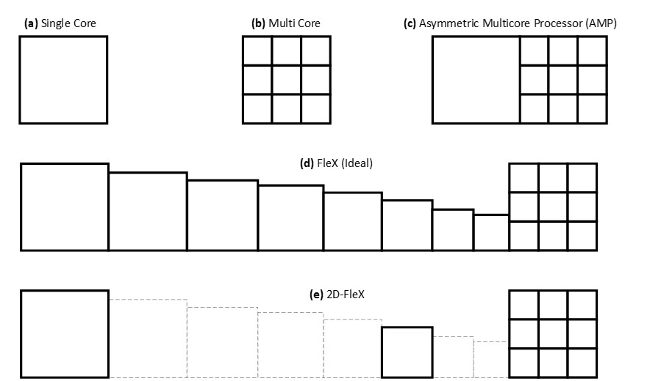

Multi-Core NFV Uri Weiser & Isaac Keslassy Technion – with ADVA
Energy minimization in asymmetric multi-core NFV
Obtained set of optimal points based on required performance
Many options for cores, frequencies, etc. → performance/energy tradeoff

