Slide 1
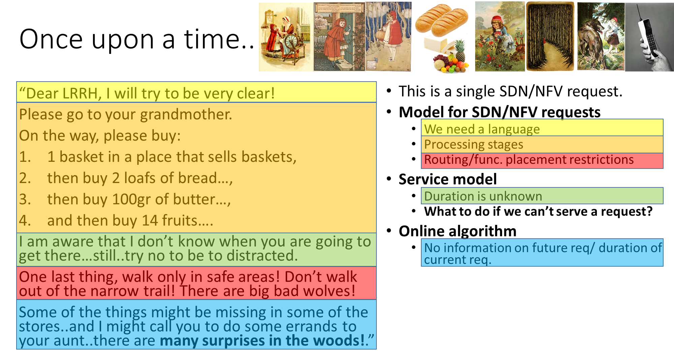

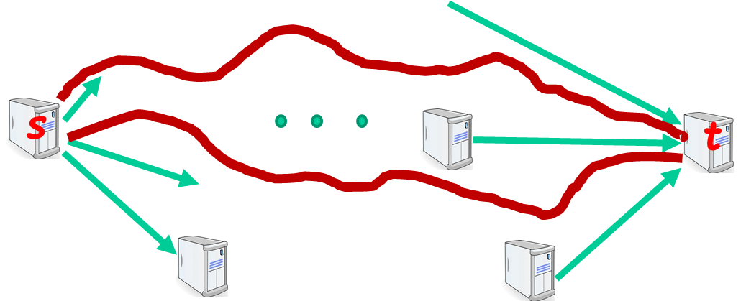

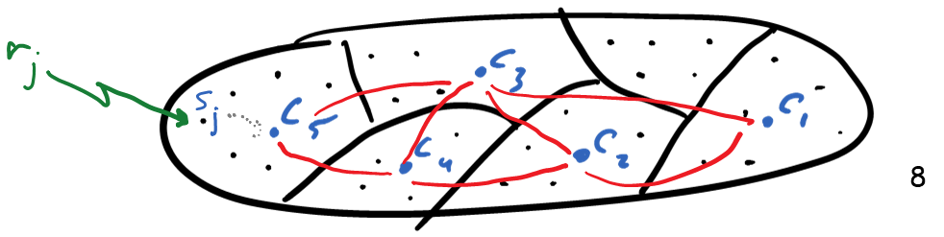
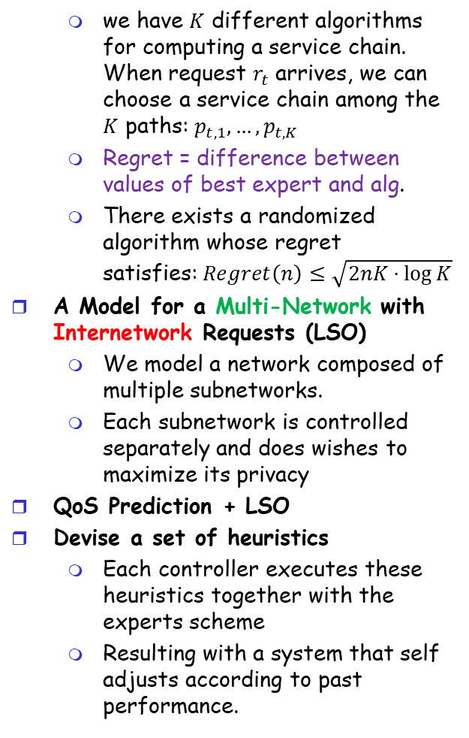
אלגוריתמים לתזמור משאבים ברשת מִתַּכְנֶתֶת Prof. Guy Even, EE@TAU/Dr. Moti Medina, ECE@BGU/ Prof. Boaz Patt-Shamir, EE@TAU/ Dr. Dror Rawitz, EE@BIU with Dr. Yaakov Stein @RAD
On-Line Path Computation and Function Placement in SDNs
Even, G., Medina, M, & Patt-Shamir. B.
Best paper award SSS 2016
Journal paper in Theory of Computing Systems
Online Fault Tolerant Service Chaining
Extended online alg to deal with 1+f routes
Lift restriction on k – the max number of functions along a service chain.
Obtain quasi-polynomial running time (running time is not exp in k)
Improved competitive ratio: from O(log n + log k) to O(log n)
Predicting QoS
Network elements do not report available capacity.
But, we do see the QoS of service chains that have been already assigned
we have $K$ different algorithms for computing a service chain. When request $r_{t}$ arrives, we can choose a service chain among the $K$ paths: $p_{t,1}, …, p_{t,K}$
Regret = difference between values of best expert and alg.
There exists a randomized algorithm whose regret satisfies:$Regret\left(n\right)≤\sqrt{2nK⋅\log{K}}$
A Model for a Multi-Network with Internetwork Requests (LSO)
We model a network composed of multiple subnetworks.
Each subnetwork is controlled separately and does wishes to maximize its privacy
QoS Prediction + LSO
Devise a set of heuristics
Each controller executes these heuristics together with the experts scheme
Resulting with a system that self adjusts according to past performance.

