Slide 1
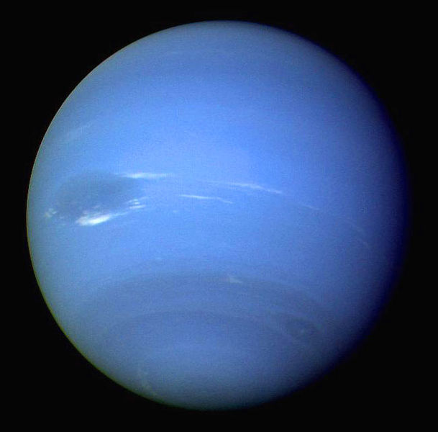
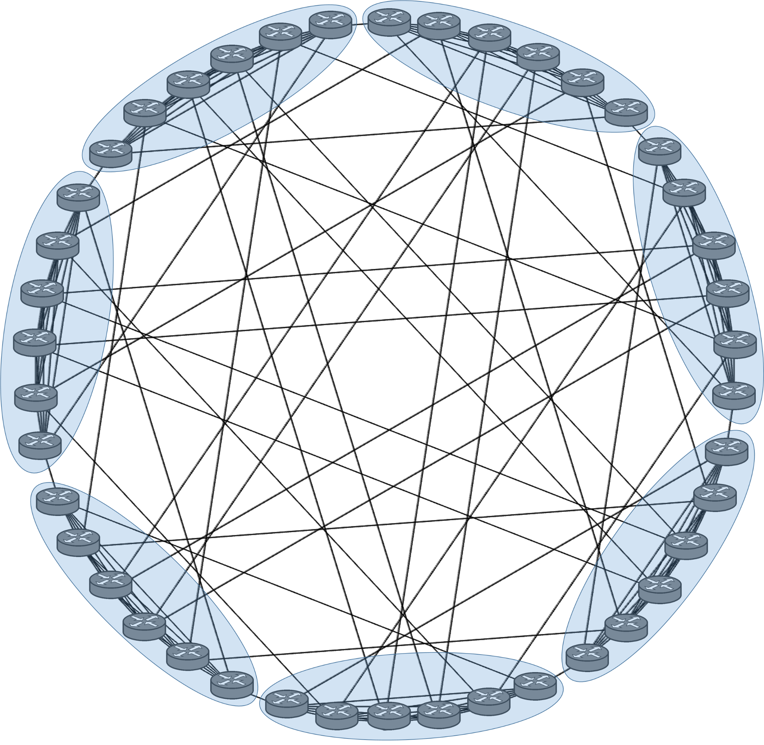
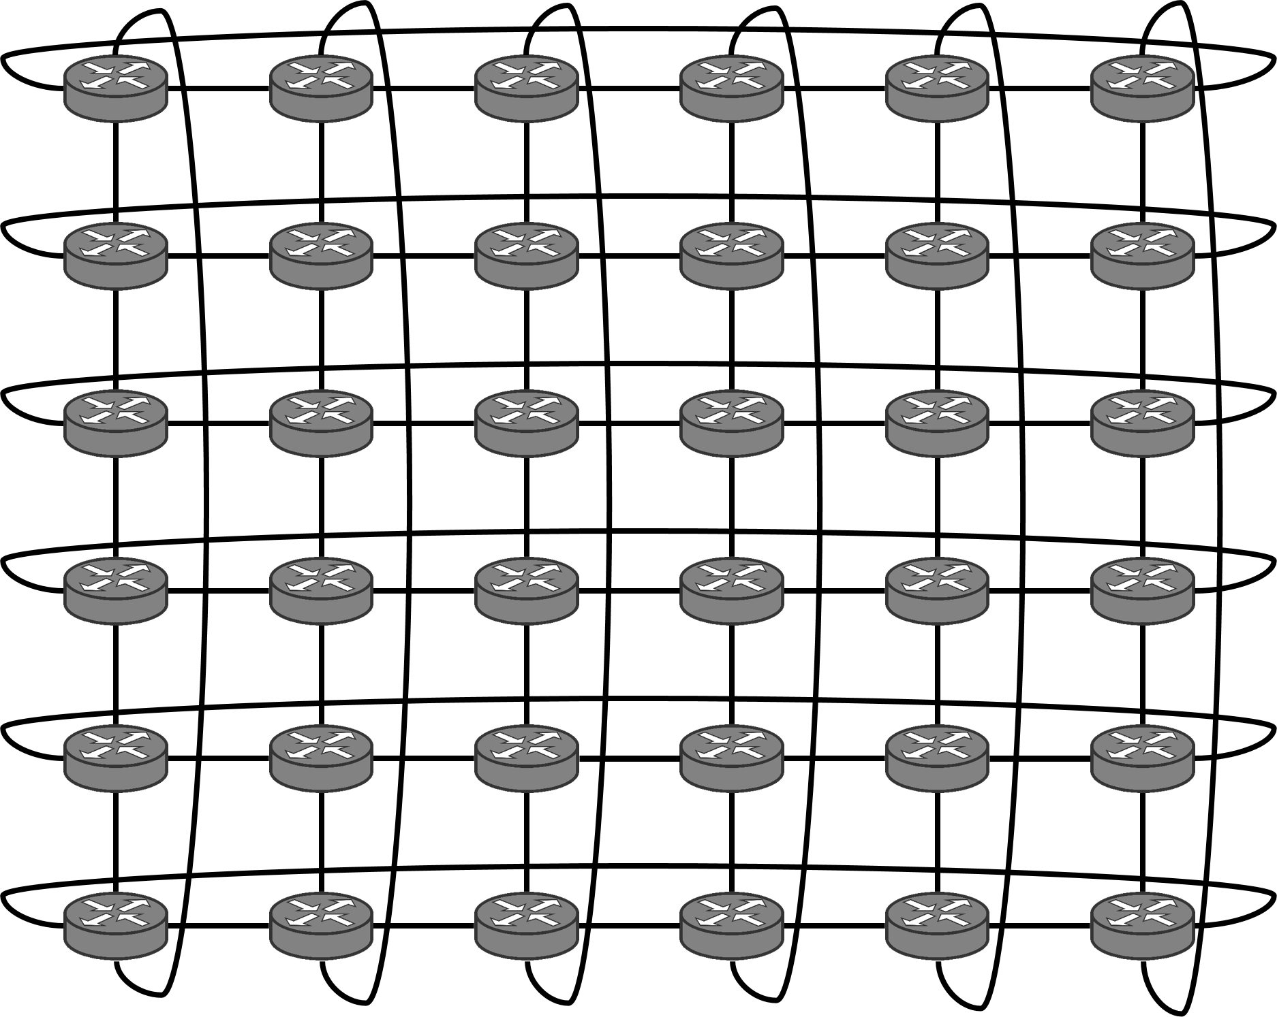
הפקולטה למדעי ההנדסה
המחלקה להנדסת מערכות תקשורת
Adaptive Segment Routing
Prof. Michael Segal
With the help of many students and Mellanox
Background & Motivation
Data Centers:
Traditionally, data center networks have comprised a large number of switches and routers that direct traffic based on the limited view of each device using a distributed routing algorithm. With a central SDN solution, the network routing can be customized more easily as well, shaping the traffic in the network to include more routes and to improve performance.
SDN Controller and Reroute Motivation:
We distinguish between two types of flows, “Elephant” and “Mouse” flows. An “Elephant flow” is a large (in total bytes) continuous flow and a “Mouse flow” is relatively short flow in terms of duration and size. Elephant flow’s path is chosen by the SDN controller, in order to choose the best path in terms on best efforts (Throughput, Utilization, End-to-End Delay, Queue Length and Bottlenecks).
Hypercube
Hypercube topology is defined as a with the dimension (n). The mathematical properties of the hypercube are easily represented the number of neighbors a node has and the diameter (maximum distance between any pair of nodes) are both equal to the dimension n.
In our project the topology is defined by: n=5
Torus
Torus topology is defined by number of dimensions (n) and number of switches in each dimension (m).
Each router is connected to 4 neighbors.
In each dimension, this maximum distance is half the number of switches in that dimension.
In our project the topology is defined by:
m=6, n=6
Dragonfly
Dragonfly topology is defined by routers in each group (a), number of hosts connected to each router (p) and number of channels within each router used to connect to other groups (h). Each router is connected to all other routers in its group and each group connected to all other group.
In our project the topology is defined by:
a=6, p=1, h=2
Results & Additional Improvements
Taking The Prediction To The Next Level:
After a path’s load passes a threshold, the algorithm used to find alternative paths with better delay and less loaded edges and replaced the current path with the best candidate.
Before the path changes, we predict the number of loaded edges and the load on the edges with the current flow’s load and decide what will give the best results, the current flow or the best candidate, the one with the best prediction parameters will be chosen.
Due to the fact we first predict the overloaded edges, there are less candidates taken to consideration, meaning the process time in the controller is now much faster!

