Slide 1

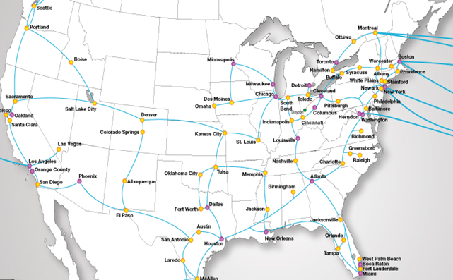








Efficient implementation of NFV in Heterogeneous Networks
Seffi Naor & Ariel Orda, Technion
SDN
Controller
Distributed Network
Functions (services) are implemented at various locations in the network
Traffic is routed to these servers using the control mechanism of SDN
given route
new route
Where to place services/functions?
Servers have bounded capacity
Opening cost for functions
Minimize detour distance of traffic routed to functions via new route
Generalizing classic facility location
Achievements
Novel NFV model
Efficient placement algorithms
O(1)-bicriteria approximation algs.
Improved experimental results
Extension to dynamic environments
PCE LTE TE
PDN-GW S-GW
SGSN/GGSN
SIP NAT RSVP
EPC
DPI

