Slide 1
Application: Data Communications
Communications is moving information from place to place
Information is the amount of surprise, and can be quantified!
Communications was originally analog – telegraph, telephone
There are many forms of digital communications that we use every day
Mobile (cellular)
  Internet
  from 4G voice is simply packet data
Television
  DVB (Idan plus)
  Cable TV (DOCSIS)
Home Internet access
  DSL (ADSL, VDSL)
  Cable modem (DOCSIS again)
Internet of Things
  smart home / smart city
  Industry 4.0

Slide 2
Digital Communications
All physical channels
have limited bandwidth (BW)
add noise (so that the signal to noise ratio SNR is finite)
so analog communications always degrades
and there is no way to completely remove noise
In analog communications the only solution to noise
is to transmit a stronger signal
since later amplification amplifies N along with S
Communications has become digital
digital communications is all or nothing
  perfect reception or no data received

Slide 3
Shannon’s Theorems
1. Separation Theorem
2. Source Encoding Theorem
Information can be quantified (in bits)
3. Channel Capacity Theorem
C = BW log₂ ( SNR + 1 )
Warning: Shannon’s Laws are not constructive
they only give us targets to aim for!
analog signal
bits
bits
info
source
encoder
channel
encoder
channel
channel
decoder
source
decoder
info

Slide 4
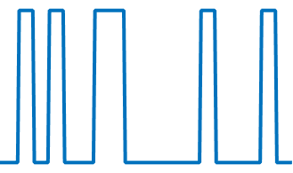
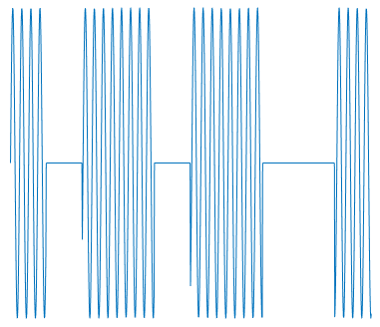
Modulation
We already learned that modulation means
changing parameters of a signal in order to carry information
We previously saw AM and FM in which
the signal carried analog information
Shannon leads us to ask how a signal can carry digital information
A simple example would be to modulate the amplitude of a DC signal
allowing it to be 0 or 1
We could also modulate the amplitude of a sinusoid (like in AM, but 0/1)
Since we will often need bidirectional transfer of information
it is convenient to package the modulator and demodulator
in a single box called a modem
(A similar box for analog modulation is called a transceiver)

Slide 5
Digital communications
Shannon’s theorems taken together
explain why all communications has become digital
Analog communications always have quality degradation
Vinyl records are very limited in spectral and dynamic range
and add a tremendous amount of noise
A Compact Disk is essentially undistinguishable form the original
When recording from tape (e.g., cassette) to tape
each successive recording is noisier, until only noise remains
Copying CD to CD the 1000th copy is indistinguishable from the 1st
Scratching a CD/DVD, either there is no effect
or nothing works at all (in video there can be missing squares)

Slide 6
The simple reason
Digital communications inherit a fundamental property of the bit
it is either 0 or 1 – on of off – perfect or nothing
Either you receive exactly what was sent
or you receive nothing (complete garbage)
But why is it perfect and not always nothing?
If I transmit a voltage of 3.14159... volt, but you receive 2.71828... volt
even if I tell you that there was noise and that isn’t what I sent
you can’t possibly figure out the right value
If I transmit a bit 1 and we obey Shannon’s laws
you should receive a bit 0
But even if you don’t and I tell you that you received the wrong value
then you know that the correct answer is 1 (error correction)

Slide 7
Separation Theorem
The separation theorem is logically the first
even if chronologically the last
The theorem states that the optimal method of transporting
any kind of information (analog or digital) involves
  properly converting it into digital format (Shannon’s 2nd theorem)
  properly modulating an analog signal (Shannon’s 3rd theorem)
  recovering digital information from the received analog signal
  recovering original format information from the digital information
Note that
  the source decoder is the inverse of the source encoder
  input with the digital format it reproduces the original information
  the channel decoder is the inverse of the channel encoder
  input with the undistorted transmitted signal
  it reproduces the digital format information
  the channel encoder is designed with knowledge of the channel

Slide 8
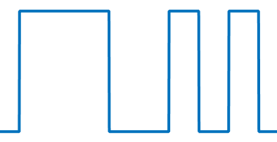
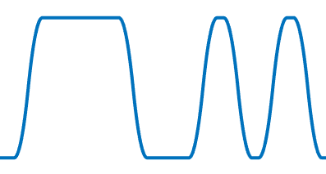
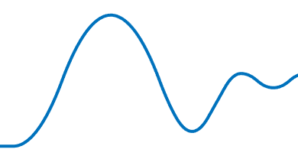
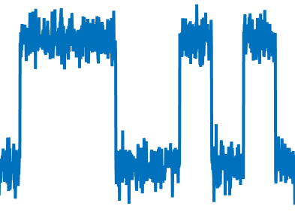
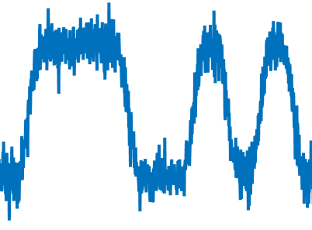
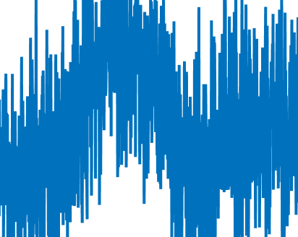
Channels
The problem with communications is that all physical channels
distort the signals traversing them
So that the signal received is not the same as the signal transmitted
Were it not for this distortion communications would be trivial
and there would be no limit on the possible (bit-)rate
From physics we know that all channels:
add noise (at least some dependent on temperature)
limit bandwidth (may be low-pass or bandpass)
bandwidth limited
with noise

Slide 9
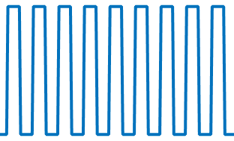
Information
What is information anyway?
Information is the amount of surprise
there is no information in yesterday’s newspaper
since we know everything and it doesn’t surprise us any more
Similarly, a constant sinusoidal signal carries no information
since it is deterministic – there is no surprise
This deterministic On/Off signal taking only 1 of two values
carries no information
But this one does carry information (it is stochastic - it surprises us!)

Slide 10
Shannon’s bits
Shannon taught us that information can be quantified
You can compare the amount of information in a book
to that in a piece of music or in a picture
just like you can compare the weight of lead and feathers
The unit often used is the bit
Beware, Shannon’s bit is more general than Tukey’s binary digit
Tukey’s bit is only useful for encoding numbers
while Shannon’s bit can be used for any form of information
Consider the set of all items of interest
(e.g., all news items, all types of animals, all letters in an alphabet)
How much information is involved in selecting one item from this set?
Shannon’s bit is defined as follows:
ask questions with yes/no (binary) answers until you find out
the minimum number of questions required
is the information content in bits

Slide 11
A simple example
Children play a game called 21 questions
One player (the puzzler) thinks of something – say an elephant
The other player (the questioner) asks yes/no questions
If he finds out in 21 questions or less the questioner wins
(and proves that the puzzler’s brain contains < 21 bits of information)
otherwise the puzzler wins
Is it an animal? YES
Is it bigger than a bread-box? YES
Does it live in the water? NO
Does it live in Africa? YES
Is it a lion? NO
Is it an elephant? YES
The questioner wins, but this is not the optimal set of questions
The optimal strategy asks questions
that divide the remaining possibilities in half!
(assuming equally probable items)

Slide 12
When both bits are the same
When are Tukey’s bits the same as Shannon’s?
Assume that the set of all possibilities consists of the numbers
between 0 and 15
The puzzler thinks of the number 10
The questioner asks the optimal set of questions as follows:
Is greater than 7 ? YES = 1
Is greater than 11? NO = 0
Is it greater than 9 ? YES = 1
Is it greater than 10? NO = 0
So the Shannon information quantity is 4 bits
and the answers form the Tukey binary number for 10 – 1010
What should the questioner do if the items are not equally probable?
0 | 1 | 2 | 3 | 4 | 5 | 6 | 7 | 8 | 9 | 10 | 11 | 12 | 13 | 14 | 15

Slide 13
Source Encoding Theorem
What does this have to do with communications?
Shannon tells us that we need to first encode the information
according to Shannon’s 2nd law
Example: if the current letter in English text is Q
how much information is there in the fact
that the following letter is U?
Exactly zero! So we shouldn’t waste bits on it!
Example: assume a language with 4 letters A, B, C, and D
If they are all equally probable
then we can encode 00, 01, 10, 11 – 2 bits per letter!
But if p(A) = 1/2 p(B) = 1/4 p(C)=p(D)=1/8
how should we encode the letters?
A=1 B=01 C=001 D=000
Average bits per letter = 1/2*1 + 1/4*2 + 1/8*3 + 1/8*3 = 1.75 bits
This is smaller – and the minimal amount!

Slide 14
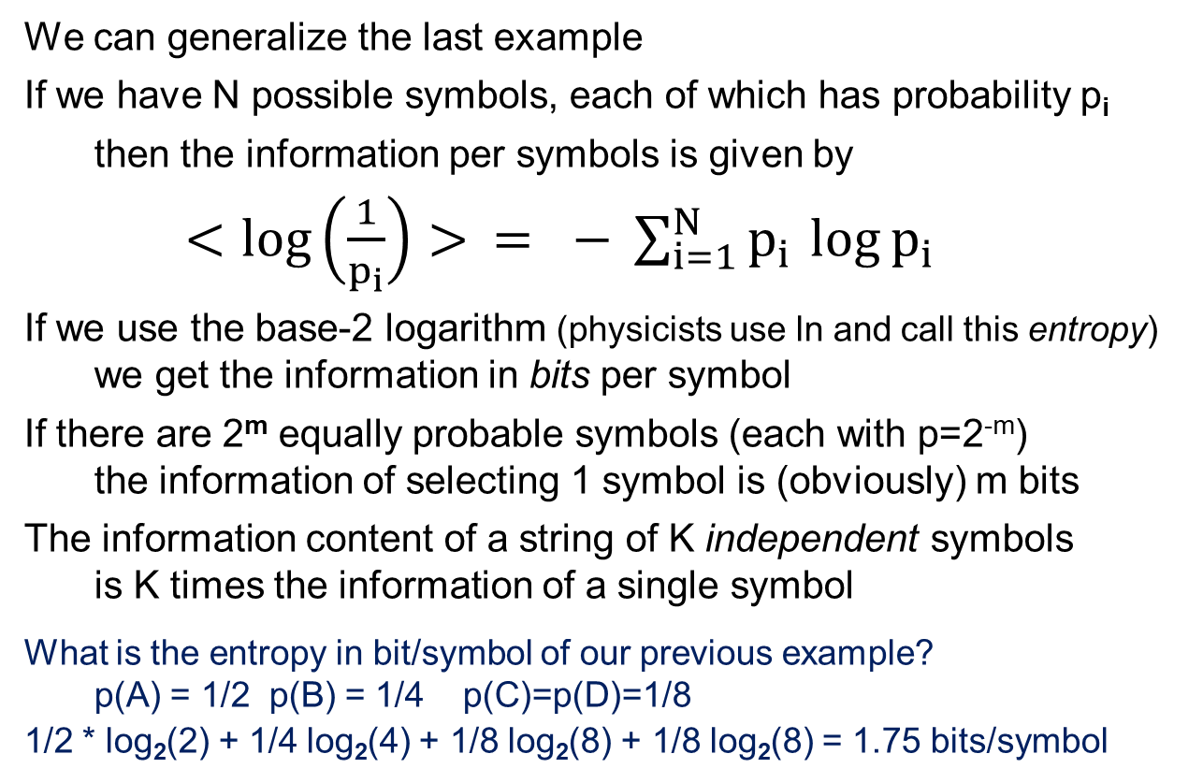
Shannon information
We can generalize the last example
If we have N possible symbols, each of which has probability p_{i}
then the information per symbols is given by
$<\log\left(\frac{1}{p_{i}}\right)> = − \sum_{i=1}^{N}{p_{i }\log{p_{i}}}$
If we use the base-2 logarithm (physicists use ln and call this entropy)
we get the information in bits per symbol
If there are 2^{m} equally probable symbols (each with p=2^{-m})
the information of selecting 1 symbol is (obviously) m bits
The information content of a string of K independent symbols
is K times the information of a single symbol
What is the entropy in bit/symbol of our previous example?
p(A) = 1/2 p(B) = 1/4 p(C)=p(D)=1/8
1/2 * log₂(2) + 1/4 log₂(4) + 1/8 log₂(8) + 1/8 log₂(8) = 1.75 bits/symbol

Slide 15
Shannon encoding
Shannon’s 2nd law is not constructive –
it tells us how many bits are required to capture information
but doesn’t teach us how to actually encode information
So generations of mathematicians and engineers have developed
coding methods that approach Shannon’s information limit
Ziv and Lempel developed a digital file compression method
that approaches Shannon’s limit asymptotically (for large files)
the speech compression methods we already learned
are lossy methods of Shannon encoding for speech signals
the Joint Photographic Experts Group have developed
a lossy mechanism to encode images
the Motion Pictures Expert Group have developed
many lossy mechanisms for encoding video
If Ziv-Lempel compression can compress a file to 1/5 its size
why can’t we recompress that file to 1/25 the original?

Slide 16
Error detection/correction
Information theory teaches us how to optimally encode information
and it also teaches us how to protect information from errors
You all know about parity bits
For example, we can add 1 bit to each byte making the number of 1s even
this adds 12.5% overhead
and detects any single bit error
but can’t correct any errors
Building on this we can make a simple error correction technique
that adds 16 bits to 64, i.e., 25% overhead
but can detect any two errors
and correct any single error
What happens if there two errors in the same row or column?
What happens if the error is in the parity check bits?
There are much more sophisticated error correction schemes!
01011001
01001010
00100000
01010011
01110100
01100101
01101001
01101110
0
1
1
0
0
0
0
1
01011001
01001010
00100000
01010011
01110100
01100101
01101001
01101110
0
1
1
0
0
0
0
1
01110110

Slide 17
To FEC or not to FEC
source
encoder
ECC
encoder
modulator
channel
demodulator
ECC
decoder
source
decoder
Shannon’s separation theorem implies
that it is suboptimal to use data-layer Error Correction schemes
This is because an ECC always adds extra non-information bits
reducing the information bit rate
Yet, many communications systems use error detection/correction
CRC (Cyclic Redundancy Code) in Ethernet
turbo codes in cellular communications
Reed Solomon FEC in ADSL and optical networks
This is because unlike the assumptions of the capacity theorem
the SNR is often not stationary due to noise events and fading
resulting in errors in the recovered information
Signal layer ECC methods (e.g., TCM)
don’t contradict the separation theorem

Slide 18
Channel capacity theorem
Shannon’s third theorem states that there is an upper limit
on the data rate in which bits can be transferred in a channel
This is the main reason a 100 Mbps Internet connection
costs more than a 20 Mbps one!
If there were no such limit then
why not give the customer as much as the routers can forward?
This capacity depends on
the Signal to Noise ratio
the amplitude of the modulated signal
divided by the amplitude of the noise added by the channel
the bandwidth of the analog channel (in Hz)
which is why communications people frequently say
bandwidth instead of data-rate!
Since this is a theorem in signal processing we are going to prove it
Well, actually our proof has a lot of holes
one day you should read Shannon’s real proof – just for the beauty of it!

Slide 19
Channel Capacity (1)
Let’s first prove that a channel with no noise has infinite capacity
even if its bandwidth is close to zero
Let’s take some large amount of information
source encode it into bits 1011101001011110001010100010...
add “0.” at the beginning 0.1011101001011110001010100010...
to obtain a number between 0 and 1
place precisely that voltage as DC on the wire
connecting transmitter to receiver
since there is no noise precisely this voltage will be received
even though the bandwidth is small (DC requires no bandwidth!)
there is no physical limit on how fast this voltage can be measured
So we can transfer a large amount of data in negligible time
which means the capacity is infinite
XMTR
RCVR
v
1
0
t

Slide 20
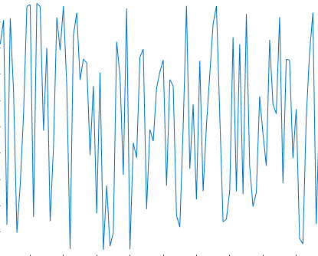
Channel Capacity (2)
Now let’s prove that a channel with infinite bandwidth
has infinite capacity even if it has noise of peak-to-peak value N
Let’s take some large amount of information
source encode it into bits 1011101001011110001010100010...
for every 0 bit transmit 0 voltage for T seconds
for every 1 bit transmit 1.5N voltage for T seconds
for every 0 bit the receiver will see a voltage between –N/2 and N/2
for every 1 bit it will see a voltage between N and 2N
since there is no overlap the receiver can identify 0/1 with no error
since the bandwidth is infinite, we can send T→0
So we can transfer a large amount of data in negligible time
which means the capacity is infinite
N/2
N
DC-less noise with uniform distribution
-N/2
2N
1.5N
N
N/2
0
-N/2

Slide 21
Shannon’s capacity theorem
If there is both noise and limited bandwidth:
assume (wolg) that we transmit some signal with values between 0 and S
assume that the channel adds DC-less noise with uniform distribution
we’ll call the peak-to-peak noise N
so that the noise values are between –N/2 and +N/2
the receiver always sees values between –N/2 and S+N/2
so the receiver’s dynamic range is S+N
to maximize the information per symbol w/o overlap
we space the signal levels by N
so there can be (S+N)/N = S/N + 1 = SNR+1 different symbols
hence each symbol contains log₂(SNR + 1) bits
but there can be BW symbols per second
Hence, the maximum information rate C = BW log₂(SNR + 1) bit/s
The maximum spectral efficiency is C/BW = log₂(SNR + 1) bit/s/Hz
S+N/2
S
N
(S+N)/N
levels
S+N
0
-N/2

Slide 22
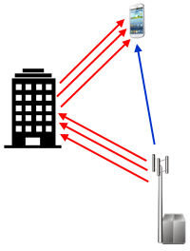
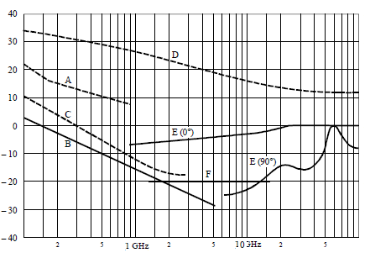
Capacity for frequency-dependent SNR
The capacity theorem assumed that the SNR was
constant from DC to BW
zero over BW
or more generally
constant in some passband
zero outside the passband
Which will not be the case if either
the signal attenuation (including multipath cancellation)
the noise (including interference)
or both, vary with frequency
The extension of the theorem is simple
divide the passband into channels of bandwidth Δf centered at f
the capacity theorem states that for the channel
C_{f} ≈ log₂(SNR(f) + 1) Δf
the composite capacity is ∑_{f} log₂(SNR(f) + 1) Δf
The theorem becomes exact when we send Δf → 0
and then C = ∫ log₂(SNR(f) + 1) df
SNR
f
SNR
0
BW
BW
f
C_{f}
f

Slide 23
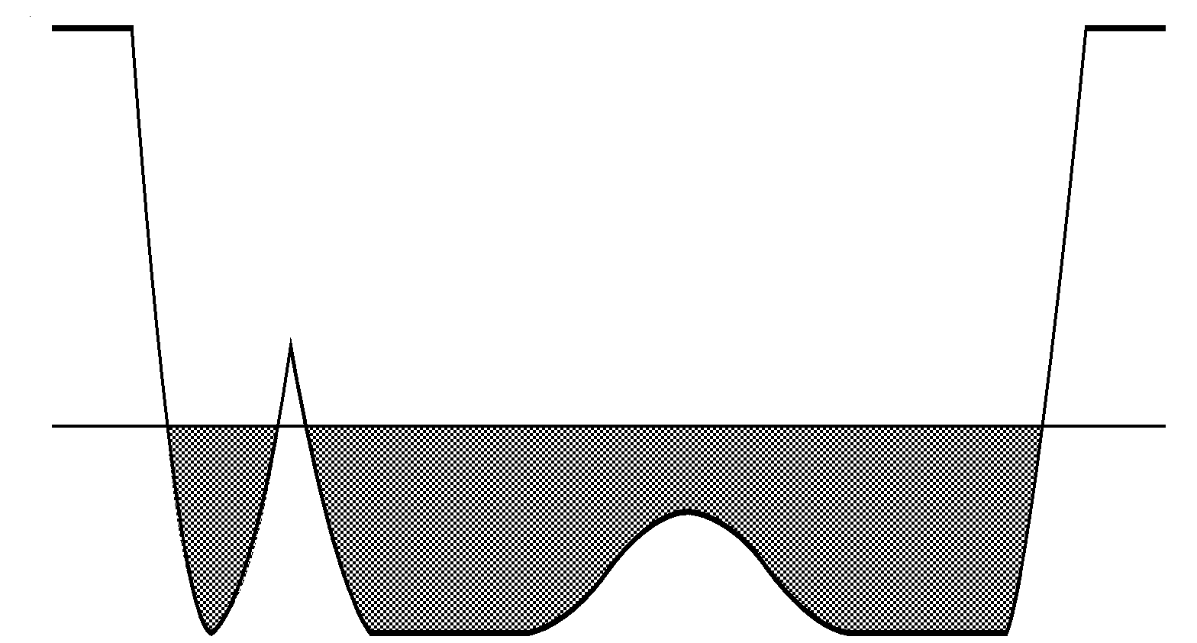
Water pouring theorem
The converse to Shannon’s channel capacity theorem
is Gallager’s water pouring theorem
The spectrum of the optimum (capacity-achieving) modulated signal
is given by the water pouring algorithm
fill a pitcher with a volume of water
  representing the total power to be transmitted
pour the water over the reciprocal SNR(f) graph (Noise to Signal Ratio)
This power spectrum can be achieved by
spectral shaping
explicit power loading
NSR
very low SNR – no transmitted power
low SNR – low transmitted power
hi SNR – high transmitted power

Slide 24
Modem design
Shannon’s theorems are existence proofs
not constructive methods to design modulation techniques
that maximize capacity given channel characteristics
So we need to be creative to reach channel capacity
Over the years many kinds of modems have been designed :
NRZ
RZ
PAM
FSK
PSK
QAM
OFDM

Slide 25
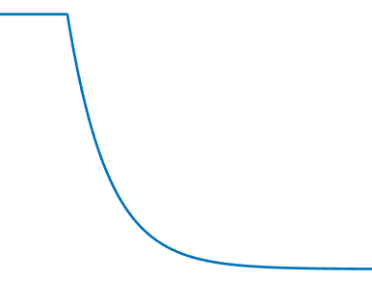
NRZ
Our first attempt is to simply transmit 1 or 0 (volts?)
This is called Non Return to Zero (i.e., NOT RZ)
Information rate = number of bits transmitted per second (bps)
But this is only good for short serial cables (e.g. RS232), because
requires DC (doesn’t work over radio or fiber)
if DC blocked lose runs of 1s
needs high bandwidth (sharp corners require high frequencies)
strong InterSymbol Interference
timing recovery may not be possible (if long runs of 0 or 1)

Slide 26
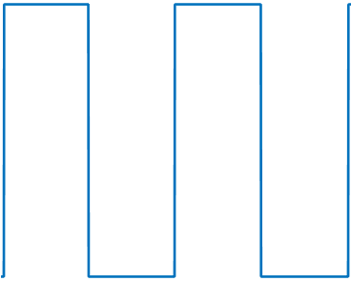
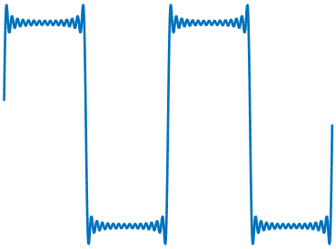
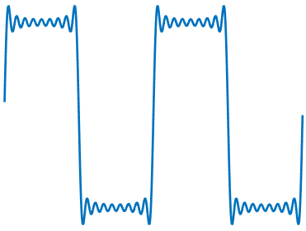
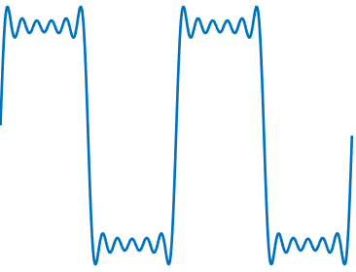
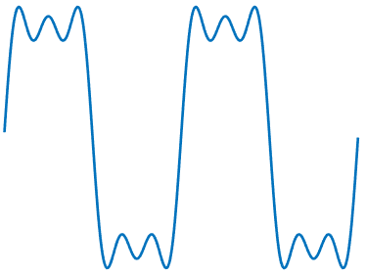
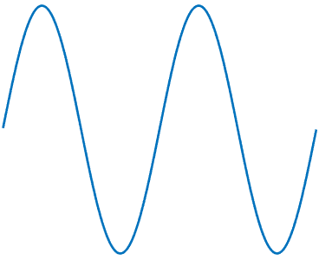
NRZ needs infinite bandwidth
infinite BW
very low BW
and this is for 0101010101!
for random bits finite BW causes an additional problem!

Slide 27
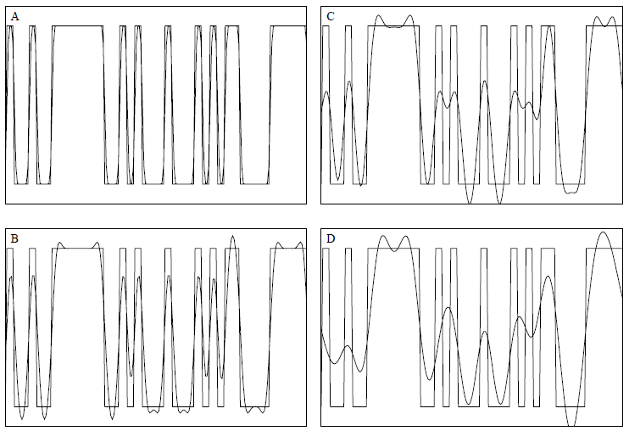
NRZ InterSymbol Interference (ISI)
low-pass filtered signal keeps up with bit changes
insufficient BW to keep up with bit changes

Slide 28
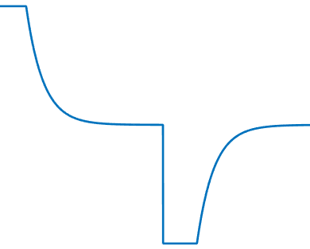
DC-less NRZ
So what about transmitting -1/+1?
This is better, but not perfect!
DC isn’t exactly zero
if DC blocked worse than before
still is modulation of DC and not for fiber or radio
still has high bandwidth (sharp corners)
even without decay, long runs ruin timing recovery

Slide 29
RZ
What about Return to Zero ?
never long + runs, so DC decay less important
BUT half-width pulses
  means twice the number of changes per second
  which requires twice the bandwidth!
Shannon strikes !

Slide 30
OOK
Even better - use OOK (On Off Keying)
no signal discontinuity (but derivative discontinuities)
absolutely no DC!
based on desired sinusoid (“carrier”) frequency
so suitable for radio and fiber
can hear it (Morse code)

Slide 31
NRZ - Bandwidth
The PSD (Power Spectral Density) of NRZ is a sinc (sinc(x) = sin(x)/x)
the first zero is at the bit rate (from the uncertainty principle!)
so channel bandwidth limits bit rate
DC depends on level placement (may be zero or spike)

Slide 32
OOK - Bandwidth
PSD of -1/+1 NRZ is the same, except there is no DC component
If we use OOK the sinc is mixed up to the carrier frequency
(The spike helps in carrier recovery)
f_{c}

Slide 33
From NRZ to n-PAM
+1
NRZ
4-PAM
(2B1Q)
8-PAM
Each level is called a symbol or baud
Bit rate = number of bits per symbol * baud rate
-1
1
1
1
0
0
1
0
+3
GRAY CODE
10 => +3
11 => +1
01 => -1
00 => -3
+1
-1
-3
11
10
01
01
00
11
01
GRAY CODE
100 => +7
101 => +5
111 => +3
110 => +1
010 => -1
011 => -3
001 => -5
000 => -7
111
001
010
011
010
000
110

Slide 34
PAM - Bandwidth
BW (actually the entire PSD) doesn’t change
with the number of levels !
So we should use many bits per symbol
But then noise becomes more important
(Shannon strikes again!)
BAUD RATE

Slide 35
ASK
What about Amplitude Shift Keying - ASK ?
2 bits / symbol
generalizes OOK in the same way that PAM generalized NRZ
not widely used since hard to differentiate between levels
when there is noise
How do we find the amplitude of a sine?

Slide 36
FSK
What can we do about noise?
If we use frequency diversity we can gain 3 dB
Use two independent OOKs with the same information
(no DC)
This is FSK - Frequency Shift Keying
We maintain continuous phase for minimum bandwidth
Note that sinusoids are orthogonal – but only over long times !

Slide 37
FSK in the frequency domain
FSK is based on orthogonality of sinusoids of different frequencies
make decision only if there is energy at f₁ but not at f₂
The uncertainty theorem says that the uncertainty in frequency
is inversely proportional to the time duarion
So when we leave a frequency for a short amount of time
its spectrum is not a line – but a sinc!
So FSK is robust but slow (Shannon strikes again!)

Slide 38
PSK
What about sinusoids of the same frequency but different phases?
Correlations reliable after a single cycle (∫sin(ωt) cos(ωt) dt = 0 on 1 cycle!)
So let’s try BPSK
1 bit / symbol
or QPSK
2 bits / symbol
Bell 212 2W 1200 bps
V.22

Slide 39
QAM
Finally, we can combine PSK and ASK (but not FSK)
by changing both the amplitude and the phase
2 bits per symbol
This is called Quadrature Amplitude Modulation
This is getting confusing

Slide 40
The secret math behind it all
Remember the Hilbert Transform?
x(t) = A(t) cos ( 2 π f_{c} t + φ(t) )
y(t) = A(t) sin ( 2 π f_{c} t + φ(t) )
A(t) is the instantaneous amplitude, φ(t) is the instantaneous phase
This can be used to demodulate analog/digital communications signals
For digital modulations we draw constellation diagrams
x and y as axes
A is the radius, φ the angle
For example, QPSK can be drawn (rotations are time shifts)
Each point represents 2 bits!

Slide 41
QAM constellations
16 QAM V.29 (4W 9600 bps)
V.22bis 2400 bps Codex 9600 (V.29)
2W
first non-Bell modem (Carterphone decision)
Adaptive equalizer
Reduced PAR constellation
Today - 9600 fax!
8PSK
V.27
4W
4800bps

Slide 42
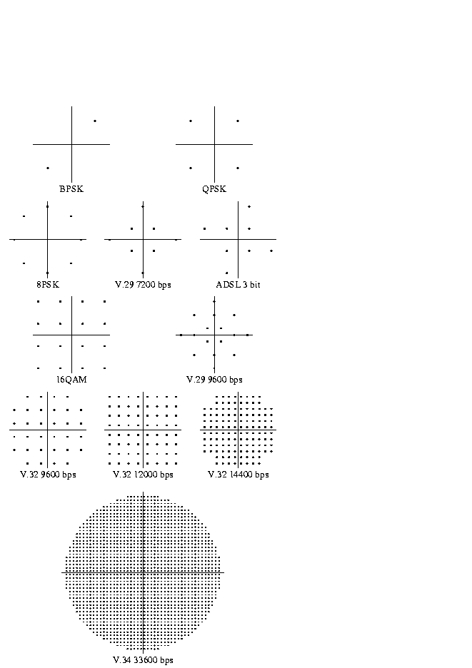
Voicegrade modem constellations

Slide 43
FDM
QAM (including PSK as a special case) is a very efficient modulation
approaching the Shannon capacity for simple bandpass channels
But the spectrum of a QAM signal is inflexible
like all discretely keyed modulations of a single carrier
it is a sinc centered at f_{c} with first zeros at f_{c} ± symbol-rate
The spectrum can be shaped using a Tomlinson precoder
but this requires a feedback channel and precomputing the filter
So, QAM does not lend itself to water-pouring
The trick is to use Frequency Domain Multiplexing
We saw FDM as a technique to mux different information sources
Here we divide a single information stream into blocks of bits
and mux them together using distinct sub-carriers
Each sub-carrier signal can
have its own power level
use its own modulation technique (PSK, QPSK, 16QAM, 64QAM, ...)
thus directly implementing water pouring

Slide 44
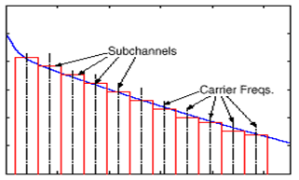
FDM combats ISI but creates ICI
FDM uses many subchannels, each with low bandwidth but low data rate
Since the data rate is low, there is essentially no ISI
And since each subchannel is localized in frequency
we can perform equalization in the frequency domain (FEQ)
i.e., simply multiply each frequency and shift its phase
But, we need to space the sub-carriers far enough apart
to avoid InterChannel Interference
This squanders bandwidth, distancing us from the Shannon capacity

Slide 45
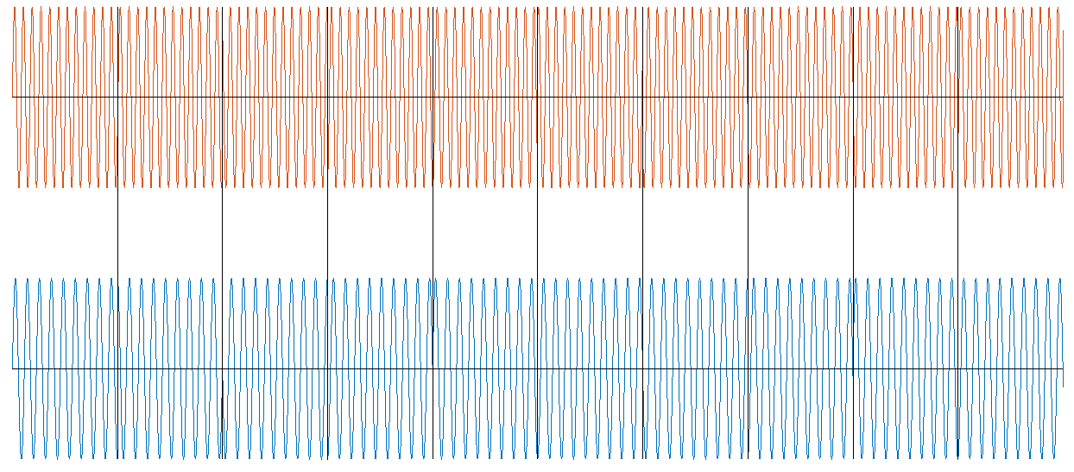
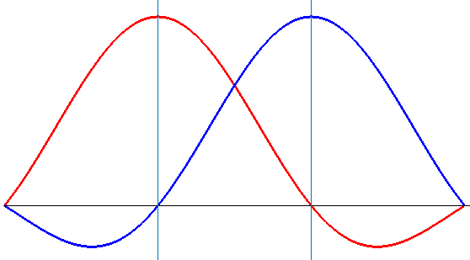
OFDM
The solution is called Orthogonal FDM (OFDM)
all sub-channels use the same symbol rate (even if different modulations)
sub-carriers are spaced at precisely the symbol rate
the sub-carriers are the precisely orthogonal
  and hence do not interfere with each other
ICI is eliminated with no guard frequencies needed
simple implementation based on the FFT

Slide 46
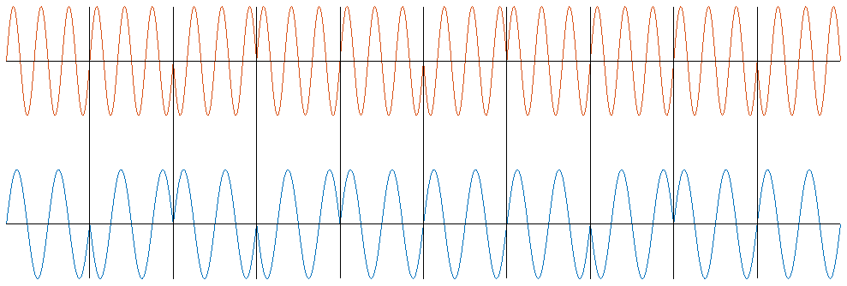
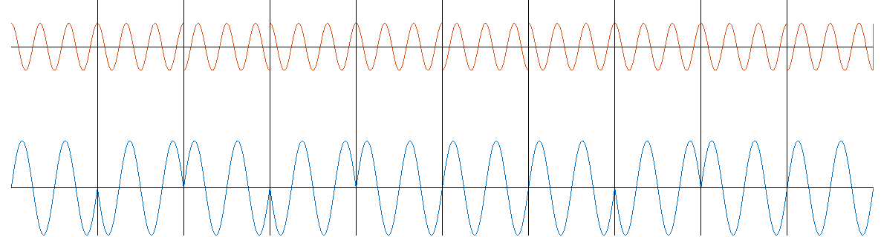

Why are the channels orthogonal?
Let’s look at the baseband signal
where all sub-carriers are multiples of the symbol rate
so that there are an integral number of sinusoid cycles in a symbol
Any two such signals are precisely orthogonal
$\int_{0}^{\frac{2π}{ω}N}{{ e}^{in_{1}ωt}}e^{−in_{2}ωt}$ $dt$ = 0 (the only requirement is for a whole number of cycles of sin Δω t !)
and the same is true if we arbitrarily phase shift or amplify the signals

Slide 47
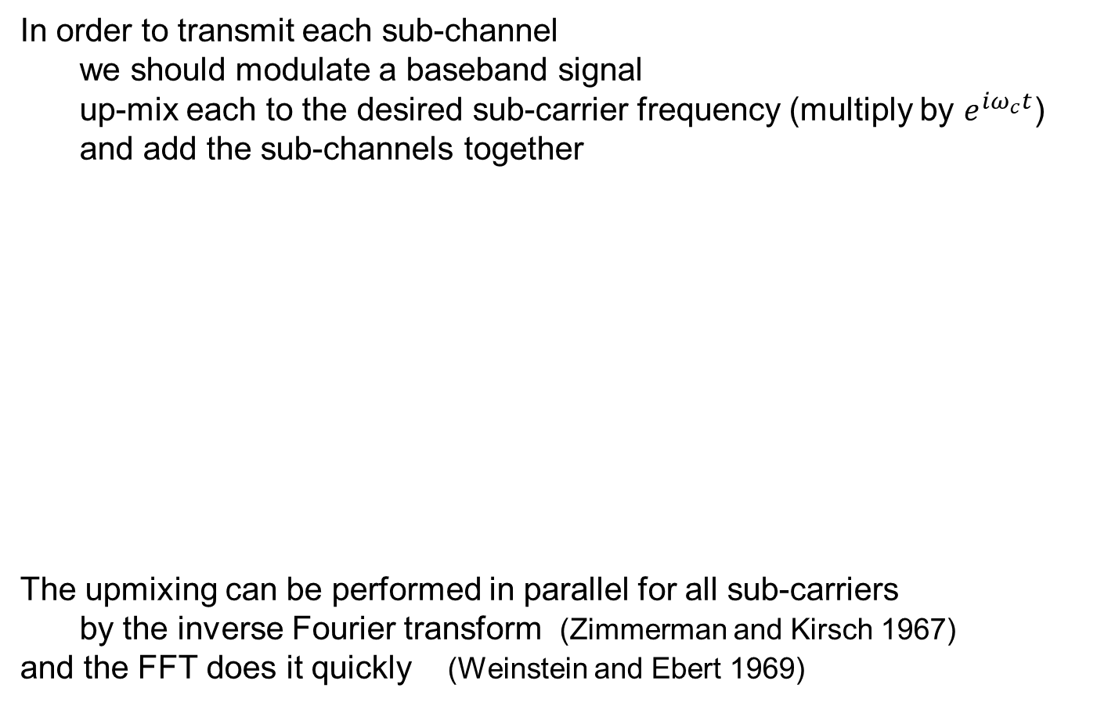
FFT
In order to transmit each sub-channel
we should modulate a baseband signal
up-mix each to the desired sub-carrier frequency (multiply by $e^{iω_{c}t}$)
and add the sub-channels together
The upmixing can be performed in parallel for all sub-carriers
by the inverse Fourier transform (Zimmerman and Kirsch 1967)
and the FFT does it quickly (Weinstein and Ebert 1969)
modulator
sin(ω₁t)
modulator
bit
stream
serial to parallel converter
D/A
analog signal
sin(ω₂t)
modulator
.
.
.
sin(ω₃t)

Slide 48
4G OFDM signal structure
f
OFDM symbol
GUARD BAND
sub-carrier
GUARD BAND
t
For 4G:
channel bandwidth ..., 5, 10, 15, or 20 MHz
guard band overhead is 10%
sub-carrier spacing = 15 kHz
OFDM symbol duration = 1/15KHz = 66.67 μsec
  short CP = 4.7 μsec so total duration = 71.367 μsec
    1 slot = 7 symbols ≈ ½ msec*
  long CP = 16.7 μsec so total duration = 83.367 μsec
    1 slot = 6 symbols ≈ ½ msec*
* CP durations are adjusted so that the slot is precisely ½ msec
BW (MHz) | usable BW (MHz) | subchannels | FFT
5 | 4.5 | 300 | 512
10 | 9 | 600 | 1024
15 | 13.5 | 900 | 1536
20 | 18 | 1200 | 2048

Slide 49
OFDMA
4G and 5G cellular are based on OFDM
but need Multiple Access and Duplexing mechanisms too
For MA an orthogonal version of FDMA is used
signals from/to different users occupy different frequencies
the SubCarrier Spacing must be exactly the OFDM symbol rate
For duplexing there are two alternatives:
Frequency Domain Duplexing
different frequency bands are used for the UL and DL
for example n1: UL 1920-1980 MHz, DL 2110-2170 MHz
Time Domain Duplexing
a single frequency band is used
for example n38: 2570-2620 MHz for both UL and DL

Slide 50
OFDMA
The basic OFDM paradigm can be readily extended to OFDMA
by allocating time-frequency Resource Elements to different users
In the DL direction the base-station transmits to all users
and each needs to know which REs it needs to extract
In the UL direction each UE transmits only in its REs
in order not to interfere with other UEs in the cell
f
GUARD BAND
Resource
Element
SCS
symbol
GUARD BAND
t

