Slide 1
Systems
0 or more signals as inputs
1 or more signals as outputs
1 signal as input
1 signal as output
A signal processing system has signals as inputs and outputs
The most common type of system has a single input and output
A system is called causal
  if y_{n} depends on x_{n-m} for m≥ 0 but not on x_{n+m}
A system is called linear (note - does not mean y_{n} = ax_{n} + b !)
if x₁ → y₁ and x₂ → y₂ then (ax₁+ bx₂)→ (ay₁+ by₂)
A system is called time invariant
if x → y then z^{n} x → z^{n} y
A system that is both linear and time invariant is called a filter

Slide 2
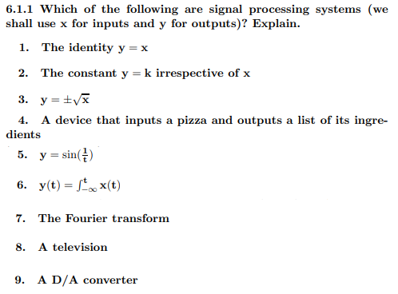
What is/isn’t a system?
answers

Slide 3
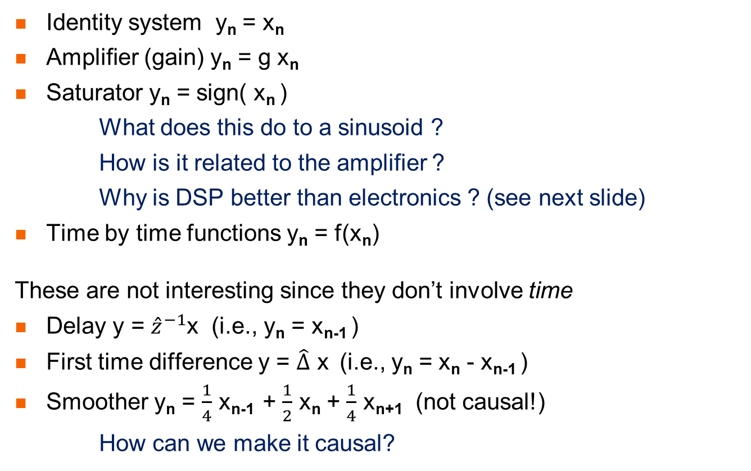
Example systems
Identity system y_{n} = x_{n}
Amplifier (gain) y_{n} = g x_{n}
Saturator y_{n} = sign( x_{n} )
What does this do to a sinusoid ?
How is it related to the amplifier ?
Why is DSP better than electronics ? (see next slide)
Time by time functions y_{n} = f(x_{n})
These are not interesting since they don’t involve time
Delay y = ${\hat{z}}^{−1}$x (i.e., y_{n} = x_{n-1} )
First time difference y = $\hat{∆}$ x (i.e., y_{n} = x_{n} - x_{n-1} )
Smoother y_{n} = $\frac{1}{4}$ x_{n-1} + $\frac{1}{2}$ x_{n} + $\frac{1}{4}$ x_{n+1} (not causal!)
How can we make it causal?

Slide 4


DSP is better than electronics
Analog electronic amplifiers have
maximum output voltage (power supply voltage)
cut-in voltage
nonlinearities
In DSP we can multiply exactly
(we’ll see later why overflow/underflow won’t concern us)
y
maximum
nonlinearities
x
cut-in

Slide 5
Filters
Filters have an important property
Y(ω) = H(ω) X(ω) Y_{k} = H_{k} X_{k}
In particular, if the input has no energy at frequency f
  then the output also has no energy at frequency f
  (what you get out of it depends on what you put into it)
This is the reason to call it a filter
  just like a colored light filter (or a coffee filter …)
Filters are used for many purposes, for example
filtering out noise or narrowband interference
separating two signals
integrating and differentiating
emphasizing or de-emphasizing frequency ranges
The simplest filters are amplification and delay

Slide 6

How does the filter law work?
X(ω)
X(ω)
X(ω)
ω
ω
ω
H(ω)
H(ω)
H(ω)
1
1
1
ω
ω
ω
Y(ω)
Y(ω)
Y(ω)
ω
ω
ω
H(ω) is called the frequency response

Slide 7
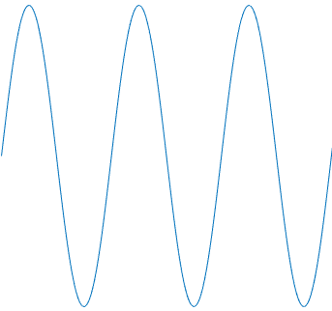
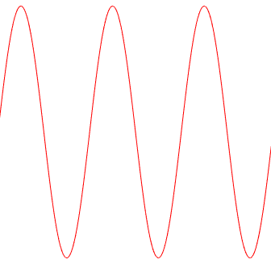
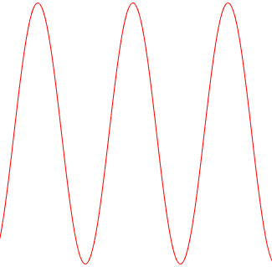
Frequency response
In general H(ω) is a complex number
The absolute value is the gain
how much the sinusoid is amplified or attenuated
The phase is the phase shift
how much the sinusoid is delayed
H(ω) is a function of ω
a filter need not do the same thing to all frequencies!
Many time we use filters that are low-pass, high-pass, etc.
but not all filters are like that
x
y
x
y
| H(f) |
| H(f) |
| H(f) |
| H(f) |
| H(f) |
f
f
f
f
f
low pass
high pass
band pass
band stop
notch

Slide 8

Types of filters
f
f
f
f
f
low pass
high pass
band pass
band stop
notch
When designing filters, we can specify :
transition frequencies
transition widths
ripple in pass and stop bands
linear phase (yes/no/approximate)
computational complexity
memory restrictions
f
multiband
realizable LP
What kind of analog filter is an anti-aliasing filter ?

Slide 9
Nonfilters
If a system is not linear it does not obey the filter law !
For example, y_{n} = x_{n} + ϵ x_{n}²
if x_{n} = sin(ωn) then y_{n} = sin(ω n) + ϵ/2 - ϵ/2 cos(2ω n)
So the input spectrum has 1 component
and the output spectrum has 3!
If a system is not time invariant it is not a filter!
For example, y(t) = e^{i Ω t} x(t)
if x(t) = e^{i ω t} then y(t) = e^{i Ω t} e^{i ω t} = e^{i (Ω + ω) t}
Why did we use complex exponentials here ?
What happens to a more general spectrum ?
sin²(ϕ) = ½ - ½ cos(2 ϕ)
original line
DC
harmonic
0
ω
2ω
ω
original line
shifted line
Ω
original spectrum
ω
Ω+ω
ω
0
ω

Slide 10
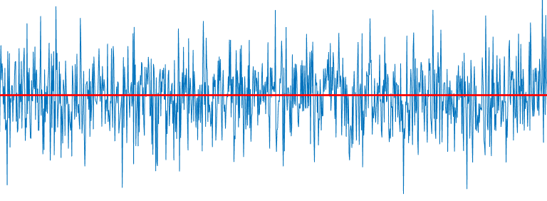
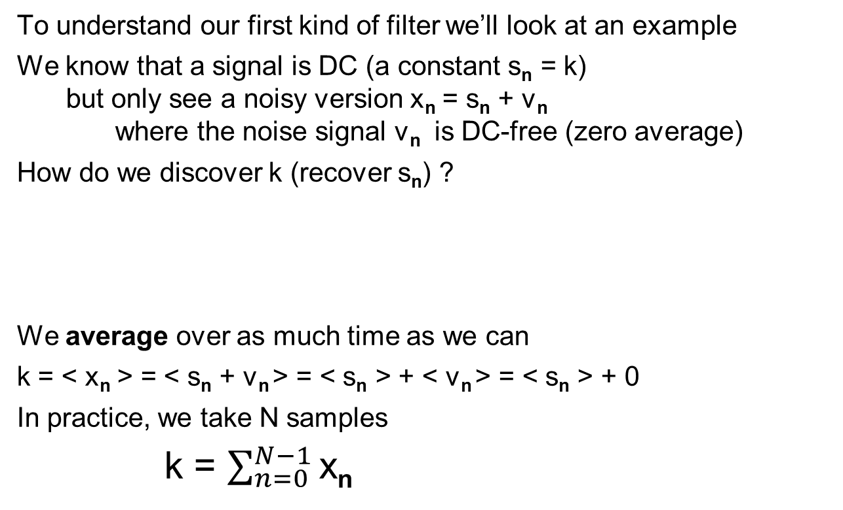
Question 1
To understand our first kind of filter we’ll look at an example
We know that a signal is DC (a constant s_{n} = k)
but only see a noisy version x_{n} = s_{n} + v_{n}
where the noise signal v_{n} is DC-free (zero average)
How do we discover k (recover s_{n}) ?
We average over as much time as we can
k = < x_{n} > = < s_{n} + v_{n} > = < s_{n} > + < v_{n} > = < s_{n} > + 0
In practice, we take N samples
k = $\sum_{n=0}^{N−1}{\text{x}\text{n}}$

Slide 11
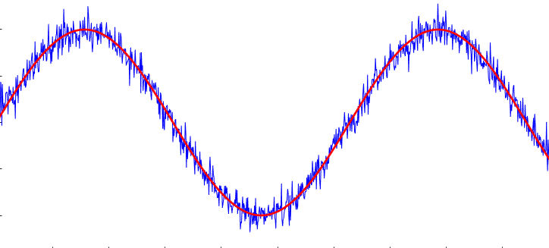
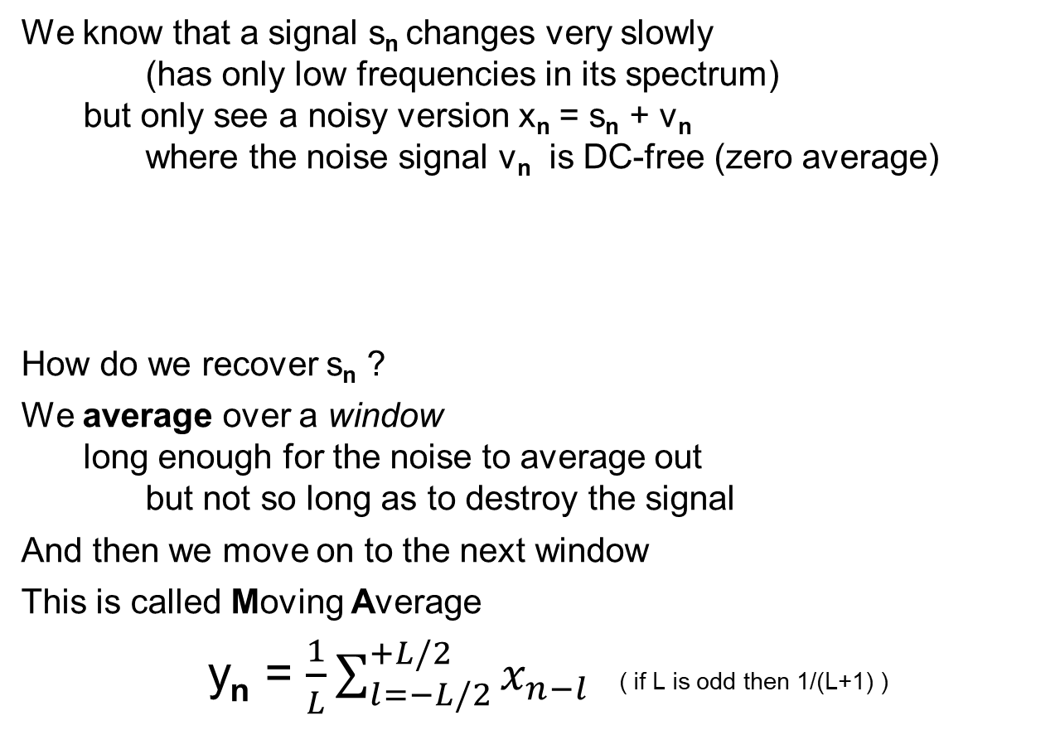
Question 2
We know that a signal s_{n} changes very slowly
(has only low frequencies in its spectrum)
but only see a noisy version x_{n} = s_{n} + v_{n}
where the noise signal v_{n} is DC-free (zero average)
How do we recover s_{n} ?
We average over a window
long enough for the noise to average out
but not so long as to destroy the signal
And then we move on to the next window
This is called Moving Average
y_{n} = $\frac{1}{L}\sum_{l=−L/2}^{+L/2}{x_{n−l}}$ ( if L is odd then 1/(L+1) )

Slide 12
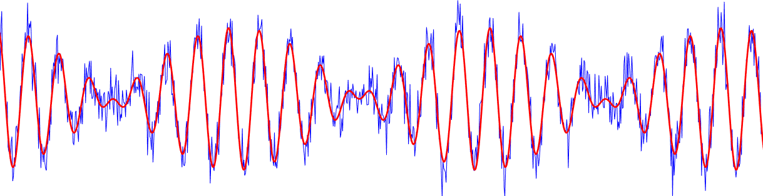



Question 3
The same, but signal s_{n} doesn’t change so slowly
(there are higher frequencies in its spectrum)
How do we recover s_{n} ?
We perform a (generalized) Moving Average but with non-equal coefficients
y_{n} = $\sum_{l=n−L/2}^{n+L/2}{a_{l}{ x}_{n−l} }$ where $\sum{a_{l}}$= 1
For example the smoother y_{n} = $\frac{1}{4}$ x_{n-1} + $\frac{1}{2}$ x_{n} + $\frac{1}{4}$ x_{n+1}
What coefficients return us to the original MA ?
Why do we often use triangular coefficients ?
$$a_{l}$$
$$l$$
- L/2
0
L/2

Slide 13
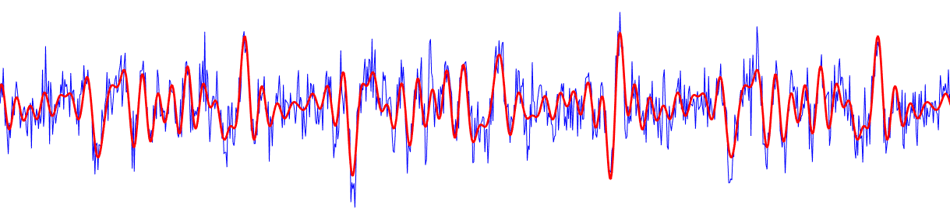


Question 4
What if the signal s_{n} has a spectrum with all frequencies ?
We can still perform Moving Average
but need to find the coefficients based on the frequency domain such that we allow the signal to pass
but block as much noise as possible
This will only work if MA is a filter!
$$S$$
v
$$ω$$

Slide 14

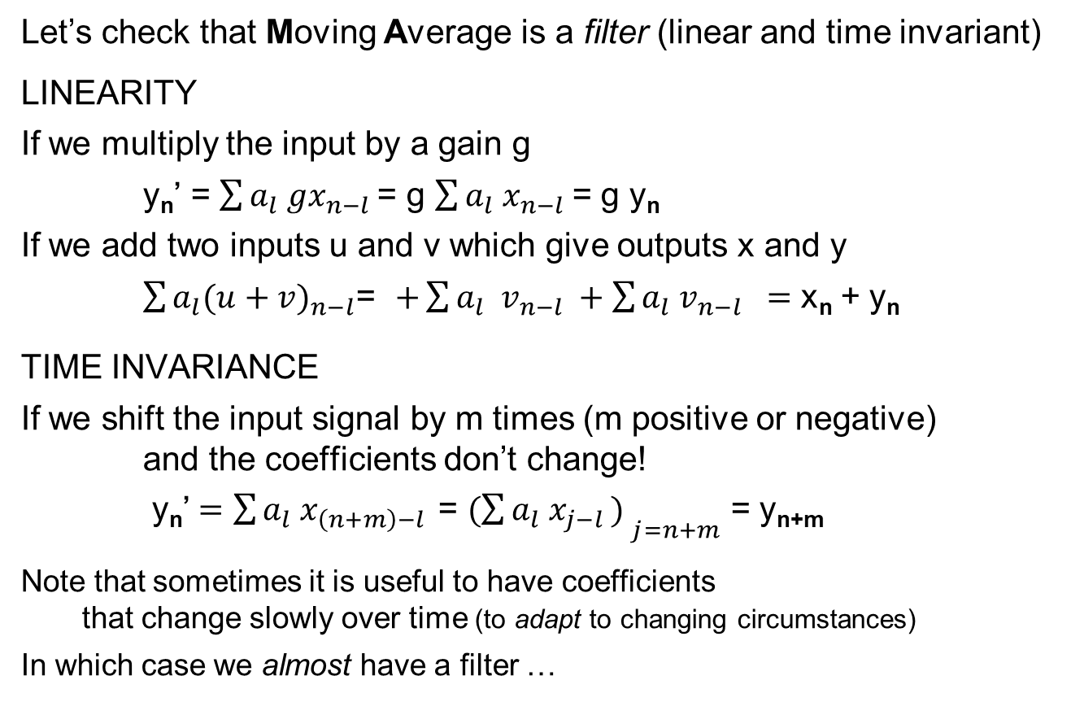
MA is always a filter
Let’s check that Moving Average is a filter (linear and time invariant)
LINEARITY
If we multiply the input by a gain g
y_{n}’ = $\sum{a_{l}{ gx}_{n−l} }$= g $\sum{a_{l}{ x}_{n−l} }$= g y_{n}
If we add two inputs u and v which give outputs x and y
$\sum{a_{l}{(u+v)}_{n−l}}$= $+\sum{a_{l} { v}_{n−l} }+\sum{a_{l}{ v}_{n−l} =}$ x_{n} + y_{n}
TIME INVARIANCE
If we shift the input signal by m times (m positive or negative)
and the coefficients don’t change!
y_{n}’ $=\sum{a_{l}{ x}_{\left(n+m\right)−l } }$= ${(\sum{a_{l}{ x}_{j−l }) }}_{j=n+m}$ = y_{n+m}
Note that sometimes it is useful to have coefficients
that change slowly over time (to adapt to changing circumstances)
In which case we almost have a filter …

Slide 15
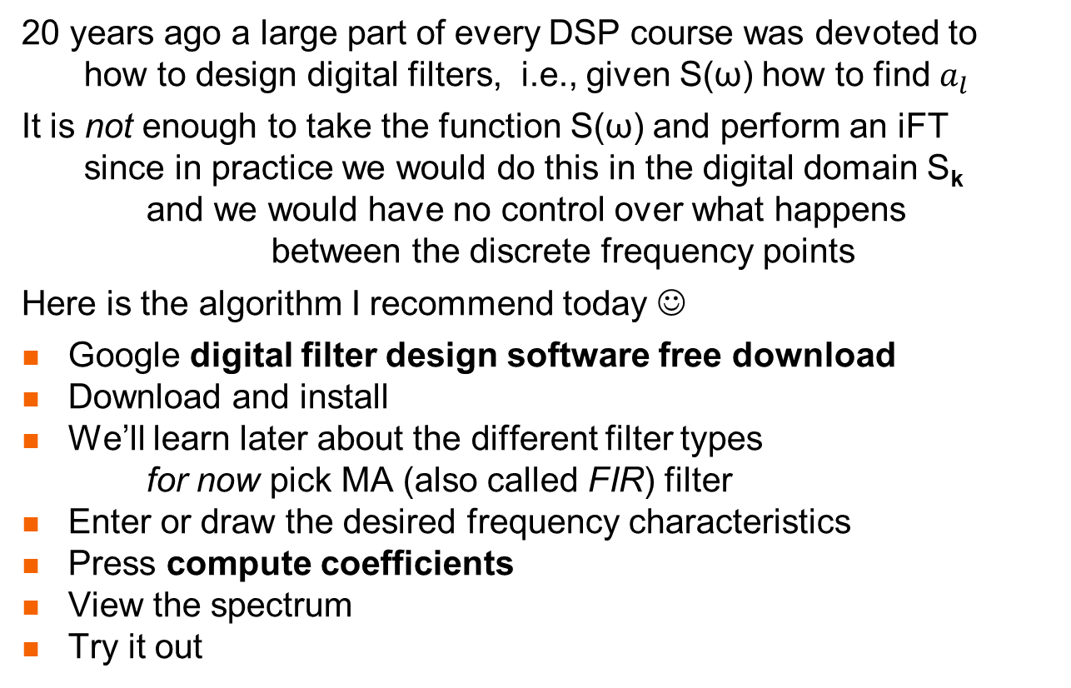
How to design a digital filter
20 years ago a large part of every DSP course was devoted to
how to design digital filters, i.e., given S(ω) how to find $a_{l}$
It is not enough to take the function S(ω) and perform an iFT
since in practice we would do this in the digital domain S_{k}
and we would have no control over what happens
between the discrete frequency points
Here is the algorithm I recommend today ☺
Google digital filter design software free download
Download and install
We’ll learn later about the different filter types
for now pick MA (also called FIR) filter
Enter or draw the desired frequency characteristics
Press compute coefficients
View the spectrum
Try it out

Slide 16
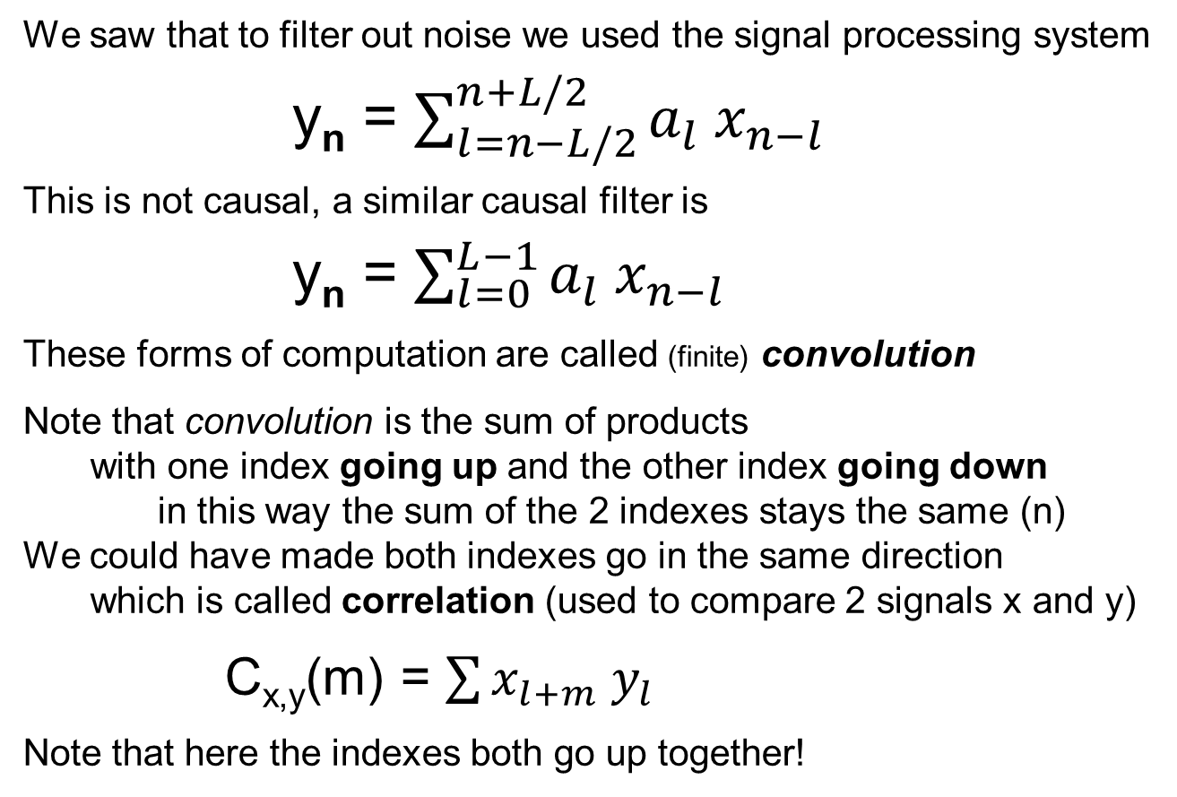
Convolution
We saw that to filter out noise we used the signal processing system
y_{n} = $\sum_{l=n−L/2}^{n+L/2}{a_{l}{ x}_{n−l} }$
This is not causal, a similar causal filter is
y_{n} = $\sum_{l=0}^{L−1}{a_{l}{ x}_{n−l} }$
These forms of computation are called (finite) convolution
Note that convolution is the sum of products
with one index going up and the other index going down
in this way the sum of the 2 indexes stays the same (n)
We could have made both indexes go in the same direction
which is called correlation (used to compare 2 signals x and y)
C_{x,y}(m) = $\sum{x_{l+m}{ y}_{l} }$
Note that here the indexes both go up together!

Slide 17
Picturing Convolution
a₂
a₁
a₂
a₀
a₁
a₂
a₀
a₁
a₂
a₀
a₂
a₁
a₁
a₀
a₂
a₀
a₁
a₀
*
*
*
*
*
*
*
*
*
*
*
*
*
*
*
*
*
*
*
*
*
*
*
*
*
*
*
*
*
*
*
*
*
*
*
*
*
*
*
*
*
*
*
*
*
x₀
x₁
x₂
x₃
x₄
x₅
y₀
y₀
y₀
y₀
y₀
y₀
y₁
y₁
y₁
y₁
y₁
y₂
y₂
y₂
y₂
y₃
y₃
y₃
y₄
y₄
y₅
We chose the coefficients so that the indexes of a and x
go in opposite directions
Note that the sum of the input indexes equals the output’s index !
+

Slide 18
Convolution
You know all about convolution !
LONG MULTIPLICATION B₃ B₂ B₁ B₀
* A₃ A₂ A₁ A₀
-----------------------------------------------
A₀B₃ A₀B₂ A₀B₁ A₀B₀
A₁B₃ A₁B₂ A₁B₁ A₁B₀
A₂B₃ A₂B₂ A₂B₁ A₂B₀
A₃B₃ A₃B₂ A₃B₁ A₃B₀
------------------------------------------------------------------------------------
POLYNOMIAL MULTIPLICATION
(a₃ x³ +a₂ x² + a₁ x + a₀) (b₃ x³ +b₂ x² + b₁ x + b₀) =
a₃ b₃ x⁶ + … + (a₃ b₀ + a₂ b₁ + a₁ b₂ + a₀ b₃ ) x³ + … + a₀ b₀

Slide 19
Multiply and Accumulate (MAC)
How do we compute a convolution? (or a correlation?)
We iterate on a basic operation
y ← y + a_{i} * x_{j}
Since this Multiplies a times x and then ACcumulates the answers
  it is called a MAC
The MAC is the most basic computational block in DSP
Even computing energy can be done using (degenerate) MACs
E ← E + x_{i} * x_{i}
The MAC is the most basic computational block in DSP
It is so important that a processor optimized to compute MACs
  is called a DSP processor

Slide 20
In the frequency domain
Remember that in DSP
we are interested in time and frequency domains
We know what an MA filter does in the time domain – convolution!
What does it do in the frequency domain?
What does an MA filter do to a sinusoid of arbitrary frequency ω ?
Here it is much easier to use complex exponentials than sines
So we ask, what does an MA filter do to x_{n} = e^{iωn} for arbitrary ω
We haven’t proven it yet (don’t worry – we will later)
but we said that for all filters Y(ω) = H(ω) X(ω)
That means that sinusoids are eigensignals of filters
MA-filter( e^{iωn} ) = H(ω) e^{iωn}
H(ω) is called the MA frequency response (0 ≤ ω ≤ π)
Why do we look at H(ω) for all ω instead of H_{k} ?
Why don’t we look at H(ω) for negative ω ?
H(ω)
0
π
ω

Slide 21
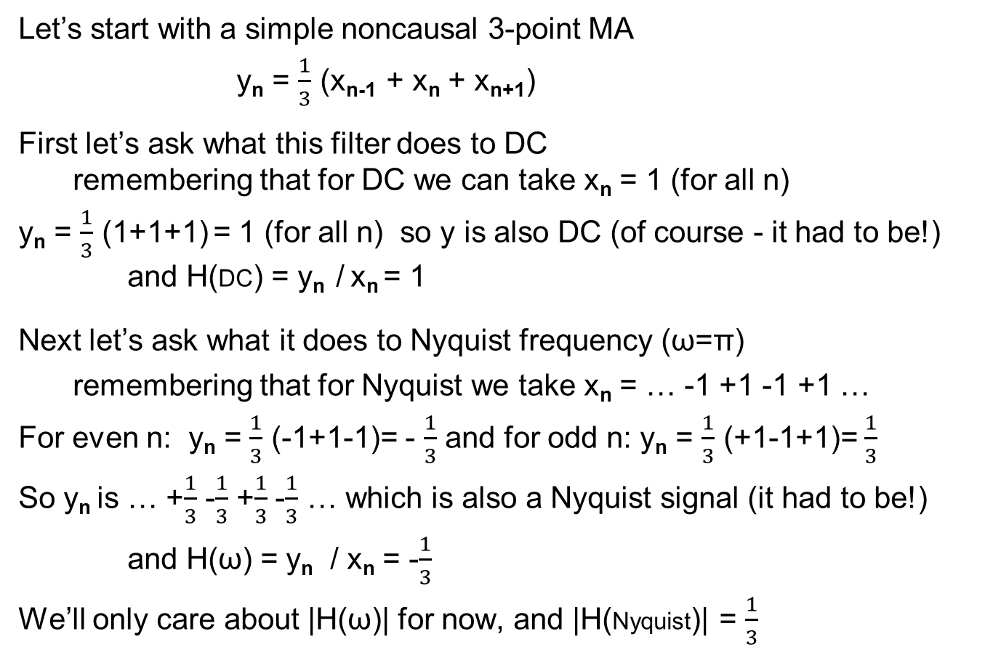
Simple MA Frequency response
Let’s start with a simple noncausal 3-point MA
y_{n} = $\frac{1}{3}$ (x_{n-1} + x_{n} + x_{n+1})
First let’s ask what this filter does to DC
remembering that for DC we can take x_{n} = 1 (for all n)
y_{n} = $\frac{1}{3}$ (1+1+1) = 1 (for all n) so y is also DC (of course - it had to be!)
and H(DC) = y_{n} / x_{n} = 1
Next let’s ask what it does to Nyquist frequency (ω=π)
remembering that for Nyquist we take x_{n} = … -1 +1 -1 +1 …
For even n: y_{n} = $\frac{1}{3}$ (-1+1-1)= - $\frac{1}{3}$ and for odd n: y_{n} = $\frac{1}{3}$ (+1-1+1)= $\frac{1}{3}$
So y_{n} is … +$\frac{1}{3}$ -$\frac{1}{3}$ +$\frac{1}{3}$ -$\frac{1}{3}$ … which is also a Nyquist signal (it had to be!)
and H(ω) = y_{n} / x_{n} = -$\frac{1}{3}$
We’ll only care about |H(ω)| for now, and |H(Nyquist)| = $\frac{1}{3}$

Slide 22
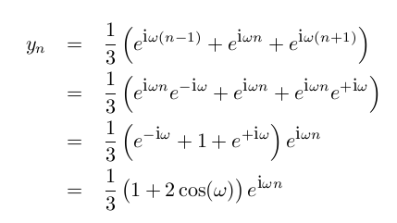
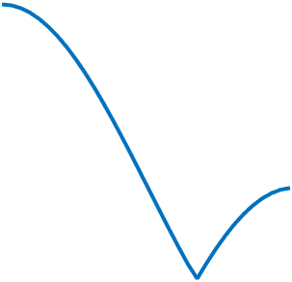

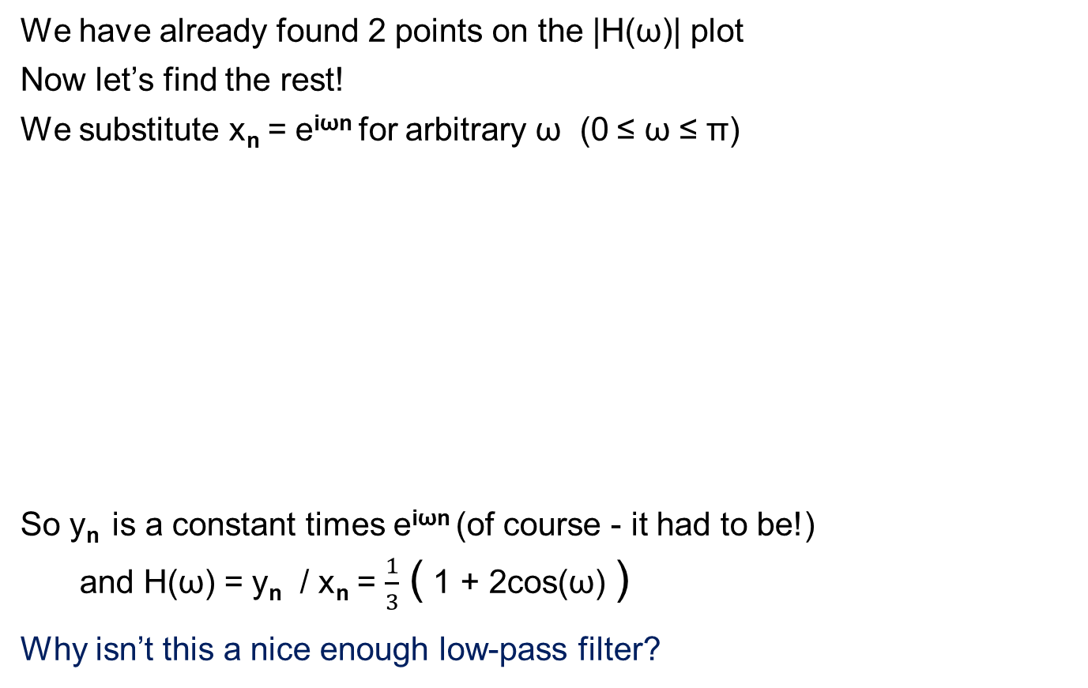

Simple MA Frequency response (cont)
|H(ω)|
We have already found 2 points on the |H(ω)| plot
Now let’s find the rest!
We substitute x_{n} = e^{iωn} for arbitrary ω (0 ≤ ω ≤ π)
So y_{n} is a constant times e^{iωn} (of course - it had to be!)
and H(ω) = y_{n} / x_{n} = $\frac{1}{3}$ ( 1 + 2cos(ω) )
Why isn’t this a nice enough low-pass filter?
1
$$\frac{1}{3}$$
0
π
ω
|H(ω)|
1
$$\frac{1}{3}$$
0
π
ω

Slide 23
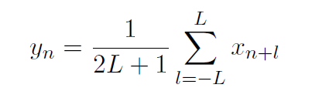
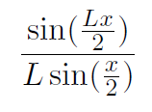
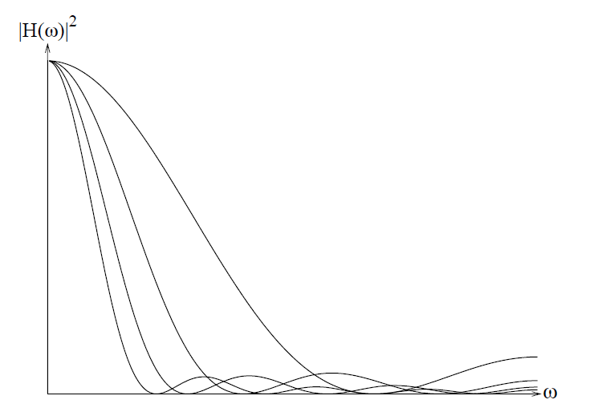
What about averaging more?
The frequency response of the more general averaging filter
is
The more we average the more low-pass the filter becomes!
Why?

Slide 24
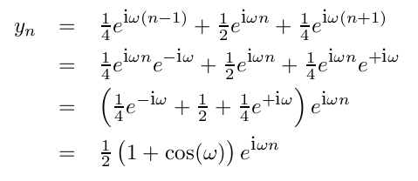
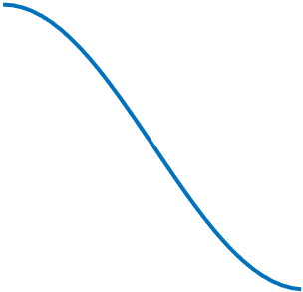
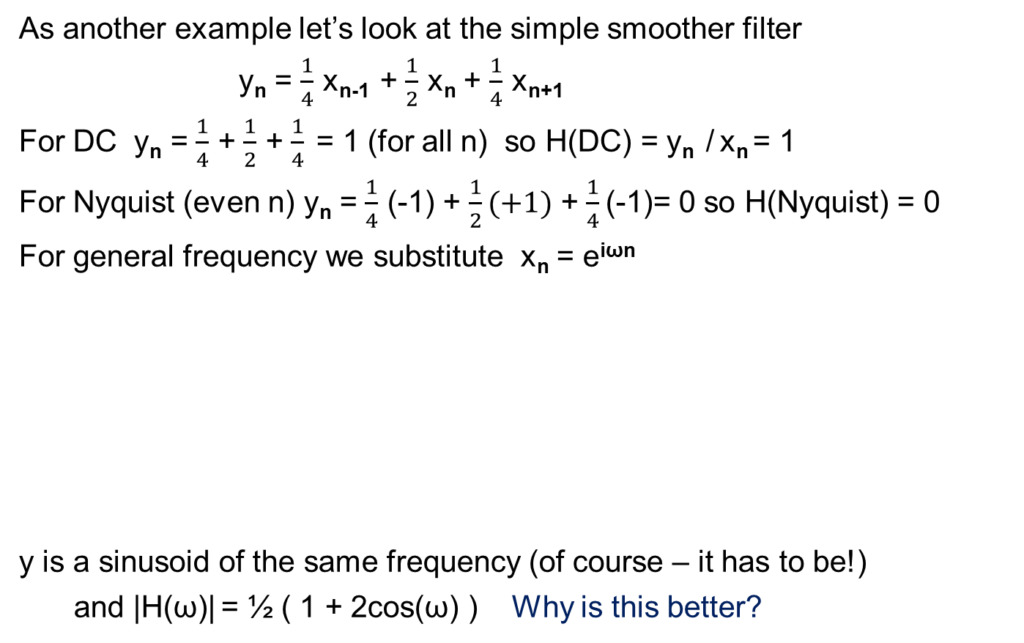
Frequency response 2
As another example let’s look at the simple smoother filter
y_{n} = $\frac{1}{4}$ x_{n-1} + $\frac{1}{2}$ x_{n} + $\frac{1}{4}$ x_{n+1}
For DC y_{n} = $\frac{1}{4}$ + $\frac{1}{2}$ + $\frac{1}{4}$ = 1 (for all n) so H(DC) = y_{n} / x_{n} = 1
For Nyquist (even n) y_{n} = $\frac{1}{4}$ (-1) + $\frac{1}{2}(+1)$ + $\frac{1}{4}$ (-1)= 0 so H(Nyquist) = 0
For general frequency we substitute x_{n} = e^{iωn}
y is a sinusoid of the same frequency (of course – it has to be!)
and |H(ω)| = ½ ( 1 + 2cos(ω) ) Why is this better?
|H(ω)|
1
0
π
ω

Slide 25
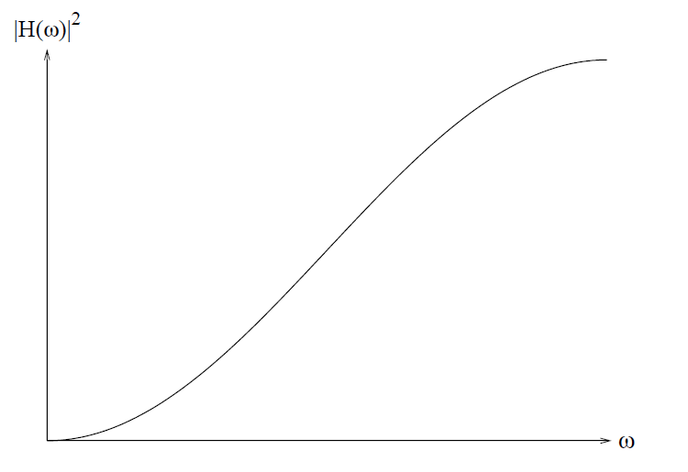
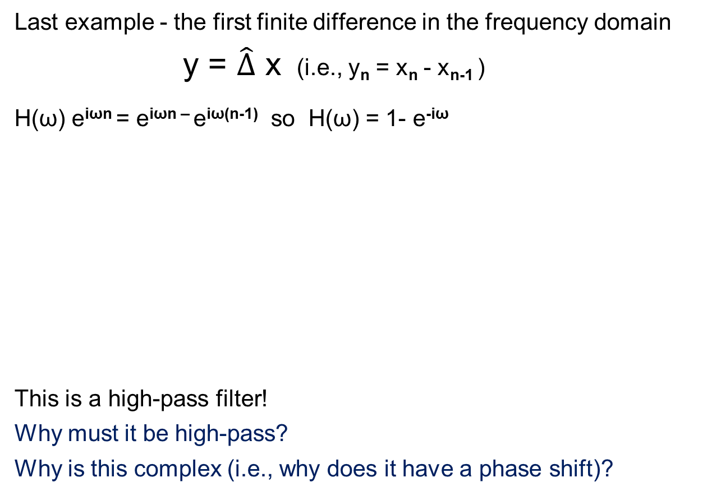
The first finite difference
Last example - the first finite difference in the frequency domain
y = $\hat{∆}$ x (i.e., y_{n} = x_{n} - x_{n-1} )
H(ω) e^{iωn} = e^{iωn –} e^{iω(n-1)} so H(ω) = 1- e^{-iω}
This is a high-pass filter!
Why must it be high-pass?
Why is this complex (i.e., why does it have a phase shift)?

Slide 26
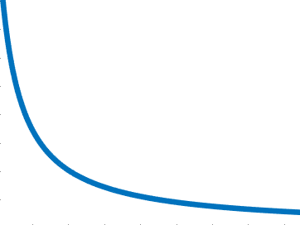
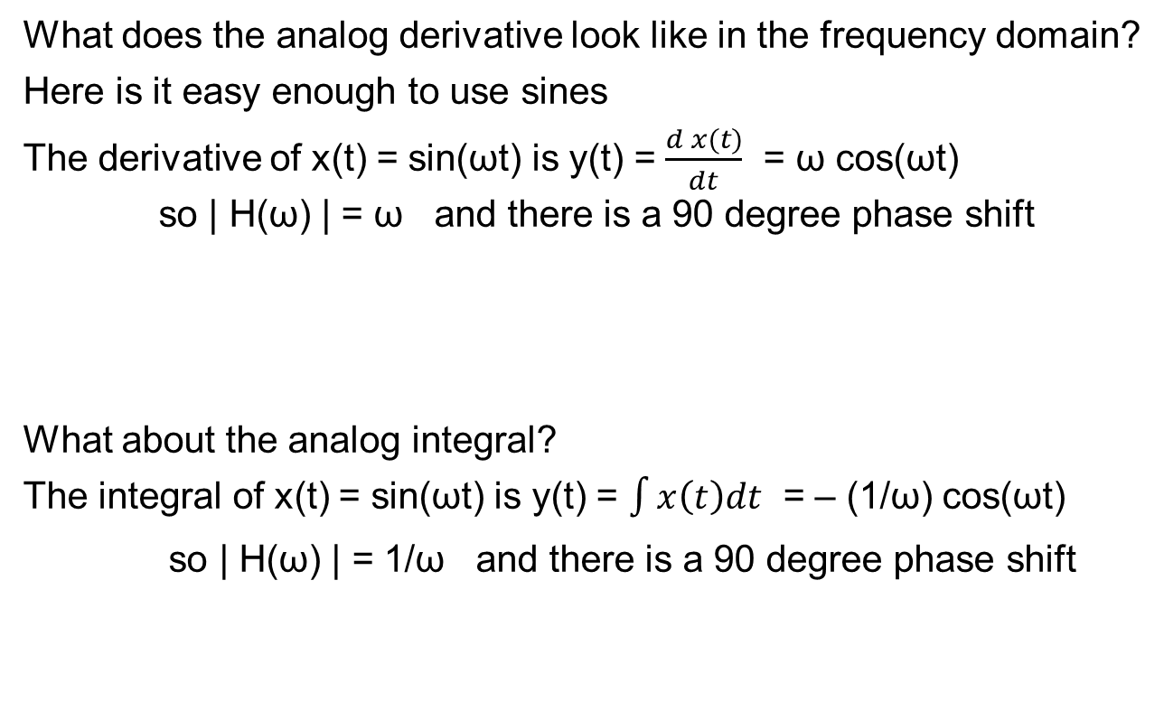
Differentiation and Integration
What does the analog derivative look like in the frequency domain?
Here is it easy enough to use sines
The derivative of x(t) = sin(ωt) is y(t) = $\frac{d x(t)}{dt}$ = ω cos(ωt)
so | H(ω) | = ω and there is a 90 degree phase shift
What about the analog integral?
The integral of x(t) = sin(ωt) is y(t) = $\int{x\left(t\right)dt}$ = – (1/ω) cos(ωt)
so | H(ω) | = 1/ω and there is a 90 degree phase shift
|H(ω)|
0
ω
|H(ω)|
0
ω

Slide 27

Convolution and multiplication
We already saw 2 connections between convolution
multiplying numbers and polynomials are convolutions
But we now understand a deeper connection
The filter law means that a convolution in the time domain
y_{n} = $\sum_{l=0}^{L−1}{a_{l}{ x}_{n−l} }$
corresponds to a multiplication in the frequency domain Y_{k} = H_{k} X_{k}
So, instead of convolving a and x in the time domain
we can move to the frequency domain and multiply
many people even write y = a*x
a₅
a₄
a₃
a₂
a₁
a₀
A₀
A₁
A₂
A₃
A₄
A₅
*
*
*
*
*
*
*
*
*
*
*
*
*
*
*
*
*
*
*
*
*
*
*
*
6 multiplications
x₀
x₁
x₂
x₃
x₄
x₅
X₀
X₁
X₂
X₃
X₄
X₅
6*6 multiplications!
y₀
y₁
y₂
y₃
y₄
y₅
Y₀
Y₁
Y₂
Y₃
Y₄
Y₅
Why 6*6 and not 1+2+3+4+5+6 = 21 ?

Slide 28
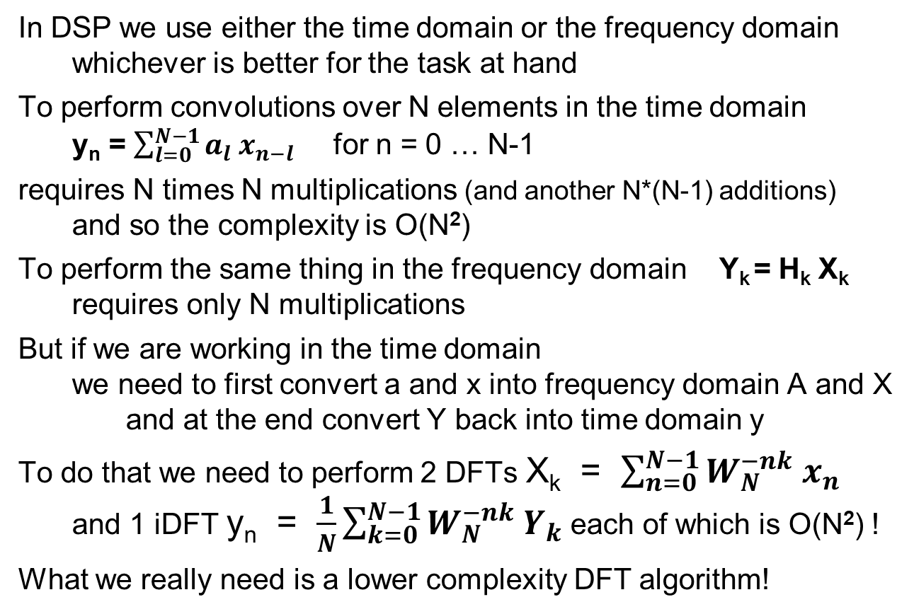
The complexity of convolution
In DSP we use either the time domain or the frequency domain
whichever is better for the task at hand
To perform convolutions over N elements in the time domain
y_{n} = $\sum_{l=0}^{N−1}{a_{l}{ x}_{n−l} }$ for n = 0 … N-1
requires N times N multiplications (and another N*(N-1) additions)
and so the complexity is O(N²)
To perform the same thing in the frequency domain Y_{k} = H_{k} X_{k}
requires only N multiplications
But if we are working in the time domain
we need to first convert a and x into frequency domain A and X
and at the end convert Y back into time domain y
To do that we need to perform 2 DFTs X_{k} = $\sum_{n=0}^{N−1}{W_{N}^{−nk} x_{n}}$
and 1 iDFT y_{n} = $\frac{1}{N}\sum_{k=0}^{N−1}{W_{N}^{−nk} Y_{k}}$ each of which is O(N²) !
What we really need is a lower complexity DFT algorithm!

Slide 29
AR
Computation of convolution is iteration
In CS there is a more general form of 'loop' - recursion
Example: let's average values of input signal up to present time
  y₀ = x₀ = x₀
  y₁ = (x₀ + x₁) / 2 = 1/2 x₁ + 1/2 y₀
  y₂ = (x₀ + x₁ + x₂) / 3 = 1/3 x₂ + 2/3 y₁
  y₃ = (x₀ + x₁ + x₂ + x₃) / 4 = 1/4 x₃ + 3/4 y₂
  y_{n} = 1/(n+1) x_{n} + n/(n+1) y_{n-1} = (1-β) x_{n} + β y_{n-1}
So the present output
  depends on the present input and previous outputs
In DSP recursion is called AutoRegression (term invented by Udny Yule)
Note: to be time-invariant, β must be non-time-dependent (not like here!)

Slide 30
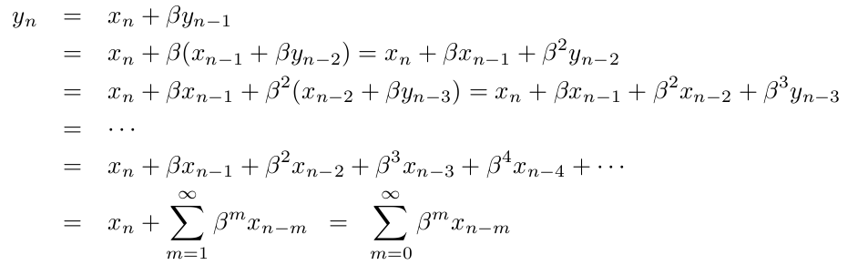
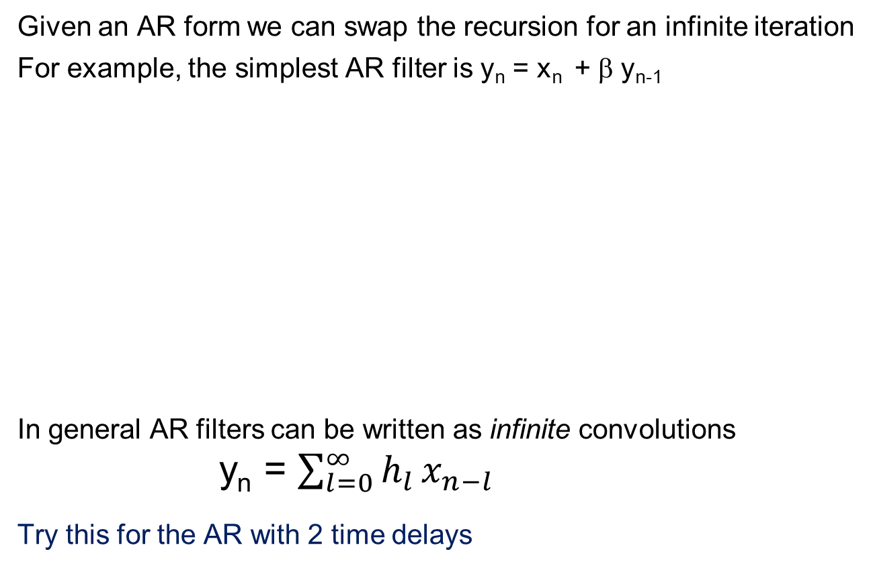
Unraveling the recursion
Given an AR form we can swap the recursion for an infinite iteration
For example, the simplest AR filter is y_{n} = x_{n} + β y_{n-1}
In general AR filters can be written as infinite convolutions
y_{n} = $\sum_{l=0}^{∞}{h_{l }x_{n−l}}$
Try this for the AR with 2 time delays
(we’ll leave out the input gain for now)

Slide 31
AR is a filter
The recursive AR form is an AR (autoregressive) filter
LINEARITY
Start from the infinite convolution form
the proof is the same as for the MA filter
TIME INVARIANCE
Start from the infinite convolution form
the proof is the same as for the MA filter
as long as the coefficients are not time dependent

Slide 32
Frequency response of an AR filter
Let’s try our simple AR example y_{n} = (1- β) x_{n} + β y_{n-1}
What happens for DC?
We know that for all n x_{n}=1 and y_{n} = H₀
so H₀ = (1- β) + β H₀ or H₀ (1 – β) = (1- β) so H₀ = 1
What happens for Nyquist ?
We know that x_{n}=… -1 +1 -1 +1 … and y_{n} = … -H_{π} +H_{π} -H_{π} +H_{π …}
so H_{π} = (1- β) - β H_{π} or H _{π} (1+β) = (1- β) so H_{π} = (1- β) / (1+β)
For general frequency ω : x_{n} = e^{iωn} and y_{n} = H(ω)e^{iωn}
so H(ω)e^{iωn} = (1- β)e^{iωn} + βH(ω)e^{iω(n-1)} so H(ω) = (1- β) + βH(ω) e^{-iω}
so H(ω) = (1- β) / (1 - β e^{-iω}) Why is this complex (i.e., has a phase shift)?
and |H(ω)|² = 1 / (1 - 2βcos(ω) + β² )
we purposely put the input gain back in!

Slide 33
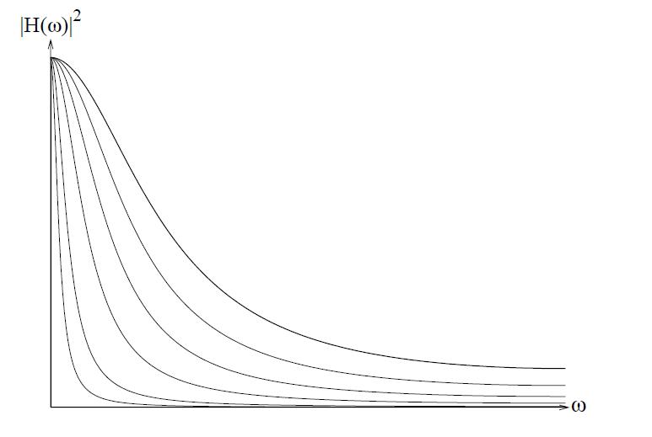
The AR frequency response
y_{n} = (1- β) x_{n} + β y_{n-1}
For small β y_{n} ≈ x_{n} so H(ω) ≈ 1
For large β y_{n} can’t keep up with x
so H(ω) is very low-pass
β = 0.5
β = 0.6
β = 0.7
β = 0.8
β = 0.95
β = 0.9

Slide 34
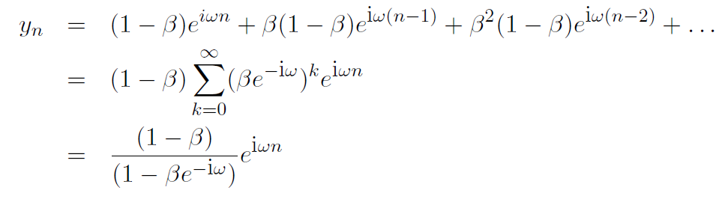
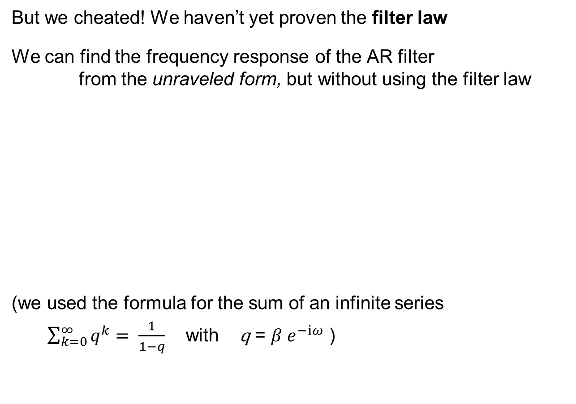
The harder way
But we cheated! We haven’t yet proven the filter law
We can find the frequency response of the AR filter
from the unraveled form, but without using the filter law
(we used the formula for the sum of an infinite series
$\sum_{k=0}^{∞}{q^{k}= \frac{1}{1−q}}$ with q = $β e^{−iω}$ )

Slide 35

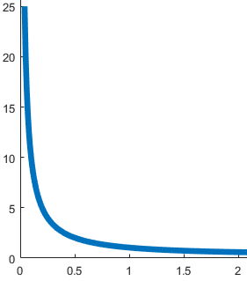

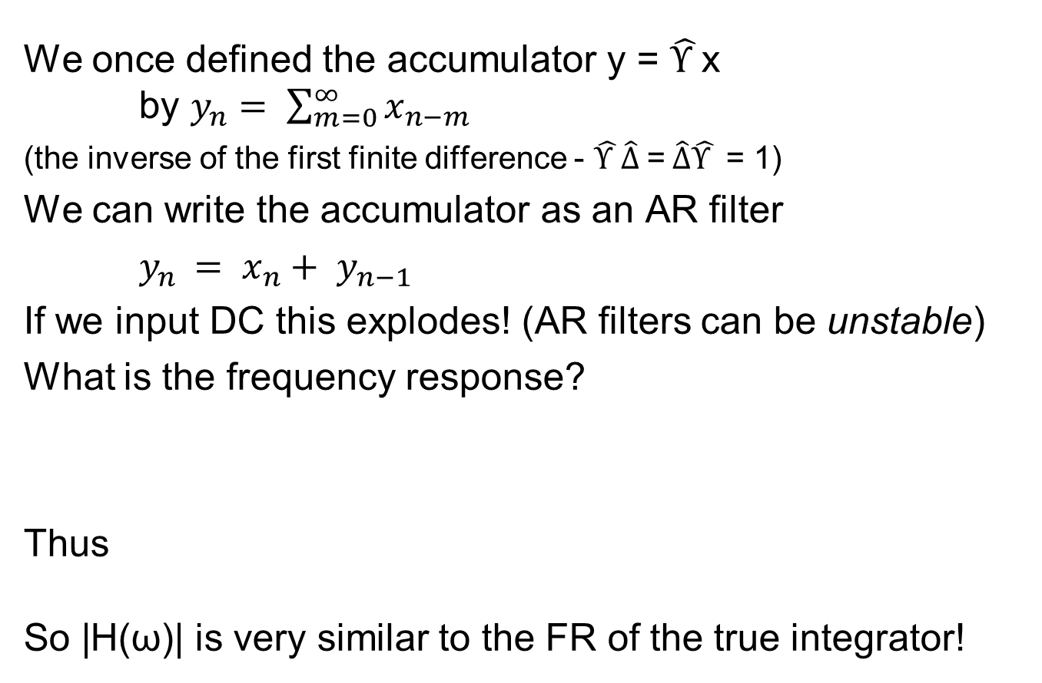
The accumulator
We once defined the accumulator y = $\hat{Υ }$x
by $y_{n}= \sum_{m=0}^{∞}{x_{n−m}}$
(the inverse of the first finite difference - $\hat{Υ }\hat{∆} \text{=} \hat{∆}\hat{Υ }$ = 1)
We can write the accumulator as an AR filter
$y_{n }= x_{n}+ y_{n−1}$
If we input DC this explodes! (AR filters can be unstable)
What is the frequency response?
Thus
So |H(ω)| is very similar to the FR of the true integrator!

Slide 36
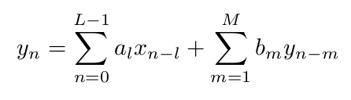
MA, AR and ARMA
The general causal system looks like this:
y_{n} = f ( x_{n} , x_{n-1} … x_{n-l} ; y_{n-1} , y_{n-2} , …y_{n-m} ; n )
But the general causal filter has to be
a linear combination of the inputs and outputs
This is called ARMA (it would be hard to say MAAR)
  if b_{m}=0 then it is MA
  if a₀=0 and a_{l >0}=0 but b_{m}≠0 then it is AR
Why doesn’t the ARMA filter depend explicitly on n ?
Why does the sum only include previous inputs and outputs?
Why must the function be a linear combination of them ?
Why does m start at 1 and not 0 ?

Slide 37
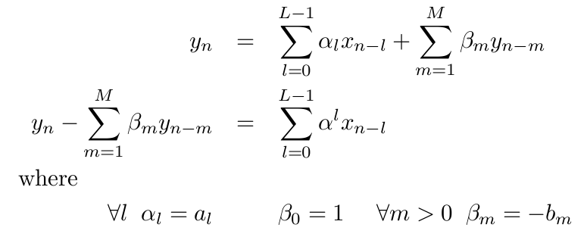

Symmetric form of writing ARMA
We can write the ARMA equation in symmetric form
by terms moving from side to side
This form is a called a difference equation
since it can be rewritten as $\sum{ B_{m} {\hat{∆}}^{m}y= }\sum{ A_{l} {\hat{∆}}^{l}x }$
What is the connection between the coefficients?

Slide 38

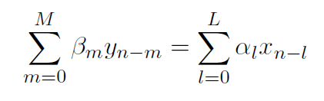
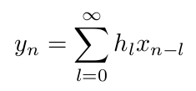
3 ways of writing the ARMA filter
So far we can write the causal ARMA filter in 3 ways
ARMA form
Symmetric form
(difference equation)
Infinite convolution
What happens when the filter is MA? AR?
How can we translate between representations?
it looks nicer with L

Slide 39
System identification
x
unknown
system
y
Up to now we have discussed
what a known ARMA system does to a given input
Now let’s consider the converse problem
We are given an unknown system with one input and one output
think of the system as inside a black box which can’t be opened
What is known are the input and output to the black box
Can we figure out what is inside the box ?
This is called the system identification problem

Slide 40
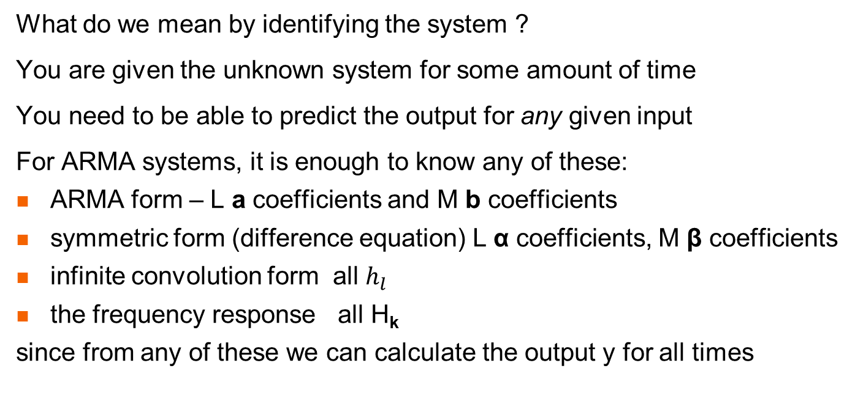
Identification?
x
unknown
system
y
What do we mean by identifying the system ?
You are given the unknown system for some amount of time
You need to be able to predict the output for any given input
For ARMA systems, it is enough to know any of these:
ARMA form – L a coefficients and M b coefficients
symmetric form (difference equation) L α coefficients, M β coefficients
infinite convolution form all $h_{l }$
the frequency response all H_{k}
since from any of these we can calculate the output y for all times

Slide 41
Two flavors
There are two different ways this game can be played
Easy system identification problem
we are allowed to input any x we want and observe the output y
what input should we use?
Hard system identification problem
the system is already "hooked up"
we can only observe the input x and output y
The hard problem is indeed harder than the easy problem
for example - what happens if the input is always 0?
x
unknown
system
y
unknown
system

Slide 42
Filter identification
Is the system identification problem always solvable ?
Not if the system characteristics can change over time
Since you can't predict what it will do next
So only solvable if system is time invariant
Not if system can have a hidden trigger signal
So only solvable if system is linear
Since for linear systems
any signal is the sum of the trigger plus the difference
small changes in input lead to bounded changes in output
So only solvable if system is a filter !

Slide 43

Easy problem
Impulse Response (IR)
To solve the easy problem (where we can input any signal(s) we want)
we need to decide which input signal x to use
One common choice is the unit impulse
the signal that is zero everywhere except at time zero n=0
The response of the filter to an impulse at time zero (UI)
  is called the impulse response IR (not a surprising name !)
  תגובה להלם
The impulse response of a filter is universally called h_{n}
What can we say about the impulse response for a causal system?
h_{n}
0
0

Slide 44
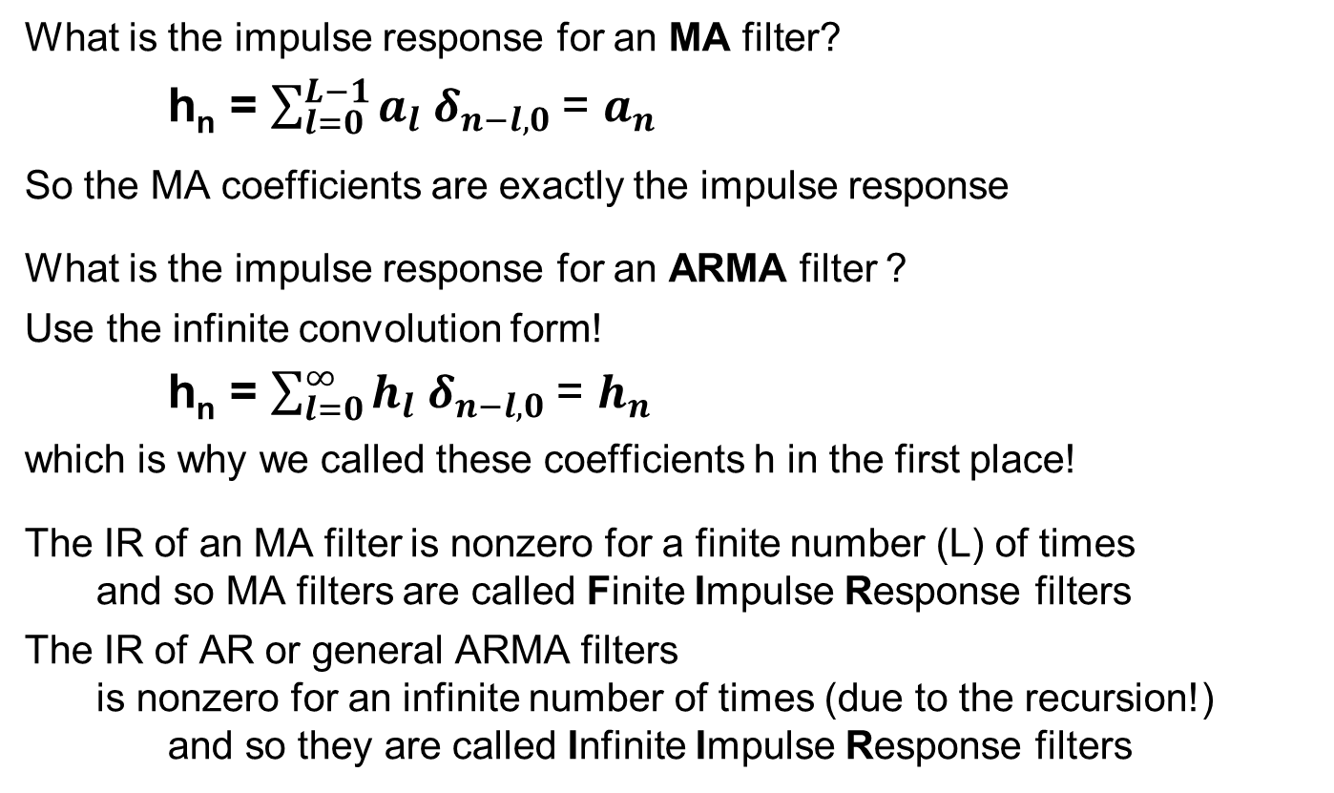
Some impulse responses
What is the impulse response for an MA filter?
h_{n} = $\sum_{l=0}^{L−1}{a_{l}{ δ}_{n−l,0} }$= $a_{n}$
So the MA coefficients are exactly the impulse response
What is the impulse response for an ARMA filter ?
Use the infinite convolution form!
h_{n} = $\sum_{l=0}^{∞}{h_{l}{ δ}_{n−l,0} }$= $h_{n}$
which is why we called these coefficients h in the first place!
The IR of an MA filter is nonzero for a finite number (L) of times
and so MA filters are called Finite Impulse Response filters
The IR of AR or general ARMA filters
is nonzero for an infinite number of times (due to the recursion!)
and so they are called Infinite Impulse Response filters

Slide 45
IR for MA filter
We can see why MA filters are FIR
by the following graphical construction
a₂
a₁
a₀
a₂
a₂
a₂
a₁
a₀
a₁
a₂
a₁
a₀
a₁
a₀
a₀
*
*
*
*
*
*
*
*
*
*
*
*
*
*
*
*
*
*
*
*
*
*
*
*
*
*
*
*
*
*
*
0
0
0
1
0
0
0
0
0
a₀
a₂
0
a₀
a₁
a₂
0
0
a₀
a₁
0
a₀
a₁
You see why we chose this direction?
convolution, not correlation!

Slide 46
IR solves the easy SI problem!
It is enough to input one simple signal to know the system !
if we know the response of a filter to the UI
we know its response to any SUI
because of time invariance (just shift the impulse!)
if we know the response of a filter to all SUIs
we know its response to any weighted combination of SUIs
because of linearity (add the weighted outputs!)
any input signal x
  can be written as the weighted combination of SUIs
since SUIs are a basis
h_{n}
h_{n}
0
m
0
m

Slide 47
Easy problem
Frequency Response (FR)
We have found one solution to the easy SI problem
Another common choice of input are the sinusoids
x_{n} = sin ( k n )
But we need to enter all possible sinusoids (k=0, 1, …)
However, from the filter law we know that
sinusoids are eigensignals of filters
  the response to a sinusoid of frequency ω : sin ( ω n )
  is a sinusoid of frequency ω (or zero output)
  y_{n} = A_{ω} sin ( ω n + φ_{ω} )
So we input all possible sinusoids
but record only the frequency response FR
the gain A_{k}
the phase shift φ_{k}
k
A_{k}
φ_{k}
0
1
2

Slide 48
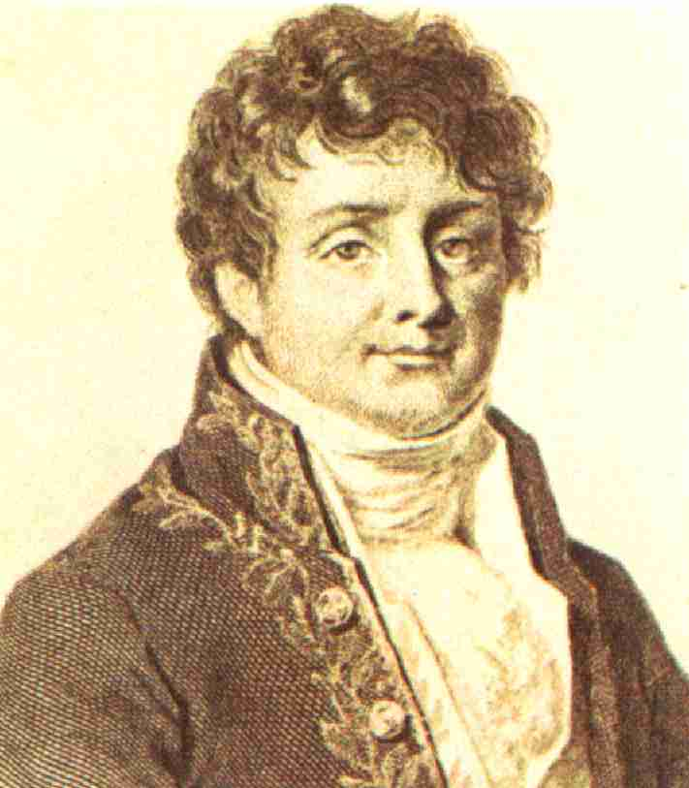
FR solves the easy SI problem!
It is enough to input these sinusoids to know the system !
if we know the response of a filter to x_{n} = sin ( k n )
we know its response to x_{n} = sin ( k n + φ )
because of time invariance
if we know the response of a filter to arbitrary sinusoids
we know its response to weighted combination of them
because of linearity (add the weighted outputs!)
any input signal x
  can be written as the weighted combination of sinusoids
since they are the Fourier basis

Slide 49
Does this make sense?
In the first solution we only needed one trial
we entered one input the UI
and recorded the impulse response h_{n}
In the second solution we had to enter many inputs – all the sinusoids!
Does this make sense?
For the impulse response we needed to record many time values
for the frequency response
we only needed one complex number for each input
For example, assume a signal with N values (in time/frequency domain)
and an MA with N coefficients
for h_{n} we need to record N values
for H_{k} we need to record N coefficients : 1 for each frequency
Why do you think we call the IR h and the FR H ?

Slide 50
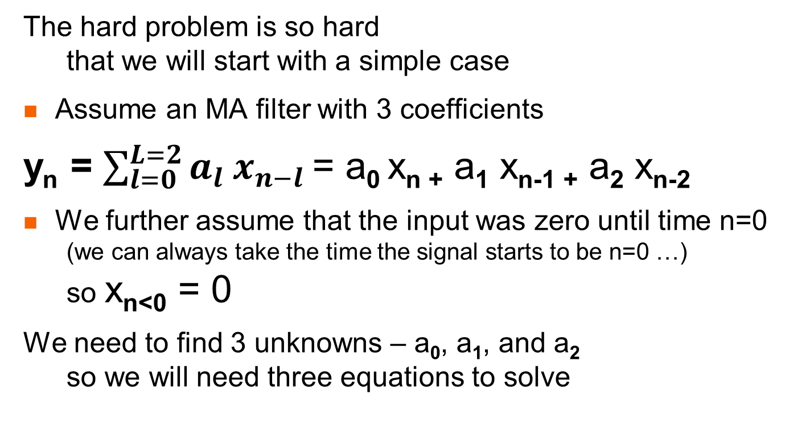
The easiest hard problem
The hard problem is so hard
that we will start with a simple case
Assume an MA filter with 3 coefficients
y_{n} = $\sum_{l=0}^{L=2}{a_{l}{ x}_{n−l} }$= a₀ x_{n +} a₁ x_{n-1 +} a₂ x_{n-2}
We further assume that the input was zero until time n=0
(we can always take the time the signal starts to be n=0 …)
so x_{n<0} = 0
We need to find 3 unknowns – a₀, a₁, and a₂
so we will need three equations to solve

Slide 51
The easiest hard problem (cont.)
First let’s write the equation for n=0
y₀ = a₀ x₀ + a₁ x₋₁ + a₂ x₋₂ = a₀ x₀
Since x₀ ≠ 0 we can divide to find a₀ = y₀ / x₀
Next we write the equation for n=1
y₁ = a₀ x₁ + a₁ x₀ + a₂ x₋₁ = a₀ x₁ + a₁ x₀
What do we already know?
y₁ = a₀ x₁ + a₁ x₀ so a₁ = (y₁ - a₀ x₁) / x₀
which is OK since x₀ ≠ 0
Finally we write the equation for n=2
y₂ = a₀ x₂ + a₁ x₁ + a₂ x₀
so a₂ = (y₂ - a₀ x₂ - a₁ x₁ ) / x₀ which is OK since x₀ ≠ 0

Slide 52
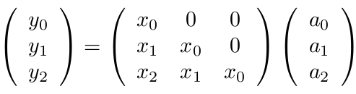
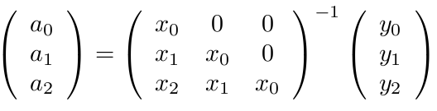
The easiest hard problem – matrix form
First can rewrite the three equations
y₀ = a₀ x₀
y₁ = a₀ x₁ + a₁ x₀
y₂ = a₀ x₂ + a₁ x₁ + a₂ x₀
in matrix format (with the coefficient as the vector)
which can be solved by inverting the matrix

Slide 53
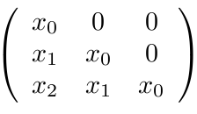


The easiest hard problem – some more
The matrix to invert is lower triangular
which is why it was so easy to solve
In fact, our solution was the straightforward inversion!
But this matrix has another characteristic
it has Toeplitz (T$\ddot{o}plitz)$ form
– the same value along diagonals
Otto Toeplitz

Slide 54

A slightly harder problem
Assume an MA filter with 3 coefficients
y_{n} = $\sum_{l=0}^{L=2}{a_{l}{ x}_{n−l} }$= a₀ x_{n} + a₁ x_{n-1} + a₂ x_{n-2}
but the input does not start nonzero
We still need to find the 3 unknowns – a₀, a₁, and a₂
so we will need three equations to solve
So pick any n (there is nothing special about any time)
and write three consecutive equations
y_{n} = a₀ x_{n} + a₁ x_{n-1} + a₂ x_{n-2}
y_{n+1} = a₀ x_{n+1} + a₁ x_{n} + a₂ x_{n-1}
y_{n+2} = a₀ x_{n+2} + a₁ x_{n+1} + a₂ x_{n}
Note that we need to observe 5 consecutive times
n-2 x_{n-2} n-1 x_{n-1} n x_{n} and y_{n}
n+1 x_{n+1} and y_{n+1} n+2 x_{n+2} and y_{n+1}

Slide 55

Solving the slightly harder problem
Let’s jump directly to the matrix form
So, here is yet another connection
between convolution and (matrix) multiplication
The solution is once again to invert the matrix
but this time it is not lower triangular
but it is still Toeplitz
Inverting a general matrix is O(N³) and may be unstable
(well actually O(n^{log2(7)}) = O(n^{2.807}) or even less)
but inverting a Toeplitz matrix takes only O(N²)
and is always stable (Levinson Durbin algorithm)

Slide 56

BTW – another connection
We wanted to solve for the coefficients
and thus put them into a vector
In other circumstances we may want to rewrite the equations
y_{n} = a₀ x_{n} + a₁ x_{n-1} + a₂ x_{n-2}
y_{n+1} = a₀ x_{n+1} + a₁ x_{n} + a₂ x_{n-1}
y_{n+2} = a₀ x_{n+2} + a₁ x_{n+1} + a₂ x_{n}
in another form
Here the matrix is Toeplitz but not square!
This is yet another connection between convolution
and multiplication by a Toeplitz matrix!

Slide 57

Wiener-Hopf equations
The equations we found
are called the Wiener-Hopf equations
However, you will never see them written in this simple way!
That is because of noise!
If we solve them twice for different n
we won’t get exactly the same answer
So you might solve many times and average the solutions
but that would require many matrix inversions
and is not even the right thing to do!
Norbert Wiener

Slide 58
What’s the right way?
Let’s go back to the original MA equation
y_{n} = $\sum_{l=0}^{L}{a_{l}{ x}_{n−l} }$
Multiple both sides by x_{n+j} and sum over all n
$$\sum_{n}^{ }{{y_{n} x}_{n+j} }=\sum_{n}^{ }{\sum_{l}^{ }{a_{l} x_{n−l} x_{n+j}}}$$
Remember that we mentioned the correlation of x and y ?
$$C_{xy}\left(j\right)= \sum_{n}^{ }{x_{n} y_{n+j}}$$
So the Wiener-Hopf equations can be written:
$C_{yx}\left(j\right)=$ $\sum_{l}^{ }{a_{l} C_{xx}{(j−l)}_{ } }$
This has the same form, but need be solved only once!
we can reverse the summation order!

Slide 59

What about AR filters?
Now let’s assume that the unknown system
is an AR filter with 3 coefficients
y_{n} = x_{n} + $\sum_{m=1}^{M=3}{b_{m}{ y}_{n−m} }$= x_{n} + b₁ y_{n-1} + b₂ y_{n-2} + b₃ y_{n-3}
Once again we have three coefficients to find
so we need to write 3 equations
Note that we need to observe 6 times - 6 ys and 3 xs

Slide 60



Yule-Walker equations
Let’s write the equations in matrix form
$\underline{y}= \underline{x}+\underline{\underline{y}} \underline{b}$ so $\underline{b}= \underline{\underline{y^{−1}}} \underline{(y−x)}$
These are called the Yule Walker equations
The matrix has Toeplitz form
and so is solved by Levinson-Durbin
Your cellphone solves YW equations
thousands of times per second !
Udny Yule
vector
matrix
Sir Gilbert Walker

Slide 61
What is the right way?
However, you will never see the Yule Walker equations
written in this simple way because of noise
Instead take the original AR equation (without the x)
y_{n} = $\sum_{m=1}^{M}{b_{m}{ y}_{n−m} }$
Multiply both sides by y_{n+j} and sum over all n
$$\sum_{n}^{ }{y_{n+j} y_{n} }=\sum_{n}^{ }{\sum_{m}^{ }{b_{m} y_{n−m} y_{n+j}}}$$
which can be written
$C_{yy}\left(j\right)=$ $\sum_{m}^{ }{b_{m} C_{yy}{(j−m)}_{ } }$
we can reverse the summation order!

Slide 62
What about ARMA filters
We can repeat the entire exercise for general ARMA filters
We have L+M variables and so have to write L+M equations
But the matrix will not turn out to be Toeplitz
and thus the equations will be difficult to solve!
So, in DSP we try to make every system identification problem
either MA or AR !

Slide 63

Another way to solve
So far we have worked in the time domain
Why can’t we use the filter law directly?
Since Y_{k} = H_{k} X_{k} we can divide to find H_{k} = Y_{k} / X_{k}
and knowing H_{k} determines the filter!
The problem is that X_{k} can be zero!
So, instead we will use the z transform
and at last prove the filter law!
We will start with
the infinite convolution form of the ARMA filter

Slide 64

Using z transform
the same tricks we’ve done before!

Slide 65


H(z) is a rational function
B(z) Y(z) = A(z) X(z)
Y(z) = A(z) / B(z) X(z)
but Y(z) = H(z) X(z)
so H(z) = A(z) / B(z)
the ratio of two polynomials is called a rational function
roots of the numerator are called zeros of H(z)
roots of the denominator are called poles of H(z)

Slide 66

Poles and zeros
From the fundamental theory of algebra we know that
every polynomial of degree n has n roots over the complex numbers
Hence we can write
where we see the zeros and poles of the transfer function
An important theorem in complex functions states
that the zeros and poles determine a rational function
to within a multiplicative constant
So the poles and zeros of the transfer function determine the filter
to within an overall gain
In diagrams zeros are shown as ● and poles as x

Slide 67
Special cases
If the ARMA form is actually an MA filter
then there are α coefficients
but all the β are zero except β₀ = 1
So H(z) = A(z) / B(z) = A(z) has zeros but no poles!
If the ARMA form is actually an AR filter
then there are β coefficients
but all the α are zero except α₀ = 1
So H(z) = A(z) / B(z) = 1/B(z) has poles but no zeros
If the ARMA filter is general (not MA or AR)
then it has both poles and zeros

Slide 68
Summary of filter names
FIR | MA | all zeros
IIR | AR | all poles
 | ARMA | zeros and poles

Slide 69
What do zeros/poles mean?
Since Y(z) = H(z) X(z), if the input is x_{n} = z^{n} the output is y_{n} = H(z) z^{n}
A zero at z means that if the input is x_{n} = z^{n} the output is zero!
  A zero on the unit circle
means an input sinusoid x_{n} = sin(ωn)
for which the output is zero
A pole means that if the input is that signal
the output explodes!
  A pole on the unit circle
means an input sinusoid x_{n} = sin(ωn)
for which the output explodes
Why do zeros and poles not on the real axis come in pairs?
Why don’t we allow poles on or outside the unit circle
while zeros can be anywhere?
ω>0
z
Nyquist
DC
ω<0

Slide 70
Are zeros important?
The filter law Y(ω) = H(ω) X(ω) tells us that
no new frequencies are created
but frequencies can disappear (when H(ω)=0) !
We call a frequency that disappears a zero of the filter
and more generally a signal z^{n} that disappears
We already saw examples of MA filters with zeros!
y_{n} = x_{n} – x_{n-1} (first finite difference) has a zero at DC
y_{n} = x_{n} + x_{n-1} has a zero at Nyquist
y_{n} = x_{n} + x_{n-2} has a zero at half Nyquist (ω = π/2)
Bandstop and notch filters are used because of their zeros
H(ω)
H(ω)
f
f
band stop
notch

Slide 71
Are poles important?
The filter law in the z plane Y(z) = H(z) X(z) tells us that
no new z^{n} signals are created
but these signals can explode (when H(ω)=∞) !
We call a z^{n} signal that explodes a pole of the filter
We already saw examples of AR filters with poles!
y_{n} = x_{n} + y_{n-1} (accumulator) has a pole at DC
y_{n} = x_{n} – y_{n-1} has a pole at Nyquist
y_{n} = x_{n} – y_{n-2} has a pole at half Nyquist (ω = π/2)
we don’t want poles on the unit circle (for sinusoids!)
but sinusoids that are amplified
require nearby poles
low-pass
high-pass

Slide 72
Designing filters by poles and zeros
DSP experts sometimes design filters directly using poles and zeros!
What do the following pole/zero diagrams mean?

Slide 73
How to find the transfer function?
If you are given the filter in the time domain
it is easy to find its transfer function and poles/zeros
by the following steps:
Move all the ys to one side and xs to the other
  to create the symmetric form
Write the equation in terms of signals using delay operators
Take the zT of both sides using our rule zT($\hat{z}$⁻¹ x) = $z$⁻¹ zT(x)
Divide leaving Y(z) on the LHS
Change numerator and denominator into polynomials (discard z^{M})
Find the roots of the polynomials

Slide 74







Transfer function exercise
1.
2.
3.
4.
5.
6.

Slide 75
Summary - filters
FIR = MA = all zero
IIR: AR = all pole
ARMA = zeros and poles
The following contain everything about the filter
(are can predict the output given the input)
a and b coefficients
α and β coefficients
impulse response h_{n}
frequency response H(ω)
transfer function H(z)
pole-zero diagram + overall gain
How do we convert between them ?

Slide 76

Conversions

Slide 77

Exercise
y_{n} = x_{n} + x_{n-1}
this filter is causal MA
we can immediately guess that it is low-pass since
  it averages!
  H(DC) = 2 (from H = 1 + 1) – gain=2!
  H(Nyquist) = 0 (from H = 1 +1)
impulse response is 1, 1
frequency response: H(ω)e^{iωn} = e^{iωn} + e^{iω(n-1)}
so H(ω) = 1 + e^{-iω} = e^{-iω/2} (e^{+iω/2} +e^{-iω/2} ) = phase*2cos(ω/2)
causality results in phase!
transfer function
y = $(1+ {\hat{z}}^{−1}$) x so H(z) = 1 + 1/z → z+1
Try y_{n} = x_{n} - x_{n-1}
IR
n=0
FR
π
PZ

Slide 78

Exercise
y_{n} = x_{n-1} + x_{n+1}
this filter is noncausal MA
we can immediately guess that it is band-stop since
  H(DC) = 2 (from H = 1 + 1)
  H(Nyquist) = 1 (from H = 1 +1)
  H(mid) = 0 (use x = -1 0 +1 0)
impulse response is 1, 0, 1
frequency response: H(ω)e^{iωn} = e^{iω(n-1)} + e^{iω(n+1)}
so H(ω) = e^{iω} + e^{-iω} = 2 cos(ω)
transfer function
y = (${\hat{z}}^{−1}$ + ${\hat{z}}^{+1}$) x so H(z) = z + 1/z = z²+1 = (z+i)(z-i)
Why are there 2 zeros?
IR
n=0
FR
PZ

Slide 79

Exercise
y_{n} = x_{n} + ½ y_{n-1}
this filter is causal AR
we can immediately guess that it is LP since
  H(DC) = 2 (from H = 1 + ½ H)
  H(Nyquist) = 2/3 (from H = 1 – ½ H)
impulse response is 1, 1/2, 1/4, 1/8, …
frequency response: H(ω)e^{iωn} = e^{iωn} + ½ H(ω)e^{iω(n-1)}
so H(ω) = 1 / (1-½e^{-iω}) = 2/(2 - e^{-iω})
|H(ω)|² = 4 / (5 – 4 cos(ω))
transfer function
(1 – ½ ${\hat{z}}^{−1}$) y = x
so H(z) = 1/(1- ½ z⁻¹) = 1 / (z- ½)
i.e., 1 pole at ½
IR
n=0
FR
PZ

Slide 80
Exercises - filters
Try these:
analog differentiator and integrator
y_{n} = x_{n} + x_{n-1} causal, MA, LP find h_{n}, H(ω), H(z), zero
y_{n} = x_{n} - x_{n-1} causal, MA, HP find h_{n}, H(ω), H(z), zero
y_{n} = x_{n} + ½ y_{n-1} causal, AR, LP find h_{n}, H(ω), H(z), pole
Tricks:
H(ω=DC) substitute x_{n} = 1 1 1 1 … y_{n} = y y y y …
H(ω=Nyquist) substitute x_{n} = 1 -1 1 -1 … y_{n} = y -y y -y …
To find H(z) : write signal equation and take zT of both sides
Some solved problems:
IR and FR for MA and AR
zeros and poles for an ARMA filter

